Slide 1

PySpark Index

Slide 2
Introduction to Spark
Why Spark was developed
What is Spark/Spark Features
Spark Components
Spark Session
Spark Context
Spark Session
spark-submit
RDD Fundamentals
What is RDD
RDD Features
When to use RDDs
RDD Properties and Problems
Create RDD
RDD Operations
Transformations and Actions
Row Level Transformations (map, flatMap, filter)
Join (join, cogroup, cartesian)
Total Aggregations (Count, reduce)
Shuffle and Combiner
Key Aggregations (groupByKey ,reduceByKey, aggregrateByKey, countByKey)
Ranking

Slide 3
sorting
set
sample
repartition and coalesce
Reading/writing from rdd to HDFS
Spark Cluster Architecture
Detailed Spark Cluster Execution Architecture
YARN Cluster Manager
JVM Processes
Commonly Used Terms in Spark Execution Framework
Narrow and Wide Transformations
RDD Lineage
DAG Scheduler
Task Scheduler
RDD Persistence
Shared Variables
Broadcast
Accumulator
Spark SQL
Architecture
Catalyst Optimizer
Volcano Iterator Model
Tungsten Execution Engine
Benchmarks
Understanding Execution Plan

Slide 4
DataFrame Fundamentals
What is a DataFrame
Sources
Features
Organization
SparkSession
Introduction to SparkSession
Spark Object
Spark Submit
Commonly used Functions
version
range
createDataFrame
sql
table
sparkContext
conf
read (csv, text, orc, parquet,json,avro,hive,jdbc)
udf
newSession
stop
catalog

Slide 5
DataTypes
DataFrame Rows
DataFrame Columns
Column Functions
DataFrame ETL
DataFrame APIs
selection
filter
sort
set
join
aggregate
groupBy
window
sample
Other Aggregate
DataFrame built-in functions
new Column
encryption
String

Slide 6
Regexp
Date
null
Collection
na
math and statistics
explode and flatten
Formatting
json
Partition
What is partition
Repartition
Coalesce
Repartition vs Coalesce
Extraction
csv
text
Parquet
Orc
Json
avro
Hive
jdbc

Slide 7
Optimization and Management
Join Strategies
Driver Configurations
Executor Configurations
Parallelism Configurations
Memory Management

Slide 8
Introduction to Spark

Slide 9
Why Spark was Developed ?

Slide 10
The biggest problem in any big data project is to achieve the “Scale”. The RDBMS databases like Oracle, sql server etc are the oldest approaches of storing and processing the data. But as data grows, they are unable to scale accordingly.
The need of new approaches led to creation of different effective systems like GFS, MapReduce.
Still the problem was not resolved fully:
For example – Lets see the shortcomings of MapReduce.
Hard to manage and administer due to operational complexity.
MapReduce forces the data processing into Map and Reduce. Other workflows like join, filter, union etcs are missing.
Stateless machine – read and write to disk before or after each map and reduce stages. This repeated performance of disk I/O took its toll: large MR jobs could run for hours, or even days.
Java Natively - support for other languages missing.
Only support batch processing – Not good for streaming, Machine Learning or interactive sql like queries.

Slide 11

Map Reduce
HDFS
Reads
HDFS
Writes
HDFS
Reads
HDFS
Writes
HDFS
HDFS
HDFS
MR
MR
Spark
HDFS
HDFS
Operation 1
Operation …
RAM
RAM

Slide 12
To handle these problems, engineers developed different systems at different times (Hive, Storm, Impala, Giraph, Mahout etc). Each of these systems have their own APIs and cluster configurations. This adds further operational complexity of Hadoop Map Reduce Systems.
So the idea was to develop a single unified system having capabilities to solve all these problems.
2009, The researchers at UC Berkeley who had previously worked on Hadoop MapReduce took on this challenge with a project and they call it Spark.
Ideas from Hadoop MapReduce are borrowed but enhanced in the Spark Project.
Spark was developed as highly fault-tolerant, massively parallel, in-memory processing support, easy APIs in multiple language in unified manner.
By 2013, Spark had gained widespread use and popularity. Some of its creators donated the Spark project to the ASF and formed a company called Databricks.
Databricks and the community of open source developers worked to release Apache Spark 1.0 in May 2014.
0.5 →June 2012
1.0 → May 2014
1.5 → Sep 2015
2.0 →July 2016
2.4 →Nov 2018
3.0 →June 2020
3.1 →Mar 2021

Slide 13
What is Spark ?

Slide 14
Unified: Spark is a unified analytics engine mainly designed for large-scale distributed data processing, on-premises data centers or in the cloud.
Speed: Spark provides in-memory storage for intermediate computations and limited disk I/O, this gives it a huge performance boost. Run workloads 100x faster.
Ease of Use (Polyglot): Write applications quickly in Java, Scala, Python, R, and SQL. Scala is the functional programming language spark is written. Spark achieves simplicity by providing a fundamental abstraction of a simple logical RDD upon which all other higher-level structured data abstractions, such as DataFrames and Datasets are constructed.
Generality: Spark powers a stack of libraries including SQL and DataFrames, MLib for machine learning, GraphX, and Spark Streaming. You can combine these libraries seamlessly in the same application.
Spark SQL
Spark Streaming
Mlib
GraphX
Apache Spark

Slide 15











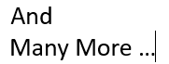

Extensibility: Decouples Compute and Storage. It focuses on fast and parallel computation engine than on storage. Storage can be extended to read data from other sources.

Slide 16
Runs Everywhere:
YARN
Mesos
Standalone
Open Source
Scalable
Distributed
Powerful Caching
Real Time and Batch Processing
Kubernetes
EC2 (AWS)

Slide 17
Spark Components

Slide 18




Spark Modules
Core - Transformations and Actions -APIs such as map, reduce, join, filter etc. They typically work on RDD
Spark SQL and Data Frames -APIs and Spark SQL interface for batch processing on top of Data Frames or Data Sets(not available for Python)
Structured Streaming - APIs and Spark SQL interface for stream data processing on top of Data Frames
Machine Learning Pipelines - Machine Learning data pipelines to apply Machine Learning algorithms on top of Data Frames
GraphX – For graphs and graph-parallel computation.
SPARK SQL
SPARK
STREAMING
MLib
GraphX
Apache Spark Core

Slide 19
Ch 2 (Spark Session)

Slide 20
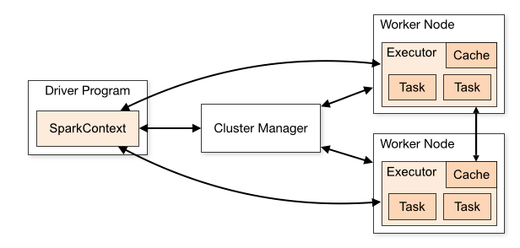
Initializing Spark
The first thing a Spark program is to create a SparkContext object, which tells Spark how to access a cluster.
When we run any spark application, the driver program starts, which has the main() function and the SparkContext gets initiated here.
Prior to 2.0, to create SparkContext we first need to build a SparkConf object that contains information about the application. (This is old way of doing.)
conf = SparkConf().setAppName(appName).setMaster(master)
sc = SparkContext(conf=conf)

Slide 21
Initializing Spark
In spark 2.0 and onwards, we can create the a spark object using SparkSession class. Then using this object we can access the SparkContext.
from pyspark.sql import SparkSession
spark = SparkSession \
.builder \
.master('yarn') \
.appName("Python Spark SQL basic example") \
.getOrCreate()
spark.sparkContext

Slide 22
Introduction To Spark Session

Slide 23
SparkSession : The Entry point Spark 2.0 Onwards
In Spark 2.0, SparkSession(spark) is the new entry point to work with RDD, DataFrame and all other functionalities.
Prior to 2.0, SparkContext(sc) used to be an entry point.
SparkContext: Entry point to work with RDD, Accumulators and broadcast variables (< Spark 2.0).
SQLContext: Used for initializing the functionalities of Spark SQL (< spark 2.0).
HiveContext: Super set of SQLContext (< spark 2.0).
Almost all the APIs available in SparkContext, SQLContext, HiveContext are now available in SparkSession.
By Default, Spark Shell provides a “spark” object which is an instance of SparkSession class (Spark 2.x).
“sc” object is created for spark 1.x.
While working a real project, we will have to create these objects manually.
Prior to 2.0
SparkContext
SQLContext
HiveContext
2.0 and Onwards
SparkSession
(Also has these old classes but not recommended to use)

Slide 24
Spark Session : The Entry point Spark 2.0 Onwards
House
Class
SparkSession
Class
Instance
Instance
Instance
My House
My Friend House
spark
Object
Object
Object

Slide 25
Spark Session : Spark Object & spark-submit

Slide 26
Spark Session : Create
from pyspark.sql import SparkSession
spark = SparkSession \
.builder \
.master('yarn') \
.appName("Python Spark SQL basic example") \
.getOrCreate()
Master can be yarn, mesos, Kubernetes or local(x) , x > 0
How to Run :
1. Organize the folders and create a python file under bin folder.
2. Write above codes in the .py file.
3. Execute the file using spark-submit command.
spark2-submit \
/devl/example1/src/main/python/bin/basic.py

Slide 27
Spark Session : spark-submit
Spark-submit is a utility to run a pyspark application job by specifying options and configurations.
spark-submit \
--master <master-url> \
--deploy-mode <deploy-mode> \
--conf <key<=<value> \
--driver-memory <value>g \
--executor-memory <value>g \
--executor-cores <number of cores> \
--jars <comma separated dependencies> \
--packages <package name> \
--py-files \
<application> <application args>

Slide 28
Spark Session : spark-submit
--master : Cluster Manager (yarn, mesos, Kubernetes, local, local(k))
local – Use local to run locally with one worker node.
local(k) – Specify k with the number of cores you have locally, this runs application with k worker
threads.
--deploy-mode: Either cluster or client
Cluster: Driver runs on one of the worker nodes and you can see the code as a driver on the spark UI of your
application. We cant see the logs on the terminal. Logs available only in the UI or the yarn CLI.
yarn logs -applicationId application_1622930712080_16253
Mainly used for production jobs.
Client: Driver runs locally where we submit the application.
See the logs on the terminal.
Mainly used for interactive or debugging purpose.

Slide 29
Spark Runtime Components in Client deploy mode:
Executor JVM
Executor JVM
JVM Heap
Client JVM
JVM Heap
JVM Heap
T
T
T
T
T
T
T
T
T
T
T
Driver
Executor JVM
Spark Context
Executor JVM
Spark Application
JVM Heap
JVM Heap
T
T
T
T
T
T
T
T

Slide 30
Spark Runtime Components in Cluster deploy mode:
Cluster
Executor JVM
Driver JVM
JVM Heap
Task Slots
T
T
T
T
T
JVM Heap
Unoccupied Task Slots
T
Client JVM
T
Spark Context
Spark Application
Executor JVM
JVM Heap
T
T
T
T

Slide 31
Spark Session : spark-submit
--conf: We can provide runtime configurations, shuffle parameters, application configurations using –conf.
Ex: --conf spark.sql.shuffle.partitions = 300
This configures the number of partitions that are used when shuffling data for joins or aggregations.
https://spark.apache.org/docs/latest/sql-performance-tuning.html
--conf spark.yarn.appMasterEnv.HDFS_PATH=“practice/retail_db/orders”
We can set environment variables like this when spark is running on yarn.
https://spark.apache.org/docs/latest/running-on-yarn.html#configuration
Default Spark Properties File (spark-defaults.conf ):
There is a default spark properties file at $SPARK_HOME/conf/spark-defaults.conf.
This could be overridden using spark-submit’s “--properties-file” command-line option.
For Ex - spark-submit --properties-file [FILE]
Individual properties of this file can be overridden by spark-sumit’s conf options.
For Ex- spark.submit.deployMode=client is in the default file.
We can override this using
spark-submit --deploy-mode “cluster”

Slide 32
Spark Session : spark-submit
--driver-memory : Amount of memory to allocate for a driver (Default: 1024M).
--executor-memory : Amount of memory to use for the executor process.
--executor cores : Number of CPU cores to use for the executor process.

Slide 33
Spark Session : spark-submit
--jars: Dependency .jar files.
Ex : --jars /devl/src/main/python/lib/ojdbc7.jar, fil2.jar, file3.jar
--packages: Pass the dependency packages.
Ex : --packages org.apache.spark:spark-avro_2.11:2.4.4
--py-files: Use –py-files to add .py and .zip files. File specified with –py-files are uploaded to the cluster before it run the application.
Ex - --py-files file1.py, file2.py,file3.zip

Slide 34
Spark Session : spark-submit
spark-submit \
--master “yarn” \
--deploy-mode “client”\
--conf spark.sql.shuffle.partitions = 300 \
--conf spark.yarn.appMasterEnv.HDFS_PATH=“practice/retail_db/orders”
--driver-memory 1024M \
--executor-memory 1024M \
--num-executors 2 \
--jars --jars /devl/src/main/python/lib/ojdbc7.jar, fil2.jar, file3.jar \
--packages org.apache.spark:spark-avro_2.11:2.4.4 \
--py-files file1.py, file2.py,file3.zip \
/dev/example1/src/main/python/bin/basic.py arg1 arg2 arg3

Slide 35
What is RDD ?

Slide 36
Spark Data Structures
2 types of data structures in PySpark - RDD and Data Frames. We will see both in detail as we proceed further.
RDD is the low-level data structure which spark uses to distribute the data between tasks while data is being processed.
DataFrame is created on top of RDDs We can seamlessly move between RDD and DataFrame.

Slide 37
RDD – Resilient Distributed Datasets
RDD is one of the fundamental abstractions of Spark on which it was created initially. Almost everything in Spark is built on top of RDDs.
Resilient – “able to withstand or recover quickly from difficult conditions”.
RDDs are immutable and can not be modified once created.
Fault Tolerance – RDDs track data lineage information to recover lost data quickly and automatically on failure at any point of execution cycle.
Distributed – Divided into smaller chucks called Partitions and distributed across multiple nodes across the cluster.
Datasets – Holds data.

Slide 38
RDD Main Features
Resilience
Distributed
Lazy Evaluation
Immutability
In-memory Computation
Structured or semi-structured Data

Slide 39
RDD Main Features
Resilience
Fault Tolerance – RDDs track data lineage information to recover lost data quickly and automatically on failure at any point of execution cycle.
Spark keeps a record of lineage while tracking the transformations that have been performed. If any part of RDD is lost, then spark will utilize this lineage record to quickly and efficiently re-compute the RDD using the identical operations.
Transformations
Lineage
Create RDD
sc.parallelize
RDD
Actions
Result

Slide 40
2. Distributed
RDD will be divided into partitions while data being processed. Each partition will be processed by one task.
If spark is running in YARN cluster, the number of RDD partitions is typically based on HDFS block size which is 128MB by default. We can control the number of minimum partitions by using additional arguments while invoking APIs such as textFile.
Worker Node 1
Partition 1
task1
Executor
e
Task 1
Task 2
RDD
Partition 2
task2
Partition 3
task3
Worker Node 2
Executor
Task 3

Slide 41
3. Lazy Evaluation:
Each Transformation is a Lazy Operation. Evaluation is not started until an action is triggered.
RDD
T
RDD
T
RDD
1
filter
Group by
3
2
A
Count
4
Only at this point execution starts.

Slide 42
Example – Find out 10 sample records having a string “Robert” from a file(1TB).
With Out Lazy Evaluation: With Lazy Evaluation:
Step 1 Step 1
Step 2
Step 2
Step 3
Load the 1TB File
Wait for an Action and then Load the 1TB File
Perform full scan to find out all Records having “Robert”
Filter out first 10 records having “Robert” .
Retrieve 10 Records

Slide 43

4. Immutability:
RDDs are considered to be “Immutable Storage”.
Single-Node
Data in Stage 1
Transformation 1
Transformation 2
Transformation …
Data in Stage 2
Data Stored Immutably
The Transformation Recipe is Stored
Ex – Logic to print all the even numbers is col%2 == 0
Data is not Stored

Slide 44
5. In-memory Computation:
The data is kept in RAM instead of disk drives and is processed in parallel.
This has become popular because it reduces the cost of memory.
The two main columns of in-memory computation are-RAM storage and Parallel distributed processing.
DISK
DISK
Operation 1
Operation …
RAM
RAM

Slide 45
6. Structured or Semi-structured Data:
Along with structured data, RDD can also be used for semi structured data like text, media streaming data etc.

Slide 46
When to Use RDDs?
Low Level API & control of dataset
Dealing with unstructured data(text or media streams)
Don’t care schema or structure of data
Don’t care about optimization, performance

Slide 47
Problems in RDD ?

Slide 48
RDD Properties
RDD is defined by five main properties:
1. List of Parent RDDs (Dependencies)
2. An array of partitions that a dataset is divided into.
3. A Compute function to do a computation on partitions.
4. Optional practitioner that defines how keys are hashed and the pairs partitioned (key value RDDs).
5. Optional Preferred locations – Information about the locations of the split block for an HDFS file (if on YARN).

Slide 49
Main Problems in RDD ?
Problem#1 Can not Optimize !!!
Compute function: Partition => Iterator(T)
Opaque Computation
&
Opaque data
Compute function is used to do computations on partitions.
Map from each partition to an Iterator of data that is stored within the RDD.
Given a particular partition, it is going to create an iterator and it will execute that particular code on that partition, distribute across the cluster and merge the results back and that’s the fundamental programming model of an RDD.
RDD does not know what is the function doing or anything about the data. It just serialize this part of code, send it over to executor and let it execute.
For example if you are trying to join or filter or project, spark can not automatically optimize it.
Also the data that is stored in the RDD is also opaque to spark and so spark can not do any pruning of data if the query does not need it.

Slide 50
Main Problems in RDD ?
Problem#2 (Pretty verbose to work with)
emp.map(lambda x: (x.deptid, (x.age, 1))) \
.reduceByKey(lambda x,y: (x(0) + y(0), x(1) + y(1))) \
. Map(lambda x: (x(0), x(1)(0) / x(1)(1))) \
.collect()
SELECT deptid, AVG(age) FROM emp GROUP BY deptid

Slide 51
Create RDD

Slide 52
Ways to create RDD :
External Data (HDFS, local etc)
Local Data
Python List/Parallelized Collections
Other RDDs
Existing DataFrame

Slide 53
Create RDD using textFile:
Using Spark Context Object sc.
ordRDD = sc.textFile('practice/retail_db/orders',8)
By default minPartitions is the file block numbers in HDFS. We can give a different number.
But if you use a number less that number of blocks, that will not be used and number of blocks tasks will be executed.
Create RDD using wholeTextFiles:
Read entire file as a single record into RDD.
ordRDD = sc.wholeTextFiles('practice/retail_db/orders',8)
Create Empty RDD:
Create empty RDD with no partition.
rdd = spark.sparkContext.emptyRDD()

Slide 54
Python List:
lst = open('/staging/test/sample.txt').read().splitlines()
rdd = sc.parallelize(lst)
Other RDDs
rdd1 = rdd
Rdd1.rdd.map(lambda x: x(1))
Existing DataFrame
df=spark.createDataFrame(data=(('robert',35),('Mike',45)),schema=('name','age'))
new_rdd= df.rdd
Create RDD from Local File:
rdd = sc.textFile("file://<local_path>")
Ex - Local Path: /staging/test

Slide 55
RDD Operations

Slide 56
Create RDD
Lineage
RDD operating in Parallel
Transformations
Actions
Results

Slide 57
https://spark.apache.org/docs/latest/rdd-programming-guide.html
Transformations
Row Level | Joining | Key Agg | Sorting | Set | Sampling | Pipe | Partitions
map | join | reduceByKey | sortByKey | union | sample | pipe | Coalesce
flatMap | cogroup | aggregateByKey |  | intersection |  |  | Repartition
filter | cartesian | groupByKey |  | distinct |  |  | repartitionAndSortWithinPartitions
mapValues |  | countByKey |  | substract
Actions
Display | Total Agg | File Extraction | foreach
take | reduce | saveAsTextFile | foreach
takeSample | count | saveAsSequenceFile
takeOrdered |  | saveAsObjectFile
first
collect

Slide 58
Low Level Transformations
(map, flatMap, filter)

Slide 59
map : map(f, preservesPartitioning=False)
Perform row level transformations where one record transforms into another record.
Number of records in input is equal to output.
Return a new RDD by applying a function to each element of this RDD.
When we apply a map function to an RDD, a pipelineRDD is formed, a subclass of RDD. It has all the APIs defined in the RDD.
ord = sc.textFile('practice/retail_db/orders')
ordItems = sc.textFile('practice/retail_db/order_items')

Slide 60
### PS: Project all the Order_ids.
ordMap = ord.map(lambda x : x.split(',')(0))
for I in ordMap.take(5) : print(i)
### PS: Project all the Orders and their status.
ord.map(lambda x : (x.split(',')(0),x.split(',')(1))).take(5)
### PS: Combine Order id and status with ‘#’
ord.map(lambda x : x.split(',')(0) + '#' + x.split(',')(3)).take(5)
### PS: Convert the Order date into YYYY/MM/DD Format.
ord.map(lambda x : x.split(',')(1).split(' ')(0).replace('-','/')).first()
### PS: Create key-value pairs with key as Order id and values as whole records.
ordMap = ord.map(lambda x : (x.split(',')(0),x))
### PS: Project all the Order_item_ids and their subtotal.
ordItemsMap = ordItems.map(lambda x : (x.split(',')(0),x.split(',')(4)))
### PS: Applied user defined function to convert status into lowercase.
def lowerCase(str):
return str.lower()
ord.map(lambda x : lowerCase(x.split(',')(3))).first()

Slide 61
flatMap : flatMap(f, preservesPartitioning=False)
Return a new RDD by first applying a function to all elements of this RDD, and then flattening the results.
Similar to map, but each input item can be mapped to 0 or more output items (so func should return a Seq rather than a single item). Number of records in input is less than or equal to output.
### PS : Word count in orders file.
ord = sc.textFile('practice/retail_db/orders')
wordCount = ord.flatMap(lambda x : x.split(',')).map(lambda w : (w,1)).reduceByKey(lambda x,y : x+y)

Slide 62
filter: filter(f)
Return a new dataset formed by selecting those elements of the source on which func returns true.
PS: Print all the orders which are closed or Complete and ordered in the year 2013.
ord = sc.textFile('practice/retail_db/orders')
filteredOrd = ord.filter(lambda x : (x.split(',')(3) in ("CLOSED","COMPLETE")) and (x.split(',')(1).split('-')(0) == '2014'))

Slide 63
mapValues: mapValues(f)
Only applicable to pair RDDs RDD((A,B)).
Do not change the key. Apply the function ‘f’ to all values of the same key.
The difference with map is map operates on the entire record.
Ex - rdd = sc.parallelize((("a", (1,2,3)), ("b", (3,4,5)),("a", (1,2,3,4,5))))
def f(x): return len(x)
rdd.mapValues(f).collect()

Slide 64
Join Transformations

Slide 65
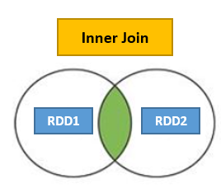
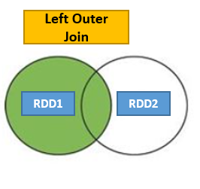
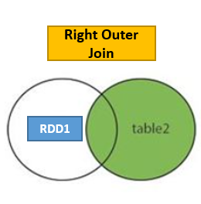
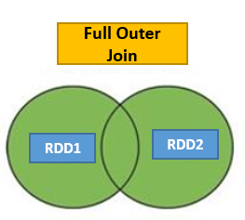

Joining datasets
Join
leftOuterJoin
rightOuterJoin
fullOuterJoin
Join: join(other, numPartitions=None)
When called on datasets of type (K, V) and (K, W), returns a dataset of (K, (V, W)) pairs with all pairs of elements for each key.
RDD2

Slide 66
ord = sc.textFile('practice/retail_db/orders')
ordItems = sc.textFile('practice/retail_db/order_items')
PS: Find the subtotal for each ORDER_CUSTOMER_ID.
ordMap=ord.map(lambda x : (x.split(',')(0),x.split(',')(2)))
ordItemsMap=ordItems.map(lambda x : (x.split(',')(1),x.split(',')(4)))
findSubtotalForCust = ordMap.join(ordItemsMap)
findSubtotalForCust.map(lambda x : x(1)(0)+','+x(1)(1)).first()
findSubtotalForCust.map(lambda x : str(x(1)(0))+','+str(x(1)(1))).first()

Slide 67
cogroup:
cogroup(other, numPartitions=None):
When called on datasets of type (K, V) and (K, W), returns a dataset of (K, (Iterable<V>, Iterable<W>)) tuples.
Ex –
x = sc.parallelize((("a", 1), ("b", 4)))
y = sc.parallelize((("a", 2)))
xy = x.cogroup(y)
for i,j in list(xy.take(5)) : print(i + ' ' + str(map(list,j)))

Slide 68
cartesian:
cartesian(other) : Perform a cross join.
Ex -
rdd = sc.parallelize((1,3,2))
sorted(rdd.cartesian(rdd).collect())

Slide 69
Aggregation Operations (Total)

Slide 70
Aggregation Operations:
There are several APIs to perform aggregation Operations.
Total aggregations – reduce, count (Actions)
By Key aggregations – reduceByKey, aggregrateByKey, groupByKey, countByKey (Transformations)

Slide 71
Total aggregations:
reduce(f): Reduces the elements of this RDD using the specified commutative and associative binary operator. Currently reduces partitions locally.
count(): Return the number of elements in this RDD.
Ex –
ord = sc.textFile('practice/retail_db/orders')
ordItems = sc.textFile('practice/retail_db/order_items')
### Count the number of orders which are closed.
ord.filter(lambda x : x.split(',')(3)).count()
### Find the total quantity sold for Order ID 1-10.
ordItems.filter(lambda x : int(x.split(',')(1)) < 11).map(lambda x : float(x.split(',')(4))).reduce(lambda x,y : x+y)
from operator import add
ordItems.filter(lambda x : int(x.split(',')(1)) < 11).map(lambda x : float(x.split(',')(4))).reduce(add)
### For a given order 10 find the maximum subtotal out of all orders.
ordItems.filter(lambda x : int(x.split(',')(1)) ==10).map(lambda x : x.split(',')(4)).reduce(lambda a,b : a if (float(a.split(',')(0)) > float(b.split(',')(0))) else b)
ordItems.filter(lambda x : int(x.split(',')(1)) ==10).map(lambda x : x.split(',')(4)).reduce(max)

Slide 72
Shuffling and Combiner

Slide 73
Shuffling and Combiner ?
Shuffle:
Shuffling is a process of redistributing data across partitions or even nodes.
Shuffle operation would create a new stage.
Based on data size we may reduce or increase the number of partitions using configuration spark.sql.shuffle.partitions or through codes like repartition and coalesce.
Costly operation as it involves disk I/O, Network I/O and data serialization/de-Serilization.
Spark shuffling triggers for transformation operations like gropByKey(), reducebyKey(), join(), union(),cogroup, groupBy() etc.
distinct creates a shuffle.
Count and countByKey does not create any shuffle.
Avoid shuffling at all cost. If Shuffling is absolutely necessary, use combiner.
Out of 3 main key aggregation APIs, the groupByKey does not use a combiner and so should be avoided. The reduceByKey and aggregrateByKey use the combiner and should be preferred.
Combiner:
It computes the intermediate values for each partition to avoid partial shuffling.

Slide 74
Shuffling with out Combiner
A1
B1
B1
Shuffling
Sorting/Partition
Reducer
Apple,1
Orange,1
Apple,1
Orange,1
Apple,1
Grapes,1
Banana,1
Grapes,1
Bananna,1
Bananna,1
Bananna,1
Apple,1
Apple,1
Apple,1
Apple,1
Apple,1
Apple,1
Apple,1
Apple,1
Apple,1
Apple,1
Bananna,1
Bananna,1
Bananna,1
Partition 1
C1
Apple,5
Bananna,3
Grapes,3
Orange,5
RDD
A2
B2
B2
Orange,1
Apple,1
Orange,1
Orange,1
Apple,1
Banana,1
Grapes,1
Banana,1
Orange,1
Orange,1
Orange,1
Orange,1
Orange,1
Grapes,1
Grapes,1
Grapes,1
Grapes,1
Grapes,1
Grapes,1
Orange,1
Orange,1
Orange,1
Orange,1
Orange,1
Partition 2

Slide 75
What Happens in Shuffle Stage?
In shuffle Stage,
1. Spark runs the map tasks on all partitions which groups all values for a single key.
2. Then the results of the map tasks are kept in memory.
3. When results do not fit into memory, Spark stores the data into a disk. So there is I/O and data serilization involved.
4. So Shuffle generates a large number of intermediate files on disk. These files are preserved until the corresponding RDDs are no longer used and are then garbage collected.
We can also mention a temporary storage directory in the spark.local.dir while configuring the sparkcontext.
5. Finally it runs the reduce tasks on each partition based on key.

Slide 76
Shuffling with Combiner
A1
Apple,1
Orange,1
Apple,1
Orange,1
Apple,1
Grapes,1
Banana,1
Grapes,1
Combiner
Shuffling
Sorting
Reducer
B1
C1
C1
Apple,3
Orange,2
Grapes,2
Banana,1
Bananna,1
Bananna,2
Apple,3
Apple,2
Apple,2
Apple,3
Bananna,1
Bananna,2
Partition 1
D1
Apple,5
Bananna,3
Grapes,3
Orange,5
RDD
A2
Orange,1
Apple,1
Orange,1
Orange,1
Apple,1
Banana,1
Grapes,1
Banana,1
B2
C2
C2
Orange,3
Apple,2
Banana,2
Grapes,1
Grapes,1
Grapes,2
Orange,2
Orange,3
Partition 2
Orange,2
Orange,3
Grapes,2
Grapes,1

Slide 77
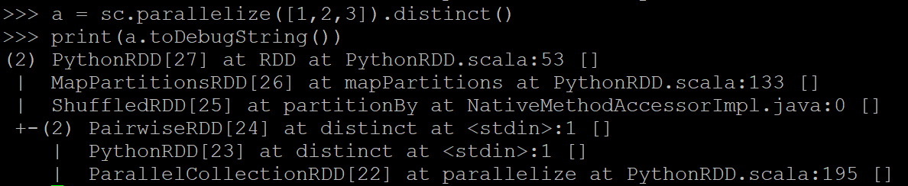
If you have a performance issues, look into the code if there is a shuffle happening.
toDebugString returns “A description of this RDD and its recursive dependencies for debugging.” It includes possible shuffles.
Use explain() for DataFrames.

Slide 78
Aggregation Operations (Key)

Slide 79
Key Aggregations:
groupByKey():
aggregrateByKey():
reduceByKey():
countByKey():

Slide 80
groupByKey(numPartitions=None, partitionFunc)
Can be used for aggregations but should be given low priority as it does not use the combiner.
When called on a dataset of (K, V) pairs, returns a dataset of (K, Iterable<V>) pairs.
If grouping in order to perform an aggregation (such as a sum or average) over each key, using reduceByKey or aggregateByKey will yield much better performance.
The number of reduce tasks is configurable through an optional argument – numPartitions.
Ex –
ordItems = sc.textFile('practice/retail_db/order_items')
For each product, find its aggregated revenue.
ordGrp = ordItems.map(lambda x : (int(x.split(',')[2]),float(x.split(',')[4]))).groupByKey()
result = ordGrp.mapValues(sum).collect()
OR
result = ordGrp.map(lambda x : (x[0],sum(x[1]))).collect()
ORDER_ITEMS
order_item_id
order_item_order_id
order_item_prod_id
order_item_quantity
order_item_revenue
order_item_price

Slide 81
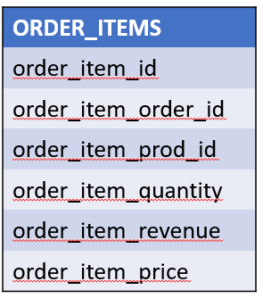
reduceByKey(func, numPartitions=None, partitionFunc)
When called on a dataset of (K, V) pairs, returns a dataset of (K, V) pairs where the values for each key are aggregated using the given reduce function func, which must be of type (V,V) => V.
Like in groupByKey, the number of reduce tasks is configurable through an optional argument - numPartitions.
It uses Combiner. Associative reduction.
Ex-
from operator import add
rdd = sc.parallelize((("a", 1), ("b", 1), ("a", 1)))
sorted(rdd.reduceByKey(add).collect())
### Find the total revenue sold for each order.
ordItems = sc.textFile('practice/retail_db/order_items')
ordItems.map(lambda x : (int(x.split(',')[1]),float(x.split(',')[4]))).reduceByKey(lambda x,y : x+y).collect()
OR
ordItems.map(lambda x : (int(x.split(',')[1]),float(x.split(',')[4]))).reduceByKey(add).collect()
### Find the maximum revenue for each order.
ordItems.map(lambda x : (int(x.split(',') [1]),x)).reduceByKey(lambda a,b : a if (float(a.split(',')[4]) > float(b.split(',')[4])) else b).collect()

Slide 82
Associative Reduction:
Partition 1
2, 199.99
2, 250.00
4, 49.98
4, 299.95
2, 449.99
4, 349.93
2, 579.98
4, 699.85
2, 129.99
4, 150.0
4, 199.92
2, 129.99
4, 349.92
Partition 2

Slide 83
aggregateByKey(zeroValue, seqOp, combOp, (numPartitions)):
First aggregate elements in each partition and then aggregating results of all partition to get the final result and the result could be any type than the type of your RDD.
3 mandatory arguments:
Zero Value: Initial value to initialize the accumulator. Use 0 for integer and NULL for collections.
SeqOp: Function used to accumulate the results of each partition, and stores the running accumulated result to U. (U,T) => U.
CombOp: Function is used to combine results of all partitions U.

Slide 84
Partition 1
Partition 2
2 → ("Joseph", 200)
2 → ("Jimmy", 250)
4 → ("Joseph", 150)
4 → ("Ram", 200)
7 → ("Joseph", 300)
2 → ("Tina", 130)
4 → ("Jimmy", 50)
4 → ("Tina", 300)
7 → ("Tina", 200)
7 → ("Jimmy", 80)
SeqOp : Max Revenue & Count
(2, 250, 2)
(4, 200, 2)
(7, 300, 1)
SeqOp : Max Revenue & Count
(2, 130, 1)
(4, 300, 2)
(7, 200, 2)
CombOp : Max Revenue & Count
(2, 250, 3)
(4, 300, 4)
(7, 300, 3)

Slide 85
Ex – 1
Find the maximum revenue for each Order.
ordItems=sc.parallelize([
(2,"Joseph",200), (2,"Jimmy",250), (2,"Tina",130), (4,"Jimmy",50), (4,"Tina",300),
(4,"Joseph",150), (4,"Ram",200), (7,"Tina",200), (7,"Joseph",300), (7,"Jimmy",80)],2)
#Create a Paired RDD
ordPair = ordItems.map(lambda x : (x[0],(x[1],x[2])))
#Initialize Accumulator
# Zero Value: Zero value in our case will be 0 as we are finding Maximum Marks
zero_val=0
#Define Sequence Operation
# Sequence operation : Finding Maximum revenue from each partition
def seq_op(accumulator, element):
if(accumulator > element[1]):
return accumulator
else:
return element[1]
#Define Combiner Operation
#Combiner Operation : Finding Maximum revenue from all partitions
def comb_op(accumulator1, accumulator2):
if(accumulator1 > accumulator2):
return accumulator1
else:
return accumulator2
aggr_ordItems = ordPair.aggregateByKey(zero_val, seq_op, comb_op)
for i in aggr_ordItems.collect(): print(i)

Slide 86
Ex – 2
Find the maximum revenue for each Order. Print customer name.
ordItems=sc.parallelize([
(2,"Joseph",200), (2,"Jimmy",250), (2,"Tina",130), (4,"Jimmy",50), (4,"Tina",300),
(4,"Joseph",150), (4,"Ram",200), (7,"Tina",200), (7,"Joseph",300), (7,"Jimmy",80)],2)
#Create a Paired RDD
ordPair = ordItems.map(lambda x : (x[0],(x[1],x[2])))
#Initialize Accumulator
# Zero Value: Zero value in our case will be 0 as we are finding Maximum Marks
zero_val=('',0)
#Define Sequence Operation
# Sequence operation : Finding Maximum revenue from each partition
def seq_op(accumulator, element):
if(accumulator[1] > element[1]):
return accumulator
else:
return element
#Define Combiner Operation
#Combiner Operation : Finding Maximum revenue from all partitions
def comb_op(accumulator1, accumulator2):
if(accumulator1[1] > accumulator2[1]):
return accumulator1
else:
return accumulator2
aggr_ordItems = ordPair.aggregateByKey(zero_val, seq_op, comb_op)
for i in aggr_ordItems.collect(): print(i)

Slide 87
Ex – 3
Sum up all revenue and number of records for each order.
ordItems=sc.parallelize([
(2,"Joseph",200), (2,"Jimmy",250), (2,"Tina",130), (4,"Jimmy",50), (4,"Tina",300),
(4,"Joseph",150), (4,"Ram",200), (7,"Tina",200), (7,"Joseph",300), (7,"Jimmy",80)],2)
#Create a Paired RDD
ordPair = ordItems.map(lambda x : (x[0],(x[1],x[2])))
#Initialize Accumulator
# Zero Value: Zero value in our case will be 0 as we are finding Maximum Marks
zero_val=(0,0)
#Define Sequence Operation
# Sequence operation : Sum up all revenue and number of records per partition.
def seq_op(accumulator, element):
return (accumulator[0] + element[1], accumulator[1] + 1)
#Define Combiner Operation
#Combiner Operation : Sum up all revenue and number of records for all partition.
def comb_op(accumulator1, accumulator2):
return (accumulator1[0] + accumulator2[0], accumulator1[1] + accumulator2[1])
aggr_ordItems = ordPair.aggregateByKey(zero_val, seq_op, comb_op)
for i in aggr_ordItems.collect(): print(i)

Slide 88
Accumulator(0, 0)
2 → ("Joseph", 200) 0+1 = 1
2 → ("Jimmy", 250) 1+1 = 2
2 → ("Tina", 130) 0+1 = 1
SeqOp : Max Revenue & Count
(2, 250, 2)
SeqOp : Max Revenue & Count
(2, 130, 1)
def seq_op(accu, element):
return (accu[0] + element[1], accu[1] + 1)
Max Revenue Count
Partition 1
Partition 2
CombOp : Max Revenue & Count
(2, 250, 3)
def comb_op(accu1, accu2):
return (accu1[0] + accu2[0], accu1[1] + accu2[1])

Slide 89
Difference Between ReduceByKey Vs AggregateByKey:
aggregateByKey() is logically same as reduceByKey() but it lets you return result in different type.
In another words, it lets you have an input as type x and aggregate result as type y.
Ex - For example (1,2),(1,4) as input and (1,"six") as output. It also takes zero-value that will be applied at the beginning of each key.

Slide 90
countByKey():
Only available on RDDs of type (K, V). Returns a (K, Int) pairs with the count of each key.
Returns a Collection Dictionary.
No shuffle.
Ex - Count number oF orders per each status.
ord = sc.textFile('practice/retail_db/orders')
ordPair = ord.map(lambda x : (x.split(',')[3],1))
countByStatus = ordPair.countByKey()
for i in countByStatus.items : print(i)
for i in countByStatus.keys : print(i)
for i in countByStatus.keys : print(i)
Orders
Order Id
Order Date
Order Customer Id
Order Status

Slide 91
Sorting Transformations

Slide 92
sortByKey(ascending=True, numPartitions=None, keyfunc=<function <lambda>>)
When called on a dataset of (K, V) pairs, returns a dataset of (K, V) pairs sorted by keys in ascending or descending order, as specified in the Boolean ascending argument.
ord = sc.textFile('practice/retail_db/orders')
Ex-1 (Sort orders using customer id.)
ordPair = ord.map(lambda x : (int(x.split(',')[2]),x))
ordSort = ordPair.sortByKey(ascending=False)
for i in ordSort.take(10) : print(i)
Ex-2 (Sort orders using customer and status.)
ordPair = ord.map(lambda x : ((int(x.split(',')[2]), x.split(',')[3]),x))
ordSort = ordPair.sortByKey(ascending=False)
for i in ordSort.take(10) : print(i)

Slide 93
Ranking

Slide 94
Global Ranking or Ranking per Group
Global Ranking :
sortByKey and take
takeOrdered or top
Ranking Per Group:
Getting ranking per group is a bit complex but important to know.
Per-key or Per group ranking can be achieved using
groupByKey with flatMap
Python Knowledge like sorted function, list etc
Global Ranking
G1
G1
G1
G2
G2
G2
Ranking Per Group

Slide 95
Global Ranking
Using sortByKey and take:
Ex – Top five products with highest prices.
prod = sc.textFile('practice/retail_db/products')
prodPair = prod.map(lambda x : (float(x.split(',')[4]),x))
prod = prod.filter(lambda x : x.split(',')[4] = '').count()
prodPair = prod.map(lambda x : (float(x.split(',')[4]),x))
top5Products = prodPair.sortByKey(False).take(5)
Using takeOrdered or top:
takeOrdered(num, key=None)
Get the N elements from an RDD ordered in ascending order or as specified by the optional key function.
Ex-
sc.parallelize([10, 1, 2, 9, 3, 4, 5, 6, 7]).takeOrdered(6)
Ex-
sc.parallelize([10, 1, 2, 9, 3, 4, 5, 6, 7]).takeOrdered(6,key=lambda x : -x)
Ex-
top5Products1 = prod.takeOrdered(5,lambda k: -float(k.split(',')[4])
Global Ranking

Slide 96
Ranking Per Group:
Ex –
Top 2 Products with highest Prices per Category.
prod = sc.textFile('practice/retail_db/products')
prodF = prod.filter(lambda x : (int(x.split(',')[1]) in [2,3,4]) and (int(x.split(',')[0]) in [1,2,3,4,5,25,26,27,28,29,49,50,51,52,53]))
prodGroupBy = prodF.map(lambda line : ( int(line.split(',')[1]), line)).groupByKey()
first = prodGroupBy.first()
sorted(first[1],key = lambda x : float(x.split(',')[4]),reverse=True)
top2ProductsByPrice= productsGroupBy.flatMap(lambda x: sorted(x[1], key=lambda k:float(k.split(",")[4]), reverse=True)[:2])
G1
G1
G1
G2
G2
G2
Ranking Per Group

Slide 97
Set Transformations

Slide 98
union(other)
A union will get all the elements from both the data sets.
In the case of a union, it will not get distinct elements. Apply distinct, if you only want to get distinct elements after union operation.
When we use set operations such as union and intersect, data should have a similar structure (Same Columns and Types).
Ex – Number of customers placed order in July or Aug Month.
ord = sc.textFile('practice/retail_db/orders')
julyOrd = ord.filter(lambda x : str(x.split(',')[1].split('-')[1]) == '07').map(lambda x : x.split(',')[2])
augOrd = ord.filter(lambda x : str(x.split(',')[1].split('-')[1]) == '08').map(lambda x : x.split(',')[2])
julyAugOrders = julyOrd.union(augOrd).distinct().count()

Slide 99
Intersection(other)
Return the intersection of this RDD and another one.
The output will not contain any duplicate elements, even if the input RDDs did.
Ex – Orders applied both in July and Aug datamonth.
julyAugCommonOrders=julyOrd.intersection(augOrd).count()
Ex – Check if duplicates are reported.
rdd1=sc.parallelize([1,2,3,3,3])
rdd2=sc.parallelize([1,3,5])
rdd1.intersection(rdd2).collect()

Slide 100
distinct(numPartitions=None)
Return a new RDD containing the distinct elements in this RDD.
Ex-
rdd1.distinct().collect()
subtract (other, numPartitions=None)
Return each value in left RDD that is not contained in right RDD.
Ex-
rdd2.subtract(rdd1).collect()

Slide 101
Sampling Transformations

Slide 102
Transformations
sample(withReplacement, fraction, seed=None)
To get random sample records from the RDD.
withReplacment: True or False. With True, Same result can be produced more than once.
Fraction: Between 0 to 1. 0.3 means 30%. Does not guarantee the exact 30% of the records.
Seed: Reproduce the same sample.
rdd = sc.parallelize(range(100), 4)
rdd.sample(seed=10,fraction=0.1,withReplacement=False).collect()
takeSample(withReplacement, num, seed=None)
Return a fixed-size sampled subset of this RDD.
This method should only be used if the resulting array is expected to be small, as all the data is loaded into the driver's memory.
‘num’ is exact.
rdd.takeSample(seed=10,num=10,withReplacement=True)
Actions

Slide 103
RDD Repartition & Coalesce

Slide 104
What is Partition ?
Datasets are huge is size and they cannot fit into a single node and so they have to be partitioned across different nodes or machines.
Partition in spark is basically an atomic chuck of data stored on a node in the cluster. They are the basic units of parallelism.
One partition can not span over multiple machines.
Spark automatically partitions RDDs/DataFrames and distributes the partitions across different nodes.
We can also configure the optimal number of partitions. Having too few or many partitions is not good.
How Spark does the default Partitioning of Data ?
Spark checks the HDFS Block size. The HDFS Block size for Hadoop 1.0 is 64mb and Hadoop 2.0/YARN is 128MB. It creates one partition for each block size.
Ex- We have a file of 500MB, so 4 partitions would be created.
At times programmers are required to change the number of partitions based on the requirements of the application job. The change can be to increase the number of partitions or decrease the number of partitions.
So we would either apply the repartition or coalesce.

Slide 105
File: test_data
Size:670 MB
Record Count :8m
No of Blocks:6
HDFS
Size: 192B
Record Count :32
Apply a Filter T
Partitions: 6
Partitions: 6

Slide 106
### Create some Dump data for testing
df = spark.range(1000000)
df = df.select(df.id,df.id*2,df.id*3)
df = df.union(df)
df = df.union(df)
df = df.union(df)
df = df.union(df)
df = df.union(df)
### Convert DataFrame to RDD.
RDD = df.rdd.map(lambda x : str(x[0]) + ',' + str(x[1]) + ',' + str(x[2]))
### Save the file at a HDFS Path
RDD.coalesce(1).saveAsTextFile('/user/test/test_data')
### Testing
rdd = sc.textFile('/user/test/test_data')
rdd.getNumPartitions()
#Apply a filter.
rdd1 = rdd.filter(lambda x : int(x.split(',')[0]) == 1)
rdd1.getNumPartitions()

Slide 107
Repartition
Repartition(numPartitions):
Return a new RDD that has exactly numPartitions partitions.
Create almost equal sized partitions.
Can increase or decrease the level of parallelism.
Spark performs better with equal sized partitions. If you need further processing of huge data, it is preferred to have a equal sized partitions and so we should consider using repartition.
Internally, this uses a shuffle to redistribute data from all partitions leading to very expensive operation. So avoid if not required.
If you are decreasing the number of partitions, consider using coalesce, where the movement of data shuffling across the partitions is lower.
Ex –
ord = sc.textFile('practice/retail_db/orders')
ord.glom().map(len).collect()
ord = ord.repartition(5)
ord.glom().map(len).collect()

Slide 108
Repartition
repartition(2)
Lots of Shuffling in Repartition.
P 1 (100)
P 6(500)
P 2(50)
P 3(350)
P 7(500)
P 4(400)
P 5(100)

Slide 109
Repartition and Sort
repartitionAndSortWithinPartitions(numPartitions=None, partitionFunc=<function portable_hash>, ascending=True, keyfunc)
Repartition the RDD according to the given partitioner and, within each resulting partition, sort records by their keys.
Need a key value paid RDD.
Ex -
rdd = sc.parallelize(((9, ('a','z')), (3, ('x','f')), (6, ('j','b')), (4, ('a','b')), (8, ('s','b')), (1, ('a','b'))),2)
rdd2 = rdd.repartitionAndSortWithinPartitions(2, lambda x : x % 2, True)
rdd2.glom().collect()

Slide 110
Coalesce
coalesce(numPartitions, shuffle=False):
Return a new RDD that is reduced into `numPartitions` partitions.
Optimized version of repartition().
No shuffling.
Results in a narrow dependency, e.g. if you go from 1000 partitions to 100 partitions, there will not be a shuffle, instead each of the 100 new partitions will claim 10 of the current partitions.
If a larger number of partitions is requested, it will stay at the current number of partitions.
By Default Coalesce can be only used for decreasing the partitions. But by passing shuffle=True parameter it behaves like repartition and we can increase the partitions as well.
#Reduce number of partitions using coalesce
rdd = sc.textFile('practice/retail_db/orders')
rdd.getNumPartitions()
rdd.coalesce(1).getNumPartitions()
#Try increase number of partitions using coalesce
rdd.coalesce(5).getNumPartitions()
#Try increase number of partitions using coalesce and shuffle param
rdd.coalesce(5).getNumPartitions()

Slide 111
coalesce
coalesce(2)
No Shuffle in coalesce.
P 1 (100)
P 1 (400)
P 2(300)
P 3(5)
P 3 (8)
P 4(3)

Slide 112
Repartition vs Coalesce
Repartition
Repartitions does a full shuffle.
Preferable used to increase number of partitions.
Repartition creates new partitions and does a full shuffle.
Repartition results in roughly equal sized partitions.
Coalesce may run faster than repartition, but unequal sized partitions are generally slower to work with than equal sized partitions.
It's critical to repartition or coalesce after running joining or filtering queries. If the data becomes smaller, consider using coalesce to merge partitions and data becomes larger consider using repartition to increase the number of partitions.
Coalesce
Coalesce avoids full shuffle.
Preferable used to decrease number of partitions.
Coalesce uses existing partitions to minimize the amount of data that's shuffled.
Coalesce results in partitions with different size of data.
Coalesce may run faster than repartition, but unequal sized partitions are generally slower to work with than equal sized partitions.
It's critical to repartition or coalesce after running joining or filtering queries. If the data becomes smaller, consider using coalesce to merge partitions and data becomes larger consider using repartition to increase the number of partitions.

Slide 113
RDD Loading/Writing from HDFS

Slide 114
Reading File from HDFS into RDD:
sc.textFile → Text File
sc.sequenceFile → Sequence File
Writing data into HDFS From RDD:
saveAsTextFile
saveAsSequenceFile

Slide 115
RDD : Save as a Text File
saveAsTextFile(path, compressionCodecClass=None)
Save this RDD as a text file.
The list of supported Codecs will be found at core-site.xml.
Ex – Find the number of customers placed order in July or Aug Month. Store the output at HDFS as a text format. Create 5 files. Compression format should be bzip2.
ord = sc.textFile('practice/retail_db/orders')
julyOrd = ord.filter(lambda x : str(x.split(',')[1].split('-')[1]) == '07‘)
augOrd = ord.filter(lambda x : str(x.split(',')[1].split('-')[1]) == '08')
julyAugOrders = julyOrd.union(augOrd).distinct()
julyAugOrders.coalesce(5).saveAsTextFile('practice/retail_db/dump/julyAugOrders', compressionCodecClass='org.apache.hadoop.io.compress.BZip2Codec')

Slide 116
RDD : Save into a SequenceFile
saveAsSequenceFile(path, compressionCodecClass=None)
A sequence File is a collection of tuple of Key-Value Pair.
Its flat binary file type that serves as a container for data to be used in Hadoop distributed computing projects and Map Reduce.
#Extract rdd to sequence file
Ex – Fine the number of customers placed order in July or Aug Month. Store the output at HDFS as a sequence file format. Create 1 file. No Compression is required.
JulyAugOrdPair = julyAugOrders.map(lambda r : (r.split(',')[0],r))
JulyAugOrdPair.coalesce(1).saveAsSequenceFile('practice/retail_db/dump/julyAugOrders')
#Keys can also be None if you do not have a suitable key.
JulyAugOrdPair = julyAugOrders.map(lambda r : (None,r))
#Load a sequence file into rdd
rdd = sc.sequenceFile('practice/retail_db/dump/julyAugOrders')

Slide 117
Spark Cluster Execution Architecture

Slide 118
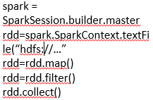

Spark Execution Architecture
Driver Program
Worker Node
Cache
Executor
8
9
1
Task
Task
2
7
JVM
3
Spark Context
Cluster Manager
6
7
Worker Node
Action Operation
Executor
8
9
Cache
Task
Task
DAG Scheduler
4
Task Scheduler
5
task1
RDD
task2
Tasks
RDD1
RDD2
Operator
DAG
task3
RDD
task4
Launch task via Task Scheduler

Slide 119
Follows master-slave architecture.
Client submits user application code to Driver. (1)
JVM Is created. (2)
Spark Context is created in the JVM of driver program. Only one active SC per JVM. (3)
Driver implicitly converts the user code into logically DAG(Directed Acyclic Graph) using DAG scheduler. (4)
DAG Scheduler performs optimizations such as pipelining transformations and then it converts the logical graph DAG into Physical executing plan with many stages.
After creating physical executing plans, it creates Physical executing units called tasks under each stage.
The stages pass on to Task Scheduler. It launces task through cluster manager. (5)
Now driver via Spark Context talks to the cluster manager and negotiates resources. It request for worker nodes and executors in the cluster. (6) (7)
Spark is agnostic to the underlying cluster manager. As long as it can acquire executor processes, and these communicate with each other, it is relatively easy to run it even on a cluster manager that also supports other applications (e.g. Mesos/YARN).
Cluster Manager allocate resources and instruct executors to execute the job.
Also track the submitted jobs and report back the status of the job to the driver.
Driver sends application code and dependencies(defined by jar or Python files passed to the SparkContext) to executors. (8)
Finally driver also send the tasks to the executors to run.
Job resources which we are trying to pass as part of execution can be cached at Worker Nodes. One of the job resource can be our code itself.
All the executors start to register themselves with the drivers so that driver will have a complete view of the executors.
Executors now start executing the tasks that are assigned by the driver program.
When application is running, the driver program will monitor the set of executors that runs. Driver also schedules the future tasks based on data placement.
After execution, the result returns back to the Spark Context. (9)

Slide 120
Cluster Manager Types:
The system currently supports several cluster managers:
Standalone – a simple cluster manager included with Spark that makes it easy to set up a cluster.
Apache Mesos – a general cluster manager that can also run Hadoop MapReduce and service applications.
Hadoop YARN – the resource manager in Hadoop 2.
Kubernetes – an open-source system for automating deployment, scaling, and management of containerized applications.

Slide 121
YARN Cluster Manager

Slide 122
YARN as Spark Cluster Manager:
Yet Another Resource Negotiator for Hadoop 2.x.
Cluster Management – Used for resource allocation and Scheduling.
It has 3 major components –
Resource Manager
Node Manager
Application Master
Flow:
Client submit the Spark application. Driver instantiates SparkContext.
Driver talks to the cluster manager(YARN) and negotiates resources.
The YARN resource manager search for a Node Manger which will, in turn, launch an ApplicationMaster for the specific job in a container.
The ApplicationMaster registers itself with the resource Manager.
The ApplicationMaster negotiates containers for executors from the ResourceManager. Can request for more resources from RM.
The ApplicationMaster notifies the Node Managers to launch the containers and executors. Executor then executes the tasks.
Driver communicates with executors to coordinate the processing of tasks of an application.
Once the tasks are complete, ApplicationMaster un-registers with the Resource Manager.

Slide 123

YARN Cluster Manager
Node Manager
3
3
Container
Driver
Resource
Manager
4
Application
Master
1
2
5
8
Node Manager
6
6
Container
Executor
7
Task
Task
Node Manager
Container
Executor
7
Task
Task

Slide 124
Resource Manager:
Runs on Master Node.
Manages the resources used across the cluster.
Two components – Scheduler and Application Manager.
Scheduler - Performs scheduling based on the requirement of resources by the applications.
Application Manager: It manages the running of Application Master and restart it on its failure. Also it is responsible to accept the submission of jobs.
Node Manager:
Runs on all Worker Nodes.
Launches and monitor containers which are assigned by RM.
Responsible for the execution of the task in each data node.
Containers:
Are set of resources like RAM, CPU, memory etc on a single node and they are scheduled by RM and monitored by NM.
Application Master:
An individual ApplicationMaster is assigned for each job by RM.
It’s chief responsibility is to negotiate the resources from the RM. It works with the Node Manager to monitor and execute the tasks.

Slide 125
JVM Processes

Slide 126
Where JVMs are created during execution across the Clusters :
Cluster
Executor JVM
Driver JVM
JVM Heap
Task Slots
T
T
T
T
T
JVM Heap
Unoccupied Task Slots
T
Client JVM
T
Spark Context
Spark Application
Executor JVM
JVM Heap
T
T
T
T

Slide 127
Terms used in Spark Execution Framework:
Application: User application built on Spark.
Job: A parallel computation consisting of multiple tasks that gets spawned in response to a Spark action (e.g. save, collect).
Stage: Each job gets divided into smaller sets of tasks called stages that depend on each other (similar to the map and reduce stages in MapReduce); you'll see this term used in the driver's logs.
Task: A unit of work that will be sent to one executor.
Application Jar: A jar containing the user's Spark application codes.
Driver Program: The process running the main() function of the application and creating the SparkContext.
Cluster Manager: An external service for acquiring resources on the cluster (e.g. standalone manager, Mesos, YARN). In YARN it is Resource Manager + Application Master.
Deploy Mode: Distinguishes where the driver process runs. In "cluster" mode, the framework launches the driver inside of the cluster. In "client" mode, the submitter launches the driver outside of the cluster.
Worker Node: Any node that can run application code in the cluster.
Executor: A process launched for an application on a worker node, that runs tasks and keeps data in memory or disk storage across them. Each application has its own executors.
Cache: Cache is nothing but the job resources which we are trying to pass as part of execution. One of the job resource can be our code itself. Typically the code will be compiled in the jar file and jar file will be passed as cache and it will be cached into the executors. Tasks will be using this cache at the run time so that it can apply the logic onto the data while data is being processed. We can also persist or cache the RDDs.

Slide 128
One Application
Multiple Jobs for Each Application
Multiple Stages for Each Job
Multiple tasks for Each stage
Multiple Jobs for Each Application
Multiple Stages for Each Job
Multiple tasks for Each stage
Multiple Jobs for Each Application
Multiple Stages for Each Job
Multiple tasks for Each stage

Slide 129
Narrow and Wide Transformations

Slide 130
Narrow and Wide Transformations
Narrow Transformations:
These types of transformations convert each input partition to only one output partition.
Spark merges all narrow transformations into one stage.
Fast.
No data shuffle.
Ex- map(), filter()
Partition 1
T
Partition 1
Partition 2
Partition 2
[
Partition 3
Partition 3
RDD1
RDD2

Slide 131
Wide Transformations:
This type of transformation will have input partitions contributing to many output partitions.
Each Wide Transformations creates a new stage.
Slow compared to Narrow.
Data shuffle.
Ex- groupByKey(), aggregateByKey(), join, distinct(), repartition() etc.
Partition 1
T
Partition 1
Partition 2
Partition 2
Partition 3
Partition 3
RDD1
RDD2

Slide 132
DAG

Slide 133
DAG Graph
Stage 1
Stage 2
Stage 3
Stage 4
aggregateByKey
parallelize
parallelize
join
map
map
map
distinct
map
filter
filter

Slide 134
DAG
DAG Stands for Directed Acyclic Graph.
Directed → Directly connected to one node to another.
Acyclic → There is no cycle or loop. So it is in line and we can not go back to its original position.
Graph → It has Vertices and Edges. Vertices indicates RDDs and edges refers to the operations on the RDD.
These all represented as a graph.

Slide 135
DAG Scheduler
Driver Program
Spark Context
DAG Scheduler
Task Scheduler
Physical Execution Plan
Operator
DAG
RDD1
task1
RDD2
RDD3
Action Operation
task2
task5
Tasks
RDD4
task3
task6
Logical Execution Plan
task4
task7
Stage 1
Stage 2

Slide 136
Steps to build a DAG
User submits a application job to spark.
Drivers takes the application and create a Spark Context to process the application.
Spark Context identifies all the T and A operations present in the application.
All the operations are arranged in a logical flow of operations called DAG (Logical Execution Plan).
It stops here if SC doesn’t find any A Operations.
If it identifies an A operations, spark submit the Operator DAG to DAG scheduler.
DAG Scheduler converts the Logical Execution plan into Physical Execution plan and creates stages and tasks. Here Narrow T are fused together into one stage. Wide T involving shuffle process creates new stages.
DAG scheduler bundles all the tasks and send it Task Scheduler which then submit the job to cluster manager for execution.

Slide 137
RDD Lineage
RDD Lineage:
Each RDD maintains a pointer to one or more parent along with metadata about what type of relationship it has with the parent.
Ex - if we call rdd2=rdd1.map(), the rdd2 keeps a reference to its parent rdd1 and this is called RDD lineage.
Print the RDD lineage information using toDebugString() API.
rdd1
rdd2
rdd3
rdd4
RDD Lineage Graph

Slide 138
toDebugString(self) :
Displays Logical Execution Plan.
We can learn about a RDD Lineage Graph using API toDebugString.
Displays the description of this RDD and its recursive dependencies for debugging.
Word Count Program:
text_file = sc.textFile('practice/retail_db/word')
wordCounts = text_file.flatMap(lambda line: line.split(",")) \
.filter(lambda x : x.isdigit() == False) \
.map(lambda word: (word, 1)) \
.reduceByKey(lambda a, b: a + b)
top3Words = wordCounts.takeOrdered(3,lambda k: -float(k[1]))
for i in rdd.toDebugString().split(“\n”) : print(i)
Spark Context
textFile
HadoopRDD
N T
Stage 1
mapPartitionsRDD
N T
mapPartitionsRDD
N T
mapPartitionsRDD
W T
shuffleRDD
Stage 2
A
top3Words = wordCounts.takeOrdered(3,lambda k: -float(k[1]))

Slide 139
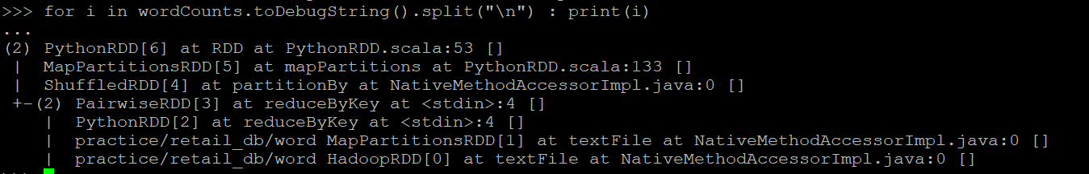
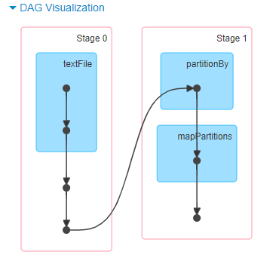
Logical Execution Plan
DAG Scheduler
Physical Execution Plan

Slide 140
Hadoop RDD
p1
p2
DAG Scheduler
mapPartitionsRDD
p1
p2
Stage 1
Task Scheduler
mapPartitionsRDD
p1
p1
mapPartitionsRDD
p1
p2
shuffleRDD
p1
p2
Stage 2

Slide 141
DAG Scheduler to Task Scheduler:
DAG Scheduler submit the stages into task scheduler.
The number of tasks submitted depends on the number of partitions present in the textFile.
For ex – imagine we have 3 partitions, then there will be 3 set of tasks created and submitted in parallel provided there are enough cores.

Slide 142
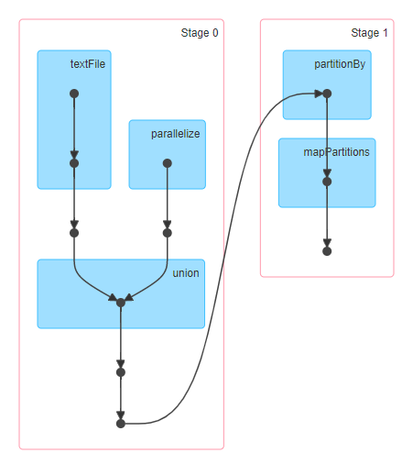
Parallel Execution of Stages:
The stages which are not dependent on each other may be submitted to the cluster for execution in parallel.
text_file = sc.textFile('practice/retail_db/orders').map(lambda x : (int(x.split(',')[0]),x.split(',')[3]))
rdd = sc.parallelize([1,2,3,4,5,6,7]).map(lambda x : (x,1*1) )
joined = text_file .join(rdd)
joined.count()

Slide 143
How to find the Resource Manager URL
Go to /etc/hadoop/conf
Open yarn-site.xml
Find the resource Manager url by searching name ‘yarn.resourcemanager.webapp.address’
Default port : 8088

Slide 144
RDD Persistence

Slide 145
One of the most important capabilities in Spark is persisting (or caching) a dataset in memory.
When we persist an RDD, each node stores any partitions of it that it computes in memory and reuses them.
We can mark an RDD to be persisted using the persist() or cache() methods on it. The first time it is computed in an action, it will be kept in memory on the nodes.
Spark’s cache is fault-tolerant – if any partition of an RDD is lost, it will automatically be recomputed using the transformations that originally created it.
Each persisted RDD can be stored using different storage level.
These levels are set by passing a StorageLevel object

Slide 146
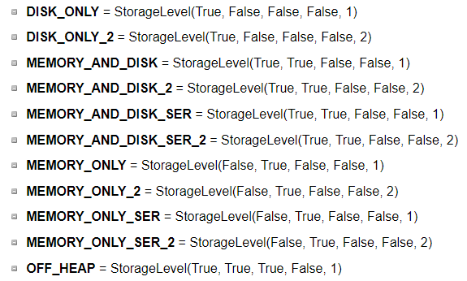
StorageLevel(useDisk, useMemory, useOffHeap, deserialized, replication=1)
Data can be stored either in Disk or Memory or off-heap memory or any of these combinations.
Data can be stored in Serialized or deserialized. Serilization is a way to convert a object in memory to series of bits. The deserialization is the process of bringing those bits into memory as an object. Whenever we are talking about 'deserialized' RDD/DF, we are always referring to RDD/DFs in memory.
Off-Heap Memory is a segment of memory lies outside the JVM, but is used by JVM for certain use-cases. Off-Heap memory can be used by Spark explicitly as well to store serialized data-frames and RDDs.
Use the replicated storage levels if you want fast fault recovery.
Default Storage

Slide 147
persist(storageLevel=StorageLevel(False, True, False, False, 1) )
Set this RDD's storage level to persist its values across operations after the first time it is computed. This can only be used to assign a new storage level if the RDD does not have a storage level set yet.
If no storage level is specified defaults to →MEMORY_ONLY.
rdd = sc.parallelize(("b", "a", "c"))
rdd.persist().is_cached
rdd.getStorageLevel()
from pyspark import StorageLevel
rdd.persist( StorageLevel.MEMORY_AND_DISK_2 )
rdd.getStorageLevel()
print(rdd1.getStorageLevel())
unpersist():
Mark the RDD as non-persistent, and remove all blocks for it from memory and disk.
Spark automatically monitors cache usage on each node and drops out old data partitions in a least-recently-used (LRU) fashion.
If you would like to manually remove an RDD instead of waiting for it to fall out of the cache, use the RDD.unpersist() method.
rdd.persist()
rdd.is_cached
rdd.unpersist()
rdd.is_cached

Slide 148
Usage and trade-offs:
Spark’s storage levels are meant to provide different trade-offs between memory usage and CPU efficiency.
If your RDDs fit comfortably with the default storage level (MEMORY_ONLY), leave them that way. This is the most CPU-efficient option, allowing operations on the RDDs to run as fast as possible.
When amount large amount of dataset or dataset operations are very expensive or memory is not sufficient to hold the data, spill it into disk.
Use the replicated storage levels if you want fast fault recovery

Slide 149
Spark Shared Variables

Slide 150
Shared Variables
Shared variables are the variables that are required to be used by functions and methods in parallel.
Shared variables can be used in parallel operations.
Spark provides two types of shared variables −
Broadcast
Accumulator

Slide 151
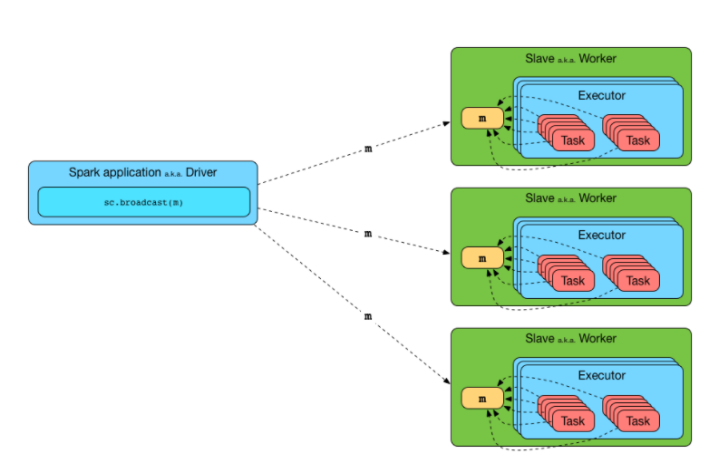
Broadcast Variables
Broadcast variables allow the programmer to keep a read-only variable cached on each machine rather than shipping a copy of it with tasks.
Immutable and cached on each worker nodes only once.
Efficient manner to give a copy of a large dataset to each node.
They should fit in memory.

Slide 152
When to use Broadcast Variable:
For processing, the executors need information regarding variables or methods. This information is serialized by Spark and sent to each executor and is known as CLOSURE.
If we have a huge array that is accessed from spark CLOSURES, for example - if we have 5 nodes cluster with 100 partitions (20 partitions per node), this Array will be distributed at least 100 times (20 times to each node). If you we broadcast it will be distributed once per node using efficient p2p protocol.
What not to do:
Once we broadcasted the value to the nodes, we shouldn’t make changes to its value to make sure each node have exact same copy of data. The modified value might be sent to another node later that would give unexpected results.

Slide 153
Hands-on:
--Broadcast a Dictionary
days={"sun": "Sunday", "mon" : "Monday", "tue":"Tuesday"}
bcDays = spark.sparkContext.broadcast(days)
bcDays.value
bcDays.value('sun')
--Broadcast a list
numbers = (1,2,3)
broadcastNumbers=spark.sparkContext.broadcast(numbers)
broadcastNumbers.value
broadcastNumbers.value(0)

Slide 154
PS: Convert the 3 bytes days into full days.
Input data= (("James","Smith","USA","mon"),
("Michael","Rose","USA","tue"),
("Robert","Williams","USA","sun"),
("Maria","Jones","USA","tue")
)
Solution:
days={"sun": "Sunday", "mon" : "Monday", "tue":"Tuesday"}
bcDays = spark.sparkContext.broadcast(days)
data = (("James","Smith","USA","mon"),
("Michael","Rose","USA","tue"),
("Robert","Williams","USA","sun"),
("Maria","Jones","USA","tue")
)
rdd = spark.sparkContext.parallelize(data)
def days_convert(dict):
return bcDays.value(dict)
input = rdd.map(lambda x: (x(0),x(1),x(2),x(3))).collect()
output = rdd.map(lambda x: (x(0),x(1),x(2),days_convert(x(3)))).collect()

Slide 155



Accumulator Variables
Accumulator is a shared variable to perform sum and counter operations.
These variables are shared by all executors to update and add information through associative or commutative operations.
Commutative -> f(x, y) = f(y, x)
Ex : sum(5 ,7 ) = sum(7, 5)
Associative -> f(f(x, y), z) = f(f(x, z), y) = f(f(y, z), x)
Ex : sum(multiply(5,6),7) = sum(multiply(6,7),5)
sum(sum(5,6),7) = sum(sum(6,7),5)

Slide 156
Accumulator Variables
Why it is needed as we can use the normal variables?
The counter Variable will not added or changed, because when spark ships this code to every executor the variables become local to that executor. So the variable is updated for that executor but do not send it back to the driver. To avoid this problems, we need ac accumulator. All the updates to accumulator variable in every executor is send it back to the driver.
counter = 0
def f1(x):
global counter
counter += 1
rdd = spark.sparkContext.parallelize((1,2,3))
rdd.foreach(f1)
counter.value
### sparkContext.accumulator() is used to define accumulator variables
counter = spark.sparkContext.accumulator(0)
def f2(x):
... global counter
... counter.add(1) ### add() function is used to add/update a value in accumulator
rdd.foreach(f1)
counter.value ### Only accessed by Driver

Slide 157
Accumulator Variables
Lets check one more example:
foreach() is an action which is applied to each element of the rdd and then adding each element to accum variable.
rdd.foreach() is executed on workers and accum.value is called from driver.
accum=sc.accumulator(0)
rdd=spark.sparkContext.parallelize((1,2,3,4,5))
rdd.foreach(lambda x:accum.add(x))
print(accum.value) #Accessed by driver

Slide 158
Accumulator Variables
Spark natively supports accumulators of numeric types (int, float) and programmers can add support for new custom types using AccumulatorParam class of PySpark.
Accumulators do not change the lazy evaluation model of Spark. If they are being updated within an operation on an RDD, their value is only updated once that RDD is computed as part of an action.
counter = spark.sparkContext.accumulator(0)
def f2(x):
global counter
counter.add(1)
rdd.map(f2)
Computations inside transformations are evaluated lazily, so unless an action happens on an RDD the transformations are not executed. As a result of this, accumulators used inside functions like map() or filter() wont get executed unless some action happen on the RDD. Spark guarantees to update accumulators inside actions only once.
Always use accumulators inside actions ONLY (ex – foreach).

Slide 159
SparkSQL Architecture

Slide 160
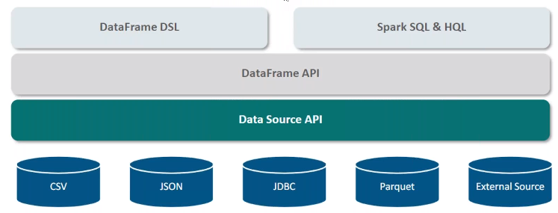

Spark SQL Architecture
Processing data in DataFrame
Processing data in DataFrame
Catalyst Optimizer
Tungsten Execution Engine
Equivalent to a relational table in SQL to perform SQL Operations
Read and Store Structured or Semi-structured data
CSV
JSON
JDBC
PARQUET
Hive
AVRO
Flexible Data Access Layer. Data is acquired from various input formats.
Elastic Search
Cassandra
HDFS
… and many more.

Slide 161
How Catalyst and Tungsten Works : An Overview
Spark 2.x
Catalyst
User Programs
Tungsten
Series of Transformations
SQL Query → Parsed
Optimized Query Plan
RDDs
Query Plan
DataFrame
Abstractions of User Programs (Trees)
SQL Query/DF API
Query Plan
Optimized Query Plan
Code
Execution
Reference: databricks.com summit

Slide 162
Spark SQL Architecture
SQL, DataFrames are high-level APIs. It means the user programs just describe what data operations are needed without specifying how to execute these operations.
Optimizer: An optimizer can automatically find out the most efficient plan to execute a query.
Catalyst Optimizer:
Spark SQL is designed with Catalyst Optimizer which is based on functional programming of Scala.
Responsible to improve the performance of user programs (SQL Query/DataFrame APIs).
It converts a query plan into optimized query plan.
Two main Purpose:
Add new optimization techniques to solve big data problems.
Allows developers/spark community to implement and extend the optimizer with new features.
Offers both rule-based and cost-based optimization (Spark 2.0).
Rule Based : How to execute the query from a set of defined rules.
Cost-Based: Generates multiple execution plans and chose the lowest cost plan.
Tungsten Execution Engine:
Generates code and execute it in the cluster in the distributed fashion.
The engine builds upon ideas from modern compilers and MPP databases.

Slide 163
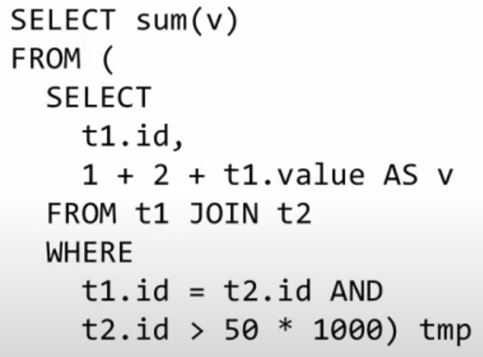
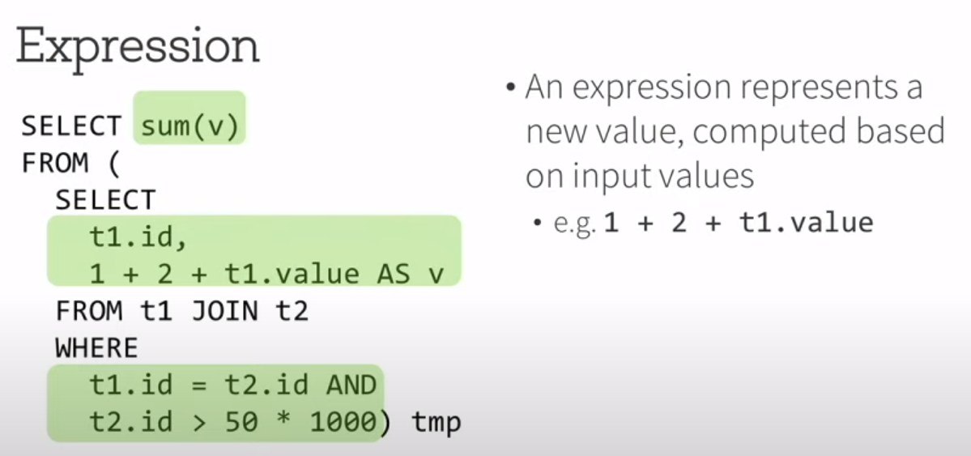
Trees: Abstractions of Users Programs
Identify Expressions
Reference: databricks.com summit

Slide 164
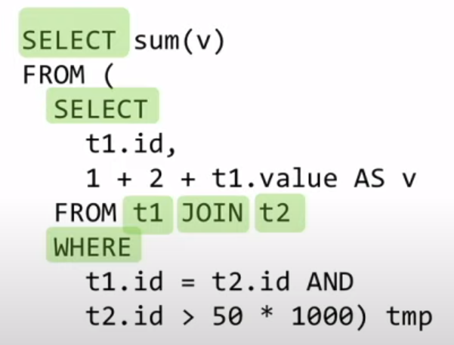
Query Plan
Describe data operation like aggregates, joins, filters etc. and these operations essentially generate a new dataset based on a input dataset.
Reference: databricks.com summit

Slide 165
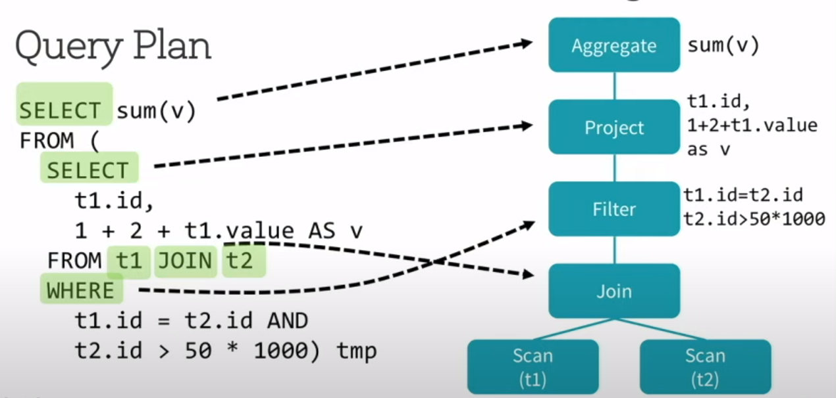

Query Plan
Reference: databricks.com summit

Slide 166
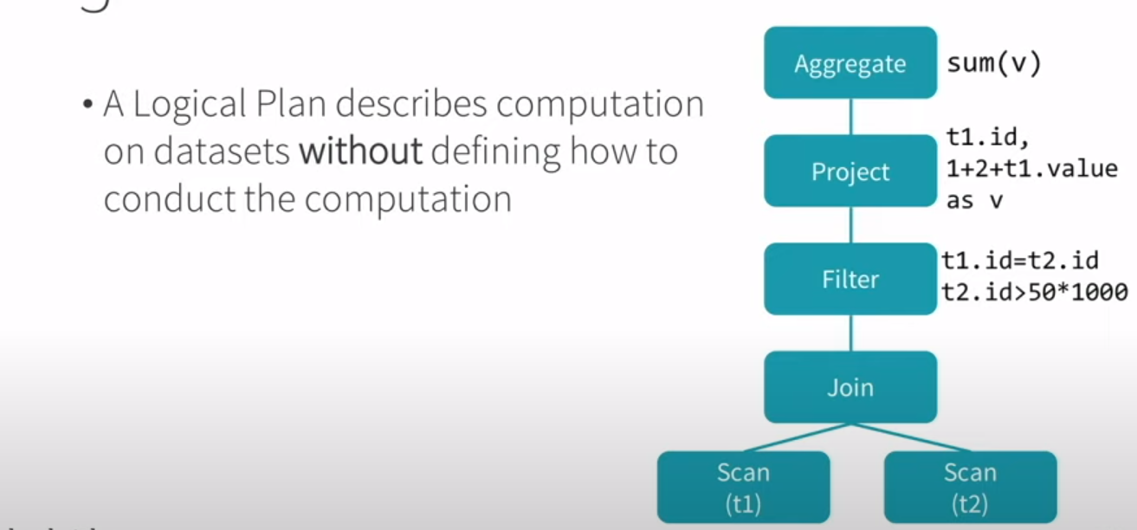

Logical Query Plan
2 types - Logical Plan and Physical Plan
Reference: databricks.com summit

Slide 167
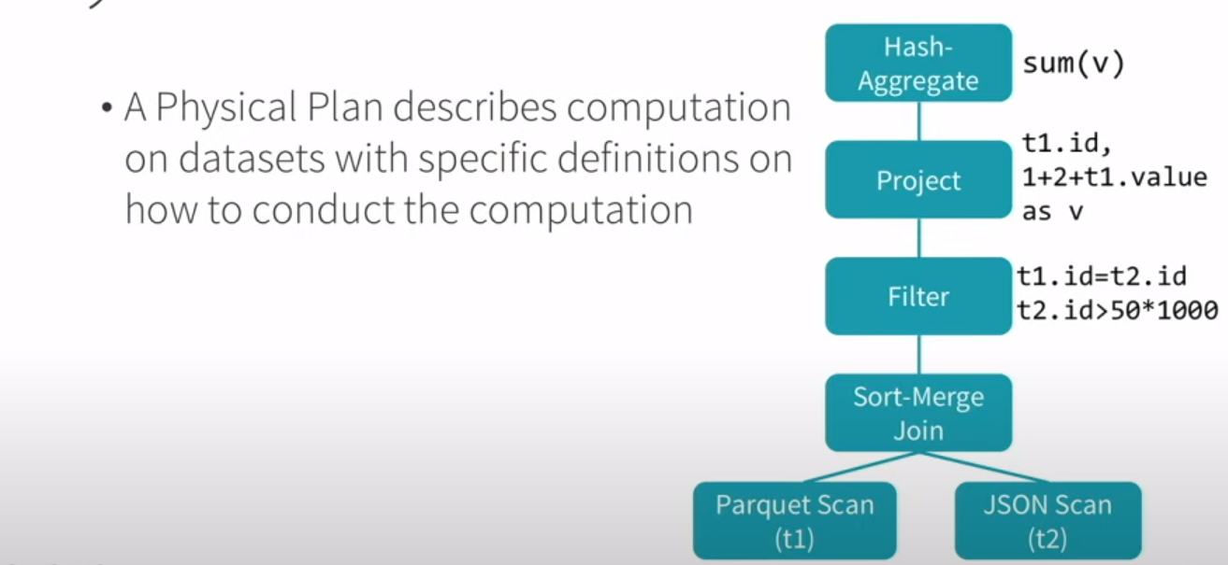

Physical Query Plan
Reference: databricks.com summit

Slide 168
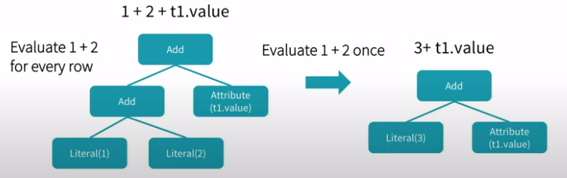

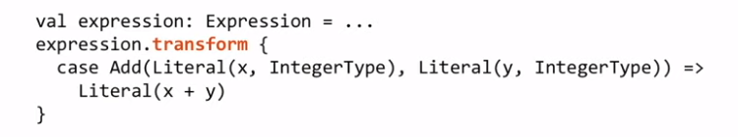
Transform
A Transform is a function associated with every tree to implement a single rule.
Reference: databricks.com summit

Slide 169
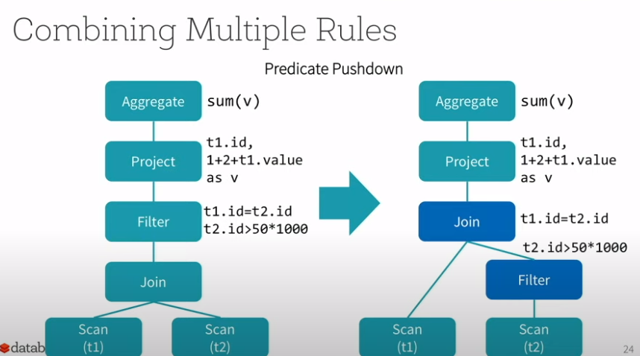
Transform
Predicate Pushdown
Reference: databricks.com summit

Slide 170
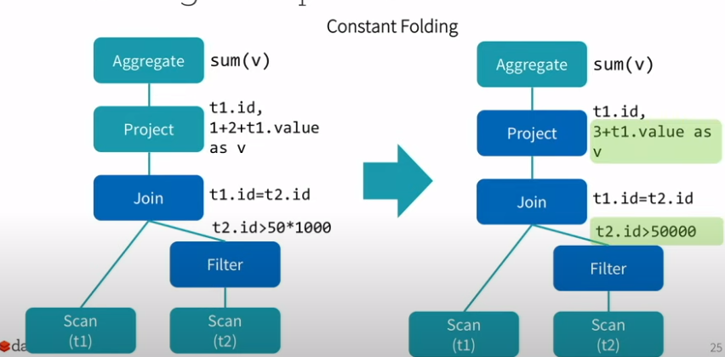
Transform
Constant Folding
Reference: databricks.com summit

Slide 171
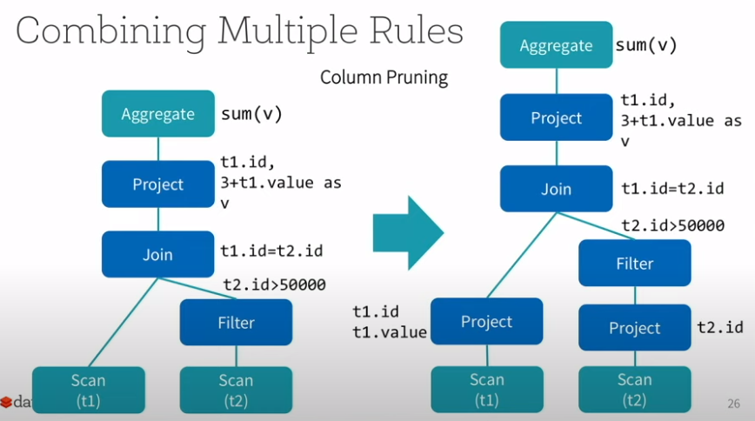
Transform
Column Pruning
Reference: databricks.com summit

Slide 172
--SQL Query
select count(*) from orders
where order_cust_id = 1000
OR
--DataFrame API
ord.select(ord.order_customer_id == 1000).count()
Aggregate
Project
Filter
Scan

Slide 173
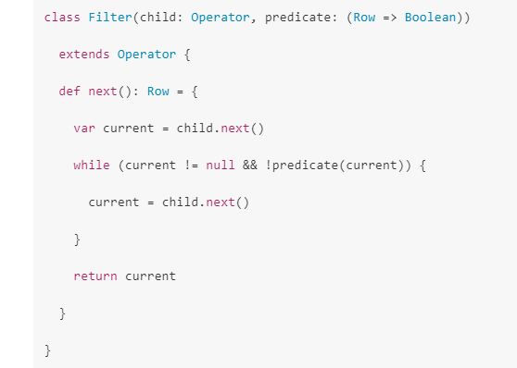
Volcano Iterator Model:
select count(*) from orders
where order_cust_id = 1000
Each operator in the query plan would implement an iterator interface that takes in the records from the operator below it, tries to do some processing and output that record optionally to the operator above it.
Aggregate
Project
Filter
Scan
Reference: databricks.com summit

Slide 174
Volcano Iterator Model:
Spark 1.6
Each operator in the query plan would implement an iterator interface that takes in the records from the operator below it, tries to do some processing and output that record optionally to the operator above it.
Advantages:
Each operator is independent from each other. So it is easy to write when we introduce a new operator and we no need to worry about how it interacts with all the other operators.
No need to worry about the operators before it or after it.
Disadvantages:
Too many virtual function calls. Since we are agnostic to the operator that is below, we have no idea where the input data is coming from.
Extensive memory access: Each operator has to write the intermediate row that its trying to send to the upstream operator into memory. So there is memory read or writes bottleneck.
Can’t take advantage of modern CPU features like SIMD, pipelining, prefetching etc.

Slide 175
Whole-stage Code Generation – Spark 2.0 Tungsten Engine
Idea is to make Spark as a Compiler (Spark would try to generate code that look like hand optimized code)
Fusing Operators together so the generator code looks like hand optimized code.
Identify chain of operators (“stages”)
Compile each stage into a single function
Better performance as if hand built system just to run your given query.
Aggregate ( ~ count)
var count = 0
for (order_cust_id in orders) {
if (order_cust_id == 1000) {
count += 1
}
}
Project (No Column to project)
Filter (~ Filter Condition)
Scan (~For Loop)
Reference: databricks.com summit

Slide 176
Volcano vs Hand Optimized Code (Whole-stage):
No Function Virtual Dispatches: In the Volcano model, to process a tuple would require calling the next() function at least once. These function calls are implemented by the compiler as virtual function dispatches. The hand-written optimized code, on the other hand, does not have a single function call.
Intermediate data memory vs CPU registers: In the Volcano model, each time an operator passes a tuple to another operator, it requires putting the tuple in memory (function call stack). In the hand-written version, by contrast, the compiler (JVM JIT in this case) actually places the intermediate data in CPU registers. Again, the number of cycles it takes the CPU to access data in memory is orders of magnitude larger than in registers.
Modern CPU Features: Volcano model is unable to use modern CPU features due to its complex function call graphs. Modern compilers are incredible efficient when compiling and executing simple for loops.

Slide 177
Benchmark

Slide 178
Lets check the performance with an example – Add one billion Numbers ?
def benchmark(version):
start = time()
spark.range(1000 * 1000 * 1000).select(sum("id")).show()
end = time()
elapsed = end-start
print(elapsed)
Spark 1.6:
spark.conf.set("spark.sql.codegen.wholeStage",False)
benchmark('1.6')
Total Time: 10.4 secs
Spark 2.0:
spark.conf.set("spark.sql.codegen.wholeStage",True)
benchmark('2.0')
Total Time: 0.4 secs

Slide 179
Understanding the Execution Plan
explain(extended=False):
Prints the (logical and physical) plans to the console for debugging purpose.
Extended is a Boolean parameter.
default : False. If False, it prints only the physical plan.
If True, it prints all – Parsed Logical Plan, Analyzed Logical Plan, Optimized Logical Plan and Physical Plan.
Explain function is extended for whole-stage code generation.
When an operator has a star around it (*), whole-stage code generation is enabled. In the following example, Range, Filter, and the two Aggregates are both running with whole-stage code generation. Exchange does not have whole-stage code generation because it is sending data across the network.
Ex –
spark.conf.set("spark.sql.codegen.wholeStage",True)
spark.range(1000).filter("id > 100").selectExpr("sum(id)").explain()

Slide 180
Operator Benchmarks : Processing Cost/row in ns.
primitive | Spark 1.6 | Spark 2.0
filter | 15 | 1.1
sum w/o group | 14 | 0.9
sum w/ group | 79 | 10.7
hash join | 115 | 4
Sort (8-bit entropy) | 620 | 5.3
Sort (64-bit entropy) | 620 | 40
Sort-merge join | 750 | 700
Parquet Decoding (single int column) | 120 | 13
5-30x Speedups
10-100x Speedups
Shuffling still the bottleneck
10x Speedups
Reference: databricks.com summit

Slide 181
Let’s put it all together

Slide 182
User Programs
Catalyst
Tungsten
Physical Planning
Analysis
Logical Optimization
Code Generation
SQL Query → Parsed
Unresolved Logical Plan
Logical Plan
Optimized Logical Plan
Cost Model
Selected Physical Plan
RDDs
Physical Plans
DataFrame
Catalog

Slide 183
Spark SQL Architecture
Spark SQL:
It is a module used for structured and semi structured data processing.
Flexible Data Access:
The bottom layer in the architecture is the flexible data access. Data is acquired from various input formats like CSV,
JSON, Parquet, any database with JDBC, Hive etc.
DataSource API:
Used to read and store structured and semi-structured data into Spark SQL.
DataSource API then fetches the data which is then converted into a DataFrame API.
DataFrame API:
Equivalent to a relational table in SQL to perform SQL Operations.
Distributed collection of data organized into named Columns.
Data is stored in partitions.
DataFrame DSL/DataFrame SQL/HQL:
Data is processed.
Catalyst Optimizer:
It converts a query plan into optimized query plan.
Tungsten:
Takes the optimized query plan from Catalyst and generates code and execute in the cluster in a
distributed fashion.

Slide 184
DataFrame Fundamentals

Slide 185
What is a DataFrame ?
DataFrame is a Dataset organized into named columns/rows.
Conceptually equivalent to RDBMS Table/Python data frame
+
Richer Optimizations.
Name | Age
Robert | 31
Alicia | 25
Deja | 19
Majoj | 31
“Robert”,31
“Alicia”,25
“Deja”,19
“Manoj”, 31
(‘name’,’age’)
Dataset
Schema
DataFrame

Slide 186






DataFrame Sources ?
Structured data files (CSV, JSON, AVRO, PARQUET etc)
Hive
Cassandra
Python Data frame
RDBMS Databases
RDDs

Slide 187
DataFrame Features

Slide 188
DataFrame Features ?
Distributed
Lazy Evaluation
Immutability
Used across the Spark Ecosystem
Polyglot
Work on Huge collection of dataset
Support both Structured and Semi-Structured Data

Slide 189
DataFrame Features - Distributed

Slide 190
DataFrame Features
1. DataFrame is Distributed.
Like RDD, DataFrame is also distributed.
Supports HA and FT.
Worker Node 1
Partition 1
Task1
DataFrame
Executor
e
Task 1
Task 2
Partition 2
Task2
Partition 3
Worker Node 2
Task3
Executor
Task 3
Hands-on 1

Slide 191
1. DataFrame is Distributed.
Ex – Find out the even numbers.
Worker Node 1
Partition 1
128MB
Task1
col%2 == 0
DataFrame
300MB
Executor
Task 1
Task 2
Partition 2
128MB
Task2
col%2 == 0
Partition 3
46MB
Worker Node 2
Task3
col%2 == 0
Executor
Task 3

Slide 192
DataFrame Features – Lazy Evaluation

Slide 193
DataFrame Features Contd …
2. Lazy Evaluation:
Each Transformation is a Lazy Operation. Evaluation is not started until an action is triggered.
DataFrame
T
DataFrame
T
DataFrame
1
filter
Group by
3
2
A
Count
4
Only at this point execution starts.

Slide 194
DataFrame Features Contd …
Example – Find out 10 sample records having a string “Robert” from a file(1TB).
With Out Lazy Evaluation: With Lazy Evaluation:
Step 1 Step 1
Step 2
Step 2
Step 3
Load the 1TB File
Wait for an Action and then Load the 1TB File
Perform full scan to find out all Records having “Robert”
Filter out first 10 records having “Robert” .
Retrieve 10 Records

Slide 195
DataFrame Features - Immutability

Slide 196
DataFrame Features Contd …
3. Immutability:
DataFrames are considered to be “Immutable Storage”.
Single-Node
Data in Stage 1
Transformation 1
Transformation 2
Transformation …
Data in Stage 2
Data Stored Immutably
The Transformation Recipe is Stored
Ex – Logic to print all the even numbers is col%2 == 0
Data is not Stored

Slide 197
DataFrame Features Contd …
Multi-Node
Data in Stage 1 on Node 1
Transformations 1
Transformations 2
Transformations …
Data in Stage 2 on Node 1
Data in Stage 1 on Node 2
Data in Stage 2 on Node 1
Transformation Recipe is stored
Data in Stage 1 on Node 3
Data in Stage 2 on Node 1
Data in Stage 1 on Node …
Data in Stage 2 on Node …

Slide 198
DataFrame Features – Used Across Spark Ecosystem

Slide 199

DataFrame Features Contd …
4. Used across the Spark Ecosystem
DataFrame is a unified API across all libraries in Spark.
Spark SQL
Use DF consistently across all Spark Libraries
Spark Streaming
DataFrame
Mlib(Machine Learning)
Spark Developer
Single API Call
Learn API
GraphX

Slide 200
DataFrame Features Contd …
5. Polyglot:
Support multiple Languages - Scala, Python, Java, R.
6. Works on Huge collection of dataset, feasible to work with a wide file.
7. Supports both Structured and Semi structured data (JSON, XML etc).

Slide 201
Hands-On
Common functions on Data Frames
printSchema – to print the column names and data types of data frame
show – to preview data (default 20 records)
describe – to understand characteristics of data
count – to get number of records
collect – to convert data frame into Array
type
dtypes
Name | Age
Robert | 31
Alicia | 25
Deja | 19
Majoj | 31

Slide 202
DataFrame Organization

Slide 203
DataFrame Organization of Data
A DataFrame has 3 levels to organize and
process its data - Schema, Storage and API.
Schema:
DataFrame is Implemented as a dataset
of rows.
Each column is named and typed.
Storage:
Storage is distributed and data is stored
in partitions.
Storage in Memory and Disc or off-heap
or any of these 3 combinations.
API
Used to process the data.
ObjectID
String
Name
String
Age
Long
…
String
Row #1
Schema
Dataset<Row>
Row #2
Row #3
Row #4
Partition #1
Alicia
35
…
…
Storage
Partition #2
Sai
31
…
…
…..
DataFrame APIs

Slide 204
DataFrame Organization of Data
StorageLevel(useDisk, useMemory, useOffHeap, deserialized, replication=1)
Data can be stored either in Disk or Memory or off-heap memory or any of these combinations.
Off-Heap Memory is a segment of memory lies outside the JVM,but is used by JVM for certain use-cases. Off-Heap memory can be used by Spark explicitly as well to store serialized data-frames and RDDs.
Data can be stored in Serialized or deserialized. Serilization is a way to convert a java object in memory to series of bits. The deserialization is the process of bringing those bits into memory as an object. Whenever we are talking about 'deserialized' RDD/DF we are always referring to RDD/DFs in memory.
Use the replicated storage levels if you want fast fault recovery.
Default Storage

Slide 205
DataFrame Organization of Data
from pyspark import StorageLevel
df = spark.range(10)
df.rdd.persist(). getStorageLevel()
df.rdd.persist(StorageLevel.MEMORY_AND_DISK_2). getStorageLevel()

Slide 206
Introduction To Spark Session

Slide 207
SparkSession : The Entry point Spark 2.0 Onwards
In Spark 2.0, SparkSession is the new entry point to work with RDD, DataFrame and all other functionalities.
Prior to 2.0, SparkContext used to be an entry point.
Almost all the APIs available in SparkContext, SQLContext, HiveContext are now available in SparkSession.
SparkContext: Entry point to work with RDD, Accumulators and broadcast variables (< Spark 2.0).
SQLContext: Used for initializing the functionalities of Spark SQL (< spark 2.0).
HiveContext: Super set of SQLContext (< spark 2.0).
By Default, Spark Shell provides a “spark” object which is an instance of SparkSession class.
Prior to 2.0
SparkContext
SQLContext
HiveContext
2.0 and Onwards
SparkSession
(Also has these old classes but not recommended to use)

Slide 208
Spark Session : The Entry point Spark 2.0 Onwards
House
Class
SparkSession
Class
Instance
Instance
Instance
My House
My Friend House
spark
Object
Object
Object

Slide 209
Spark Session : Spark Object & spark-submit

Slide 210
Spark Session : Create
from pyspark.sql import SparkSession
spark = SparkSession \
.builder \
.master('yarn') \
.appName("Python Spark SQL basic example") \
.getOrCreate()
Master can be yarn, mesos, Kubernetes or local(x) , x > 0
How to Run :
1. Organize the folders and create a python file under bin folder.
2. Write above codes in the .py file.
3. Execute the file using spark-submit command.
spark2-submit \
/devl/example1/src/main/python/bin/basic.py

Slide 211
Spark Session : spark-submit
Spark-submit is a utility to run a pyspark application job by specifying options and configurations.
spark-submit \
--master <master-url> \
--deploy-mode <deploy-mode> \
--conf <key<=<value> \
--driver-memory <value>g \
--executor-memory <value>g \
--executor-cores <number of cores> \
--jars <comma separated dependencies> \
--packages <package name> \
--py-files \
<application> <application args>

Slide 212
Spark Session : spark-submit
--master : Cluster Manager (yarn, mesos, Kubernetes, local, local(k))
local – Use local to run locally with one worker node.
local(k) – Specify k with the number of cores you have locally, this runs application with k worker
threads.
--deploy-mode: Either cluster or client
Cluster: Driver runs on one of the worker nodes and you can see the code as a driver on the spark UI of your
application. We cant see the logs on the terminal. Logs available only in the UI or the yarn CLI.
yarn logs -applicationId application_1622930712080_16253
Mainly used for production jobs.
Client: Driver runs locally where we submit the application.
See the logs on the terminal.
Mainly used for interactive or debugging purpose.

Slide 213
Spark Session : spark-submit
--conf: We can provide runtime configurations, shuffle parameters, application configurations using –conf.
Ex: --conf spark.sql.shuffle.partitions = 300
This configures the number of partitions that are used when shuffling data for joins or aggregations.
https://spark.apache.org/docs/latest/sql-performance-tuning.html
--conf spark.yarn.appMasterEnv.HDFS_PATH=“practice/retail_db/orders”
We can set environment variables like this when spark is running on yarn.
https://spark.apache.org/docs/latest/running-on-yarn.html#configuration

Slide 214
Spark Session : spark-submit
--driver-memory : Amount of memory to allocate for a driver (Default: 1024M).
--executor-memory : Amount of memory to use for the executor process.
--executor cores : Number of CPU cores to use for the executor process.

Slide 215
Spark Session : spark-submit
--jars: Dependency .jar files.
Ex : --jars /devl/src/main/python/lib/ojdbc7.jar, fil2.jar, file3.jar
--packages: Pass the dependency packages.
Ex : --packages org.apache.spark:spark-avro_2.11:2.4.4
--py-files: Use –py-files to add .py and .zip files. File specified with –py-files are uploaded to the cluster before it run the application.
Ex - --py-files file1.py, file2.py,file3.zip

Slide 216
Spark Session : spark-submit
spark-submit \
--master “yarn” \
--deploy-mode “client”\
--conf spark.sql.shuffle.partitions = 300 \
--conf spark.yarn.appMasterEnv.HDFS_PATH=“practice/retail_db/orders”
--driver-memory 1024M \
--executor-memory 1024M \
--num-executors 2 \
--jars --jars /devl/src/main/python/lib/ojdbc7.jar, fil2.jar, file3.jar \
--packages org.apache.spark:spark-avro_2.11:2.4.4 \
--py-files file1.py, file2.py,file3.zip \
/dev/example1/src/main/python/bin/basic.py arg1 arg2 arg3

Slide 217
Spark Session : Commonly Used Functions

Slide 218
Spark Session : Commonly Used Functions
version:
Returns Spark version where your application is running.
range():
This creates a DatFrame with a range of values.
createDataFrame() :
This creates a DataFrame from a collection(list, dict), RDD or Python Pandas.
sql() :
Returns a dataframe representing the result of a given query.
table():
Returns the specified table as dataframe.
sparkContext:
Returns sparkContext
conf():
Runtime configuration (get and set).
Ex- spark.sql.shuffle.partitions
read(): Used to load a dataframe from external storage systems.
udf() : Dedicated section for this.
newSession()
stop() : Stop the underlying SparkContext.
catalog()

Slide 219
SparkSession - Version

Slide 220
Spark Session : version Method
version: Returns Spark version where your application is running.
spark.SparkContext.version
sc.version

Slide 221
SparkSession - range

Slide 222
Spark Session : range() Method
range():
This creates a DatFrame with a range of values.
Ex- 1 :
df = spark.range(1,10,2)
Ex-2:
df =spark.range(10)

Slide 223
SparkSession - createDataFrame

Slide 224
Spark Session : createDataFrame() Method
createDataFrame() :
This creates a DataFrame from a collection(list, dict), RDD or Python Pandas.
Ex-1 : Using Python List
lst = (('Robert',35),('James',25))
spark.createDataFrame(data=lst),
df = spark.createDataFrame(data=lst,schema=('Name','Age')) ##With Out Schema
df = spark.createDataFrame(data=lst,schema=('Name','Age')) ##With Schema
Ex-2 : Using Python Dict
dict = ({"name":"robert","age":25}, {"name" : "james","age" : 31})
df = spark.createDataFrame(dict)
Ex-3: Using RDD
rdd = sc.parallelize(lst)
df = spark.createDataFrame(data=rdd,schema=('name string, age long'))
Ex-4: Using Row in RDD
#Row is used to create row Object using named arguments.
from pyspark.sql import Row
rdd = sc.parallelize((Row(name='James',age=31),Row(name='Robert',age=55)))
df = spark.createDataFrame(data=rdd)

Slide 225
Spark Session : createDataFrame() Method
Ex-5 : Using Python Pandas DamaFrame
Pandas dataframe is a two dimensional structure with named rows and columns. So data is aligned in a tabular fashion in rows and columns
import pandas as pd
data = (('tom', 10), ('nick', 15), ('juli', 14))
df_pandas = pd.DataFrame(data,columns=('Name','Age'))
df = spark.createDataFrame(data=df_pandas)

Slide 226
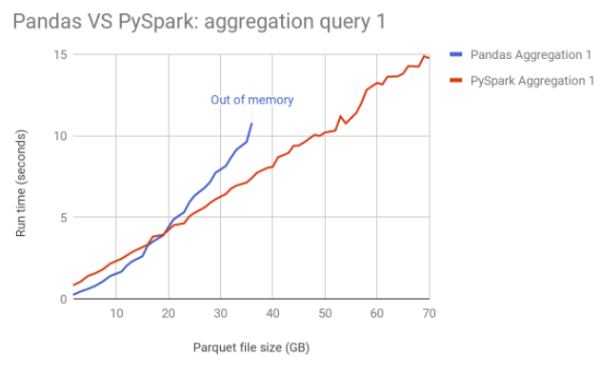
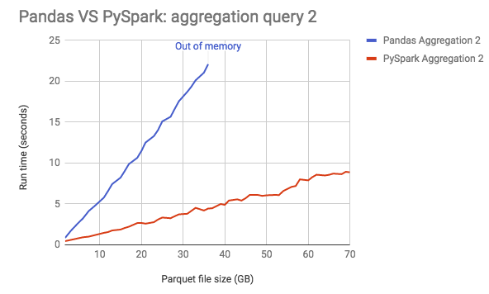
Performance: Pandas DataFrame Vs Spark DataFrame
Source: www.databrics.com

Slide 227
Spark Session : sql() Method
sql() :
Returns a dataframe representing the result of a given query.
Ex-1:
lst1 = (('Robert',35),('James',25))
lst2= (('Robert',101),('James',102))
df_emp = spark.createDataFrame(data=lst1,schema=(‘EmpName','Age'))
df_emp.createOrReplaceTempView("dept")
df_dept = spark.createDataFrame(data=lst2,schema=(‘EmpName',’DeptNo'))
df_dept.createOrReplaceTempView("dept")
df_joined = spark.sql (""" select e.name,e.age,d.dept from emp e join dept d where e.name = d.name """)
createOrReplaceTempView("table1") //Creates the view in the current database and valid for only one session.
createOrReplaceGlobalTempView(“table1”) //Creates the views in global_temp database.
// Valid across all sessions of an application.
Ex-2: Using Hive Table
df = spark.sql (“”” select * from emp “””)

Slide 228
Spark Session : table() Method
table() :
Returns the specified table as dataframe.
Ex-1:
lst1 = (('Robert',35),('James',25))
df_emp = spark.createDataFrame(data=lst1,schema=(‘EmpName','Age'))
df_emp.createOrReplaceTempView(“emp")
df_op = spark.table(“emp")
sorted(df_op.collect()) == sorted(df_emp.collect())

Slide 229
Spark Session : conf() Method
conf():
We can provide runtime configurations, shuffle parameters, application configurations using –conf or spark.conf().
Ex-1: System Defined
spark.conf.get("spark.sql.session.timeZone"
spark.conf.get('spark.sql.shuffle.partitions')
spark.conf.set(‘spark.sql.shuffle.partitions’,300) # configures the number of partitions that are used
when shuffling data for joins or aggregations.
https://spark.apache.org/docs/latest/sql-performance-tuning.html
Ex-2 : Spark Running on YARN Environment Variables
spark.conf.set('spark.yarn.appMasterEnv.HDFS_PATH','practice/retail_db/orders')
--conf spark.yarn.appMasterEnv.HDFS_PATH #From spark-submit
https://spark.apache.org/docs/latest/running-on-yarn.html#configuration

Slide 230
Spark Session : read() Method
read(): Interface used to load a dataframe from external storage systems.
Load a csv File:
Load a Text File:
Load a orc File:
Load a Parquet File:
Load a json File:
Load a avro File:
Read a hive Table:
Read a JDBC:

Slide 231
Spark Session : read – csv
Load a csv File:
Ex-1: df = spark.read.load(path='practice/retail_db/orders', format='csv', \
schema=('order_id int,order_date string,order_customer_id int,order_status string'))
Ex-2: df = spark.read.load(path='practice/retail_db/orders', format='csv',inferSchema=True)
Ex-3: df = spark.read.load(path='practice/retail_db/orders', format='csv',header=True)
Ex-4: df=spark.read.load('practice/retail_db/testSpace.txt',format='csv',sep=',',ignoreLeadingWhiteSpace=True,ignoreTrailingWhiteSpace=True)

Slide 232
Spark Session : read – text
Load a text File:
Use text file where there is fixed length.
Default field name is ‘value’.
Also you may load Into rdd.
Convert to dataframe using toDF() and Row.
df = spark.read.load('practice/retail_db/orders',format='text')
--Read the whole text file into a single line.
df =spark.read.load('practice/retail_db/orders',format='text', wholeText=True)

Slide 233
Spark Session : read – orc/parquet
Load a orc File
df = spark.read.load('practice/retail_db/orders_orc',format='orc')
Load a Parquet File
df = spark.read.load('practice/retail_db/orders_parquet',format='parquet')
CSV, JSON and AVRO are Row-based File formats. Sample data in CSV:
ID,FIRST_NAME,AGE
1, Matthew, 19
2, Joe,25
ORC,PARQUET are Column-based File formats.
ID/INT/3:1,2
FIRST_NAME/STRING/11:Matthew,Joe
AGE/INT/6:19,25

Slide 234
Spark Session : read – json
Load a json File:
df = spark.read.load(‘practice/retail_db/orders_json',format='json')

Slide 235
Spark Session : read – avro
Load a avro File:
Avro Is a third party file format. We need to import its package or jar file while launching a spark-submit application or pyspark shell. spark by default does not support it.
pyspark2 --master yarn \
--packages org.apache.spark:spark-avro_2.11:2.4.4
df = spark.read.load(‘practice/retail_db/orders',format='avro')

Slide 236
Spark Session : read() Method
Load a Hive Table: If Hive and Spark are integrated, we can create data frames from data in Hive tables or run Spark SQL queries against it.
spark.sql(“”” SELECT * FROM <db>.<tabe_name>“””).show()
spark.table(“<db>.<table_name>”).show()

Slide 237
Spark Session : read() Method
Load a JDBC Table:
Make sure JDBC jar file is registered using –packages or –jars while launching pyspark or spark-submit
Typical jdbc files are located at /usr/share/java folder. You may keep it there or copy it to your project lib folder.
pyspark2 ---jars <jdbc driver jar file>
Ex-1: Table
df= spark.read.format("jdbc") \
.option("url", "jdbc:oracle:thin:@xxxx-xxx-xxxx:1521/xxx") \
.option("driver", "oracle.jdbc.driver.OracleDriver") \
.option("dbtable",“ORDERS” ) \
.option("user", “someUser") \
.option("password", “somePsw") \
.load()

Slide 238
Spark Session : read() Method
Ex-2: Query
df= spark.read.format("jdbc") \
.option("url", "jdbc:oracle:thin:@xxxx-xxx-xxxx:1521/xxx") \
.option("driver", "oracle.jdbc.driver.OracleDriver") \
.option("dbtable",“(SELECT * FROM T_EMP WHERE ID=1) query” ) \
.option("user", “someUser") \
.option("password", “xxx") \
.load()

Slide 239
Spark Session : read() Method
Ex-3: Partition
Partitioning can be done only on numeric or date fields. If there is no numeric field generate it. For ex- Use ROWNUM to generate dummy numeric fields in Oracle Database. Define partitionColumn, numPartitions, lowerBound, upperBound.
df= spark.read.format("jdbc") \
.option("url", "jdbc:oracle:thin:@xxxx-xxx-xxxx:1521/xxx") \
.option("driver", "oracle.jdbc.driver.OracleDriver") \
.option("dbtable",“ORDERS” ) \
.option(“partitionColumn”,”ORDER_ID”) \
.option(“lowerBound”, “500”) \
.option(“upperBound”, “1000”) \
.option(“numPartitions”,”5”) \
.option("user", “someUser") \
.option("password", “somePassword") \
.load()

Slide 240
Spark Session : read() Method
lowerBound=500
upperbound=1000
numPartitions=5
So stride is = (upperbound-lowerbound)/numPartitions = 100.
Total Records in the Table = 1509
Partition 1: (599 Records)
First 499 Records
+
Select * from orders where order_id between (500,599) → 100 records
Partition 2: (100 Records)
Select * from orders where order_id between (600,699) → 100 records
Partition 3: (100 Records)
Select * from orders where order_id between (700,799) → 100 records
Partition 4: (100 Records)
Select * from orders where order_id between (800,899) → 100 records
Partition 5: (610 Records)
Select * from orders where order_id >=900

Slide 241
Spark Session : read() Method
Ex-4: Partition with out Numeric field
df= spark.read.format("jdbc") \
.option("url", "jdbc:oracle:thin:@xxxx-xxx-xxxx:1521/xxx") \
.option("driver", "oracle.jdbc.driver.OracleDriver") \
.option("dbtable", "(select t1.*, cast(ROWNUM as number(5)) as num_rows from (select * from orders) t1) oracle_table1") \
.option(“partitionColumn”, ”num_rows ”) \
.option(“lowerBound”, “500”) \
.option(“upperBound”, “1000”) \
.option(“numPartitions”,”10”) \
.option("user", “someUser") \
.option("password", “somePassword") \
.load()

Slide 242
Spark Session : spark.udf
UDFs are the User Defined Functions. Spark UDFs are similar to RDBMS User Defined Functions.
If there is a need of a function and pyspark build-in features don’t have this function, then you can create a udf and use it is DataFrames and Spark SQLs.
UDFs are error-prune and so should be designed carefully. First check if similar function is available in pyspark functions library(pyspark.sql.functions). If not designed properly, we would come across optimization and performance issues.
We can use UDFs both in DataFrame and Spark SQL.
1. For Spark SQL, create a python function/udf and register it using spark.udf.register
method.
2. For DataFrame, create a udf by wrapping under @udf or udf() function.

Slide 243
Ex – 1 (Create a udf, use it in DataFrame and register for spark sql)
import string
from pyspark.sql.functions import udf
from pyspark.sql.types import StringType,IntegerType
@udf(returnType=StringType())
def initCap(str):
finalStr=""
ar = str.split(" ")
for word in ar:
finalStr= finalStr + word[0:1].upper() + word[1:len(word)] + " "
return string.strip(finalStr)
DataFrame:
df.select(df.emp_name, initCap(df.emp_name)).show()
Spark Sql:
spark.udf.register("initcap1", initCap)
spark.sql(""" select emp_name, initcap1(emp_name) from default.emp """).show()

Slide 244
Ex-2: (Using Python Function and Register in Spark sql)
def convertCap(str):
finalStr=""
ar = str.split(" ")
for word in ar:
finalStr= finalStr + word(0:1).upper() + word(1:len(word)) + " "
return string.strip(finalStr)
Spark Sql:
spark.udf.register(" initcap ", convertCap)
Spark.sql(" " " select emp_name,initcap(emp_name) from default.emp " " ")

Slide 245
Ex-3: (Using Python Lambda Function and Use it in Spark Sql)
from pyspark.sql.types import IntegerType
from pyspark.sql.functions import udf
slen = udf(lambda s: len(s), IntegerType())
spark.udf.register("slen", slen)
spark.sql("SELECT slen('test')").collect()

Slide 246
Spark Session : newSession()
spark.newSession():
Returns a new SparkSession as new session, that has separate SQLConf, registered temporary views and UDFs, but shared SparkContext and table cache.
Ex- The registered udfs will not be visible to the new session.
Ex- 1 (Using udf) → Different SparkContext
new_spark = spark.newSession()
import string
from pyspark.sql.functions import udf
from pyspark.sql.types import StringType,IntegerType
@udf(returnType=StringType())
def initCap(str):
finalStr=""
ar = str.split(" ")
for word in ar:
finalStr= finalStr + word(0:1).upper() + word(1:len(word)) + " "
return string.strip(finalStr)
spark.udf.register("initcap1", initCap)
spark.sql(""" select emp_name, initcap1(emp_name) from default.emp """).show()
spark.sql(""" select emp_name, initcap1(emp_name) from default.emp """).show()

Slide 247
Ex-2: (Using Table data) → Shared SparkContext
new_spark = spark.newSession()
spark.sql (""" create table student(name int) """);
spark.sql (""" insert into student values (1) """);
spark.sql (""" select count(*) from student """).show()
new_spark.sql (""" select count(*) from student """).show()

Slide 248
Spark Session : stop()
spark.stop(): To stop the underlying spark context.

Slide 249
Spark Session : catalog()
Catalog is introduced in spark 2.0 which is a standard API for accessing metadata in Spark SQL.
This works both for Spark Sql and Hive Metadata.
Below are different methods in catalog for extracting important information.
Database Functions:
currentDatabase
listDatabases
setCurrentDatabase
Table Functions:
listColumns
listTables
cacheTable
isCached
uncacheTable
clearCache
recoverPartitions
refreshTable
refreshByPath
View Functions:
dropGlobalTempView
dropTempView
Function based functions:
listFunctions
registerFunction (= spark.udf.register)

Slide 250
Data Types

Slide 251
Supported Data Types:
Below are some of the important data types supported in both Data Frame and Spark SQL. For full list, please visit
https://spark.apache.org/docs/latest/sql-ref-datatypes.html.
from pyspark.sql.types import *
Numeric Types
IntegerType() | 4-byte signed integer numbers
FloatType() | 4-byte single-precision floating point numbers
DoubleType() | 8-byte double-precision floating point numbers
String Types
StringType() | Character String Values
VarcharType(length) | Variant of StringType with Length limitation
CharType(length) | Variant of VarcharType with Fixed Length
Boolean Types
BooleanType () | Boolean Values (True or False. Also can have Null Values)
Binary Type
BinaryType () | Byte Sequence Values

Slide 252
Supported Data Types:
Date Types
TimestampType() | year, month, day, hour, minute, second, time zone
DateType () | year, month, day
Complex Type
ArrayType (elementType,containsNull)
MapType (keyType, valueType,valueContainsNull)
StructType (fields)

Slide 253
Supported Data Types:
from pyspark.sql.types import StructType,StructField, StringType, IntegerType, DateType
Ex-1
schema = StructType((
StructField("name",StringType(),True),
StructField("id", IntegerType(),True),
))
data=(("James",1),
("Robert",2),
("Maria",3)
)
df = spark.createDataFrame(data=data,schema=schema)
df.printSchema()
df.show(truncate=False)

Slide 254
Supported Data Types:
Ex-2 (Map Types)
schema=MapType(StringType(),StringType())
schema = StructType((
StructField('name', StringType(), True),
StructField('properties', MapType(StringType(),StringType()),True)
))
d = ( ('James',{'hair':'black','eye':'brown'}),
('Michael',{'hair':'brown','eye':None}),
('Robert',{'hair':'red','eye':'black'})
)
df_map= spark.createDataFrame(data=d, schema = schema)
df_map.printSchema()
df_map.show(truncate=False)
df_map.select(df_map.properties).show(truncate=False)
df_map.select(df_map.properties[‘eye’]).show(truncate=False)

Slide 255
Supported Data Types:
Ex-3 (Array Types)
schema=ArrayType(IntegerType())
schema = StructType((
StructField('name', StringType(), True),
StructField('mobileNumbers', ArrayType(IntegerType()),True)
))
d = ( ('James',(123,456,789)),
('Michael',(234,456,678)),
('Robert',(168,89,190))
)
df_arr = spark.createDataFrame(data=d, schema = schema)
df_arr.printSchema()
df_arr.show(truncate=False)
df_arr.select(df_arr.mobileNumbers[1]).show()

Slide 256
Supported Data Types:
What we have been so far ? → Aliases used in Spark Sql
For Ex-
IntegerType → int, integer
StringType →string
BooleanType →boolean

Slide 257
Supported Data Types:
Special Values:
None (Null)
Inf, -Inf (FloatType or DoubleType. Infinity)
NaN (FloatType or DoubleType. Non a Number)
NaN = NaN returns True.
In aggregations, all NaN values are grouped together.
Ex – spark.sql (""" SELECT float('NaN') AS col """).show()
spark.sql(""" SELECT double('NaN') = double('NaN') AS col """).show()
spark.sql (""" CREATE TABLE test (c1 int, c2 double) """)
spark.sql (""" INSERT INTO test VALUES (1, double(10)) """)
spark.sql (""" INSERT INTO test VALUES (2, double(10)) """)
spark.sql (""" INSERT INTO test VALUES (3, double('NaN')) """)
spark.sql (""" INSERT INTO test VALUES (4, double('NaN')) """)
spark.sql (""" INSERT INTO test VALUES (5, double('NaN')) """)
spark.sql (""" SELECT c2,count(*) FROM TEST GROUP BY C2""").show()

Slide 258
DataFrame Rows

Slide 259
DataFrame is a Dataset organized into named columns/rows.
Name | Age
Robert | 31
Alicia | 25
Deja | 19
Majoj | 31

Slide 260
Row
Represented as a record/row in DataFrame.
We can create a Row object by using named arguments, or create a custom Row like class.
Available in pyspark.sql.Row
1. Row Object:
from pyspark.sql import Row
row = Row(name="Alice", age=11)
row.name
'name' in row
'Alice' in row.name
lst=(Row(name="Alice",age=11), Row(name="Robert",age=35),Row(name="James",age=33))
rdd = sc.parallelize(lst)
for i in rdd.collect(): print (str(i.age) + ' ' + i.name)
df = spark.createDataFrame(lst)

Slide 261
Row
2. Custom Class from Row
Person = Row("name", "age")
p1=Person("James", 40)
p2=Person("Alice", 35)
print(p1.name +","+p2.name)
lst=(Person("Alice",11), Person("Robert",35),Person("James",33))
rdd=sc.parallelize(lst)
for i in rdd.collect() : print i.name
df = spark.createDataFrame(lst)

Slide 262
Row
Row Methods:
count(): Return number of occurrences of value
person = Row(name="Alice", age=11,username="Alice")
person.count("Alice")
index(): Return first index of value.
person.index(11)
asDict(): Resturn as a Dict
person.asDict()

Slide 263
DataFrame Columns

Slide 264
Column
A column in a DataFrame.
Available in pyspark.sql.Column
ord = spark.read.load('practice/retail_db/orders',format='csv',sep=',',schema=('order_id int,order_date timestamp,
order_cust_id int,order_status string') )
Select a Column
df.order_id or df(“order_id")
ord.select(col("*")).show() #from pyspark.sql.functions import col
2. Give a alias name to a column
alias()
Ex - df.select(df.order_id.alias("orderId")).show(5)
3. Order a Column
asc()
asc_nulls_first()
asc_nulls_last()
desc()
desc_nulls_first()
desc_nulls_last)
Ex - ord.orderBy(ord.order_status.asc()).select(ord.order_status).distinct().show()

Slide 265
Column
4.cast() : Convert type of a column. asType() is alias of cast().
PS: Convert order_id column from Integer Type to String Type.
ord.select(ord.order_id.cast("string"))
5. between():
PS: Print all the orders between 10 and 20.
ord(ord.order_id.between(10,20)).show()
ord.where(ord.order_id.between(10,20)).show()
6. contains(), startswith,endswith(),like(),rlike()
PS: Print all the orders with Status CLOSED.
ord.where(ord.order_status.contains('CLOSED')).show()
PS: Print all the status with alphabets ‘LO.’
ord.where(ord.order_status.like('%LO%')).show()
7.isin(): Multiple values.
PS: Print all the status with CLOSED or PENDING Orders.
ord.where(ord.order_status.isin('CLOSED','PENDING')).select(ord.order_status).distinct().show()

Slide 266
Column
8. eqNullSafe() : Equality test that is safe for null values.
Assignments in pyspark do not check the Null or None Values. To check them use this function.
from pyspark.sql import Row
df1 = spark.createDataFrame(( Row(id=1, value='foo'), Row(id=2, value=None) ))
df1.select( df1('value') == 'foo', df1('value').eqNullSafe('foo'), df1('value').eqNullSafe(None)).show()
isNull(), isNotNull()
9. substr
PS: Find Number of completed orders in the year 2013.
ord.where((ord.order_date.substr(1,4).contains('2013')) & (ord.order_status.contains('CLOSED') )).count()
ord.where((ord.order_date.substr(1,4) == '2013') & (ord.order_status == 'CLOSED' )).count()
10.getField() : gets a field by name in a StructField
Ex - #create a struct field
df1 = spark.createDataFrame((Row(r=Row(a1=1, a2="b"))))
df1.select(df.r.getField(“a2")).show()
df1.select(df.r.a).show()
11. getItem(): An expression that gets an item at position ordinal out of a list, or gets an item by key out of a dict.
Ex- df = spark.createDataFrame((((1, 2), {"key": "value"})), ("lst", "dict"))
df.select(df.lst.getItem(0), df.dist.getItem("key")).show()
df.select(df.lst(1)).show()

Slide 267
Column
12. when(), otherwise() :
Kind of if-else statements in SQL. Using this, we can check multiple conditions in sequence and returns a value when the first condition is met.
Ex –
from pyspark.sql.functions import when
ord.select(ord.order_status,
when(ord.order_status == 'PENDING_PAYMENT', 'PP')
.when(ord.order_status == 'CLOSED', 'CL')
.when(ord.order_status == 'COMPLETE', 'CO')
.when(ord.order_status == 'PROCESSING', 'PR')
.otherwise(ord.order_status).alias("order_status2")).show(10)

Slide 268
DataFrame Transformations and Extractions

Slide 269
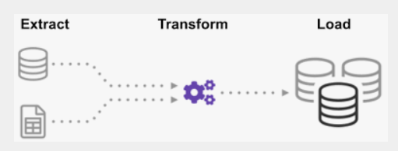

Slide 270
Transformations
DataFrame APIs
selection
filter
sort
set
join
aggregation
groupBy
window
sample
DataFrame Built-in Functions
New Column
Encryption
String
RegExp
Date
Null
Collection
Na
Math & Statistics
Explode & Flatten
Formatting
Json
Other
Extraction
csv
text
parquet
orc
avro
json
hive
jdbc
Part1
Part3
Part2

Slide 271
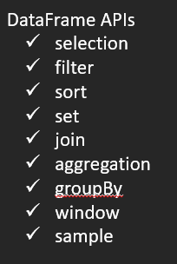
Part 1
DataFrame APIs

Slide 272
DataFrame APIs : Selection APIs

Slide 273
### Prepare Data
ord = spark.read.load('retail_db/orders',sep=',',format='csv',schema=('order_id int,order_date timestamp, order_customer_id int,order_status string'))
data=(('Robert',35,40,40),('Robert',35,40,40),('Ram',31,33,29),('Ram',31,33,91))
emp = spark.createDataFrame(data=data,schema=('name','score1','score2','score3'))

Slide 274
Selection or Projection APIs
Select(*cols)
Select one or more columns.
ord.select(ord.order_id,'order_id',"order_id", (ord.order_id +100).alias("order10")).show()
Can apply necessary functions on the selected columns.
ord.select(lower(ord.order_status)).show()
selectExpr(*expr)
This is a variant of select that accepts SQL expressions.
ord.selectExpr('substring(order_date,1,10) as order_month').show()
ord.select(substring(ord.order_date,1,4).alias('order_year')).show()
If we want to use any functions available in SQL but not in Spark Built-in functions, then we can use selectExpr.
stack(n, expr1, ..., exprk) - Separates expr1, ..., exprk into n rows.
df.selectExpr("stack(3,1,2,3,4,5,6)").show()

Slide 275
Selection or Projection APIs
withColumn(colName, col)
Applied transformation to only selected columns.
The first argument is an alias name. If we give an alias name same as a column name, the transformations will apply on the same column.
Otherwise a new column will be formed. Avoid giving alias name same as column name.
ord.withColumn('order_month',substring(orderDF.order_date,1,10)).show()
withColumnRenamed(existingCol, newCol)
Rename Existing Column.
ord.withColumnRenamed('order_id','order_id1').show()

Slide 276
Selection or Projection APIs
drop(*cols)
Drop a column.
order = ord.drop('order_id','order_date')
dropDuplicates(subset=None)
Drop duplicate rows.
Optionally can consider only subset of columns.
emp.dropDuplicates().show()
emp.dropDuplicates(("name","score1","score2")).show()

Slide 277
DataFrame APIs : Filter APIs

Slide 278
### Prepare Data
ord = spark.read.load('retail_db/orders',sep=',',format='csv',schema=('order_id int,order_date timestamp, order_customer_id int,order_status string'))

Slide 279
Filter APIs
filter(condition): (Its alias ‘where’)
Filter rows using a given condition.
use '&' for 'and‘. '|' for 'or‘. (boolean expressions)
Use column function isin() for multiple search.
Or use IN Operator for SQL Style syntax.
ord.where((ord.order_id > 10) & (ord.order_id < 20)).show()
--Using isin()
ord.where(ord.order_status.isin('COMPLETE','CLOSED')).show()
--Using IN Operator
ord.where("order_status IN ('COMPLETE','CLOSED') ").show()

Slide 280
DataFrame APIs : Sort APIs

Slide 281
### Prepare Data
ord = spark.read.load('retail_db/orders',sep=',',format='csv',schema=('order_id int,order_date timestamp, order_customer_id int,order_status string'))
data=(('a',1),('d',4),('c',3),('b',2),('e',5))
df = spark.createDataFrame(data=data,schema='col1 string,col2 int')

Slide 282
Sorting APIs
sort() or orderBy():
Sort specific column(s).
ord.sort(ord.order_date.desc(),ord.order_status.asc()).show()
ord.sort(ord.order_date,ord.order_status,ascending=(0,1)).show() #1 Ascending, 0 Descending
sortWithinPartitions:
At time, we may not want sort globally, but with in a group. In that case we can use sortWithinPartitions.
df.sortWithinPartitions(df.col1.asc(),df.col2.asc()).show()

Slide 283
DataFrame APIs : Set Operators

Slide 284
Set Operator APIs
union() and unionAll():
Same and contains duplicate values.
Use distinct after union or unionAll to remove duplicates .
unionByName():
The difference between this function and :func:`union` is that this function
resolves columns by name (not by position)
df1 = spark.createDataFrame(data=(('a',1),('b',2)),schema=('col1 string,col2 int'))
df2 = spark.createDataFrame(data=((2,'b'),(3,'c')),schema=('col2 int,col1 string'))
df1.union(df2).show()
df1.unionByName(df2).show()
intersect(): Containing rows in both DataFrames. Removed duplicates.
intersectAll(): Same as intersect. But retains the duplicates.
df1 = spark.createDataFrame(data=(('a',1),('a',1),('b',2)),schema=('col1 string,col2 int'))
df2 = spark.createDataFrame(data=(('a',1),('a',1),('c',2)),schema=('col1 string,col2 int'))
df1.intersect(df2).show()
df1.intersectAll(df2).show()
exceptAll(): Rows present in one DataFrame but not in another.
df1.exceptAll(df2).show()

Slide 285
DataFrame APIs : Join

Slide 286
Join APIs
Join Type | ~ SQL Join
inner | INNER JOIN, JOIN
outer, full, fullouter, full_outer | FULL OUTER JOIN
left, left_outer,leftouter | LEFT JOIN
right,right_outer,rightouter | RIGHT JOIN
cross | CROSS JOIN
left_anti, leftanti
leftsemi,left_semi
PT: Semi joins performs better than inner joins. Use them wherever possible.

Slide 287
Join APIs
join (otherDF, on=None, how=None)
on: Joining Column
how: 'inner', 'outer', 'full', 'fullouter', 'full_outer', 'leftouter', 'left', 'left_outer', 'rightouter', 'right', 'right_outer', 'leftsemi', 'left_semi', 'leftanti', 'left_anti', 'cross'.
df1 = spark.createDataFrame(data=((1,'Robert'),(2,'Ria'),(3,'James')),schema='empid int,empname string')
df2 = spark.createDataFrame(data=((2,'USA'),(4,'India')),schema='empid int,country string')
df1.join(df2,df1.id == df2.id,'inner').select(df1.id,df2.country).show()
crossJoin(self, other)
self Join
df1 = spark.createDataFrame(data=((1,'Robert',2),(2,'Ria',3),(3,'James',5)),schema='empid int,empname string,managerid int')
df1.alias("emp1").join(df1.alias("emp2"),col("emp1.managerid") == col("emp2.empid"),'inner').select(col("emp1.empid"),col("emp1.empname"),col("emp2.empid").alias("managerid"),col("emp2.empname").alias("managaer_name")).show()
Use of col(): Sometimes we need to use the column name which is the alias of a withColumn. In that case we need to refer the column name as col(column _name).
pyspark.sql.functions import col

Slide 288
Join APIs
Multi Column Join
df1 = spark.createDataFrame(data=((1,101,'Robert'),(2,102,'Ria'),(3,103,'James')),schema='empid int,deptid int,empname string')
df2 = spark.createDataFrame(data=((2,102,'USA'),(4,104,'India')),schema='empid int,deptid int,country string')
df1.join(df2,(df1.empid == df2.empid) & (df1.deptid == df2.deptid)).show()
Multi DataFrame Join
df1 = spark.createDataFrame(data=((1,'Robert'),(2,'Ria'),(3,'James')),schema='empid int,empname string')
df2 = spark.createDataFrame(data=((2,'USA'),(4,'India')),schema='empid int,country string')
df3 = spark.createDataFrame(data=((1,'01-jan-2021'),(2,'01-feb-2021'),(3,'01-mar-2021')),schema='empid int,joindate string')
df1.join(df2,df1.empid==df2.empid).join(df3,df1.empid == df3.empid).show()

Slide 289
DataFrame APIs : Aggregation

Slide 290
Aggregation APIs
summary
df.summary("count", "min", "25%", "75%", "max").show()
df.select("age", "name").summary("count").show()
avg, max, min
ordItems.select(avg(ordItems.price)).show()
sum, sumDistinct
ordItems.select(sum(ordItems.price), sumDistinct(ordItems.price)).show()
count, countDistinct
ordItems.select(count(ordItems.order_item_product_id),countDistinct(ordItems.order_item_product_id).show()
first,last
ordItems.sort(ordItems.price.asc()).select(first(ordItems.price)).show()
collect_set, collect_list
df = spark.createDataFrame(((1,100),(2,150),(3,200),(4,50),(5,50)),schema='id int,salary int')
df.select(collect_list(df.salary)).show(truncate=False)
skewness
variance
stddev

Slide 291
DataFrame APIs : groupBy

Slide 292
GroupBy API
When we apply groupBy on a DataFrame Column, it returns GroupedData object. It has below aggregate functions:
avg(),mean()
count()
min()
max()
sum()
agg() →For multiple aggregations at once
pivot()
apply()
data = (("James","Sales","NY",9000,34),
("Alicia","Sales","NY",8600,56),
("Robert","Sales","CA",8100,30),
("Lisa","Finance","CA",9000,24),
("Deja","Finance","CA",9900,40),
("Sugie","Finance","NY",8300,36),
("Ram","Finance","NY",7900,53),
("Kyle","Marketing","CA",8000,25),
("Reid","Marketing","NY",9100,50)
)
schema=("empname","dept","state","salary","age")
df = spark.createDataFrame(data=data,schema=schema)
df.groupBy(df.dept)
<pyspark.sql.group.GroupedData object at 0x7f68eaead690>

Slide 293
GroupBy API
Using avg(),sum(),min(),max(),count(),agg()
Ex-1 (Using 1 column)
df.groupBy(df.dept).avg("salary").show()
Ex-2 (Multiple Columns)
df.groupBy(df.dept,df.state).min("salary","age").show()
Ex-3 (Using Agg() many aggregations)
df.groupBy(df.dept).agg(min("salary").alias('min_salary'),
max("salary").alias('max_salary'),
avg("salary").alias('avg_salary')
).show()
Ex-4 (Using filter or where)
df.where(df.state == 'NY').groupBy(df.dept).agg(min("salary").alias('min_salary')).where(col("min_salary") > 8000).show()

Slide 294
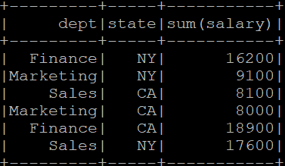
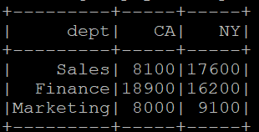
GroupBy API
Using pivot():
Transpose rows into columns.
Ex-
df_t = df.groupBy(df.dept).pivot("state").sum("salary")

Slide 295
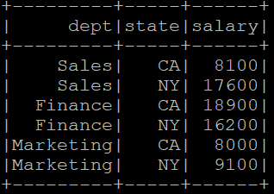
GroupBy API
Using unpivot:
Ex-
There is no such function as unpivot. We can do it using stack() function in a selectExpr.
stack(n, expr1, ..., exprk) - Separates expr1, ..., exprk into n rows. Uses column names col0, col1, etc. by default unless specified otherwise.
spark.sql(""" select stack(3,1,2,3,4,5,6) """).show()
spark.sql(""" select dept, stack(2,'CA',CA,'NY',NY) as (state,salary) from d """).show()
df_t.selectExpr("dept","stack(2,'CA',CA,'NY',NY) as (state,salary)").show()

Slide 296
GroupBy API
/* Not Recorderd */
Using apply(pandas_udf):
Takes a pandas udf and apply it to the current dataframe and returns a dataframe.
Pandas_udf is available in pyspark.sql.functions
pandas_udf(f=None, returnType=None, functionType=None)
f →Function. Optional. User Defined Function.
returnType →Optional. The return type of user defined function.
functionType → Optional. A value in pyspark.sql.functions.pandasUDFType. Default:scalar. Exists for compatibility.
Ex-
from pyspark.sql.functions import pandas_udf, PandasUDFType
df = spark.createDataFrame(((1, 1.0), (1, 2.0), (2, 3.0), (2, 5.0), (2, 10.0)),("id", "v"))
@pandas_udf("id long, v double", PandasUDFType.GROUPED_MAP) # doctest: +SKIP
def normalize(pdf):
v = pdf.v
return pdf.assign(v=(v - v.mean()) / v.std())
df.groupby("id").apply(normalize).show()

Slide 297
DataFrame APIs : window

Slide 298
Window Functions
Window Functions operates on a group of rows and return a single value for each input row.
Main Package: pyspark.sql.window. It has two classes Window and WindowSpec
Window class has APIs such as partitionBy, orderBy, rangeBetween, rowsBetween.
WindowSpec class defines the partitioning, ordering and frame boundaries. It has also above 4 APIs.
These APIs such partitionBy returns a WindowSpec object.
>>> spec = Window.partitionBy(df.dept)
>>> Window.partitionBy(df.dept)
<pyspark.sql.window.WindowSpec object at 0x7f88d8ef3910>
To perform a window function, we will have to partition the data using Window.partitionBy.
Lets see 3 types of Window Functions:
Ranking
Analytical
Aggregate

Slide 299
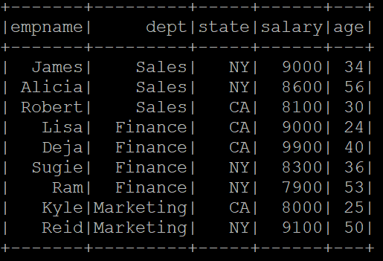
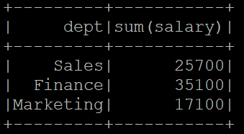
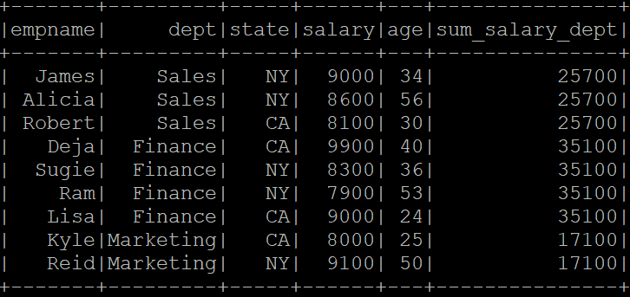
Window Functions
Aggregate Function
Analytical Function

Slide 300
Window Functions
--Prepare Input Data
data = (("James","Sales","NY",9000,34),
("Alicia","Sales","NY",8600,56),
("Robert","Sales","CA",8100,30),
("John","Sales","AZ",8600,31),
("Ross","Sales","AZ",8100,33),
("Kathy","Sales","AZ",1000,39),
("Lisa","Finance","CA",9000,24),
("Deja","Finance","CA",9900,40),
("Sugie","Finance","NY",8300,36),
("Ram","Finance","NY",7900,53),
("Satya","Finance","AZ",8200,53),
("Kyle","Marketing","CA",8000,25),
("Reid","Marketing","NY",9100,50)
)
schema=("empname","dept","state","salary","age")
df = spark.createDataFrame(data=data,schema=schema)

Slide 301
Window Functions
Ranking Window Functions: Used to provide a ranking to the result within a partition.
row_number() : Sequential Row Number.
rank() : Ranks but gaps when ties.
dense_rank() : Ranks with out any gaps.
percent_rank: Relative rank (i.e. percentile) of rows within a window partition. First row is always 0 and last row is always 1.
ntile() :returns the ntile group id (from 1 to n inclusive) in an ordered window partition. For example, if n is 4, the first quarter of the rows will get value 1, the second quarter will get 2, the third quarter will get 3, and the last quarter will get 4.
cume_dist():Returns the cumulative distribution of values within a window partition,
i.e. the fraction of rows that are below the current row.
Ex –
from pyspark.sql.window import *
from pyspark.sql.functions import *
spec = Window.partitionBy("dept").orderBy("salary")
df.select(df.dept,df.salary) \
.withColumn("row_number",row_number().over(spec))\
.withColumn("rank",rank().over(spec))\
.withColumn("dense_rank",dense_rank().over(spec))\
.withColumn("percent_rank",percent_rank().over(spec))\
.withColumn("cume_dist",cume_dist().over(spec))\
.withColumn("ntile",ntile(3).over(spec))\
.show()

Slide 302
Window Functions
Analytical Window Functions:
lag() : Return offset row value before the current row value.
lead() : Return offset row value after the current row value.
Ex -
df.select(df.dept,df.salary) \
.withColumn("lag_prev_sal",lag("salary",1,0).over(spec)) \
.withColumn("lead_next_sal",lead("salary",1,0).over(spec)) \
.show()

Slide 303
Window Functions
Aggregate Window Functions:
avg
sum()
max()
min()
count()
first()
last()
Ex –
spec = Window.partitionBy("dept")
df.select(df.dept,df.salary) \
.withColumn("sum_sal",sum("salary").over(spec)) \
.withColumn("max_sal",max("salary").over(spec)) \
.withColumn("min_sal",min("salary").over(spec)) \
.withColumn("avg_sal",avg("salary").over(spec)) \
.withColumn("count_sal",count("salary").over(spec)) \
.show()
Ex –
spec = Window.partitionBy("dept").orderBy("salary")
df.select(df.dept,df.salary) \
.withColumn("first_sal",first("salary").over(spec)) \
.withColumn("last_sal",last("salary").over(spec)) \
.show()

Slide 304
Window Functions
rangeBetween:
Takes two argument (start,end) to define frame boundaries.
Default : unboundedPreceding and unboundedFollowing.
Both `start` and `end` are relative from the current row. For example, "0" means "current row", while "-1" means one off before the current row, and "5" means the five off after the current row.
Recommend to use ``Window.unboundedPreceding``, ``Window.unboundedFollowing``, and ``Window.currentRow`` to specify special boundary values, rather than using integral values directly.
spec=Window.partitionBy(df.dept).\
orderBy(df.salary). \
rangeBetween(Window.unboundedPreceding, Window.unboundedFollowing)
spec=Window.partitionBy(df.dept).\
orderBy(df.salary). \
rangeBetween(Window.currentRow, Window.unboundedFollowing)
spec=Window.partitionBy(df.dept).\
orderBy(df.salary). \
rangeBetween(Window.currentRow,500)
df.select(df.dept,df.salary).withColumn("sum_sal",sum("salary").over(spec1)).show()

Slide 305
Window Functions
rowsBetween:
Takes two argument (start,end) to define frame boundaries.
Deafult : unboundedPreceding and unboundedFollowing.
Both `start` and `end` are relative from the current row. For example, "0" means "current row", while "-1" means one off before the current row, and "5" means the five off after the current row.
Recommend to use ``Window.unboundedPreceding``, ``Window.unboundedFollowing``, and ``Window.currentRow`` to specify special boundary values, rather than using integral values directly.
spec1=Window.partitionBy(df.dept).\
orderBy(df.salary). \
rowsBetween(Window.unboundedPreceding, Window.unboundedFollowing)
spec1=Window.partitionBy(df.dept).\
orderBy(df.salary). \
rowsBetween(Window.currentRow, Window.unboundedFollowing)
spec1=Window.partitionBy(df.dept).\
orderBy(df.salary). \
rowsBetween(Window.currentRow, 2)
df.select(df.dept,df.salary).withColumn("sum_sal",sum("salary").over(spec1)).show()

Slide 306
Window Functions
rangeBetween(Window.unboundedPreceding, Window.unboundedFollowing)
rowsBetween(Window.unboundedPreceding, Window.unboundedFollowing)
rangeBetween(Window.currentRow, Window.unboundedFollowing)
rowsBetween(Window.currentRow, Window.unboundedFollowing)
dept | salary | sum_sal
Finance | 7900 | 43300
Finance | 8200 | 43300
Finance | 8300 | 43300
Finance | 9000 | 43300
Finance | 9900 | 43300
dept | salary | sum_sal
Finance | 7900 | 43300
Finance | 8200 | 35400
Finance | 8300 | 27200
Finance | 9000 | 18900
Finance | 9900 | 9900

Slide 307
Window Functions
rangeBetween(Window.currentRow, 500)
rowsBetween(Window.currentRow, 2)
dept | salary | sum_sal
Finance | 7900 | 24400
Finance | 8200 | 16500
Finance | 8300 | 8300
Finance | 9000 | 9000
Finance | 9900 | 9900
dept | salary | sum_sal
Finance | 7900 | 24400
Finance | 8200 | 25500
Finance | 8300 | 27200
Finance | 9000 | 18900
Finance | 9900 | 9900

Slide 308
Window Functions
### Prepare Input Data
--df DataFrame
data = (("James","Sales","NY",9000,34),
("Alicia","Sales","NY",8600,56),
("Robert","Sales","CA",8100,30),
("John","Sales","AZ",8600,31),
("Ross","Sales","AZ",8100,33),
("Kathy","Sales","AZ",1000,39),
("Lisa","Finance","CA",9000,24),
("Deja","Finance","CA",9900,40),
("Sugie","Finance","NY",8300,36),
("Ram","Finance","NY",7900,53),
("Satya","Finance","AZ",8200,53),
("Kyle","Marketing","CA",8000,25),
("Reid","Marketing","NY",9100,50)
)
schema=("empname","dept","state","salary","age")
df = spark.createDataFrame(data=data,schema=schema)
--df1 DataFrame
df1 = spark.range(10)

Slide 309
DataFrame API: Sampling

Slide 310
sample(withReplacement=None, fraction=None, seed=None):
To get random sample records from the dataset.
withReplacment: True or False. With True, Same result can be produced more than once.
Fraction: Between 0 to 1. 0.3 means 30%. Does not guarantee the exact 30% of the records.
Seed: Reproduce the same sample.
Ex-
dataset=spark.range(100)
dataset.sample(withReplacement=True,fraction=0.07,seed=10).show()
sampleBy(col, fractions, seed=None):
Returns a stratified sample without replacement based on the fraction given on each stratum.
If a stratum is not specified, we treat its fraction as zero.
Ex-
from pyspark.sql.functions import col
dataset = spark.range(0, 100).select((col("id") % 3).alias("key"))
sampled = dataset.sampleBy("key", fractions={0: 0.1, 1: 0.2}, seed=0)
sampled.groupBy("key").count().orderBy("key").show()

Slide 311
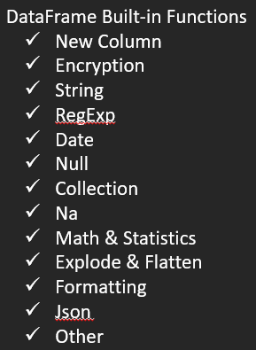
Part 2
DataFrame Built-in Functions

Slide 312
DataFrame APIs : New Column Functions

Slide 313
New Columns Functions:
Window Ranking Functions( dense_rank, rank, row_number etc) :
monotonically_increasing_id():
A column that generates monotonically increasing 64-bit integers.
The generated ID is guaranteed to be monotonically increasing and unique, but not consecutive.
Use Case: Create a Primary Key/Unique column.
df.withColumn('id',monotonically_increasing_id()).show()
lit():
It creates a static column with value is provided.
df.withColumn('col',f.lit(10)).show()
Can also be used to concat columns.
df.select(concat('salary',lit('|'),'age').alias('value')).show()

Slide 314
New Columns Functions:
expr(str):
It takes SQL Expression as a string argument, executes the expression and returns a Column Type.
Ex - df.withColumn('empname_len',expr("length(empname)")).show()
We can use SQL-like functions that are not present in pyspark column type and built-in functions(pyspark.sql.functions).
For example – CASE WHEN, Concat operator || etc
df.withColumn(age_desc",expr(" case when age > 50 then 'Senior' else 'Adult' end")).show()
df.withColumn('emp-dept',expr(" empname ||'-'|| dept")).show()
Arithmatic Expression
df.select(expr(" age + 10 as age_10 ")).show()
Spark do not check this in the compile type like other DataFrame Operations.
spark_partition_id():
Generates a column with partitions ids.
Ex-
df1 = spark.range(10)
df1.repartition(5)
df1=df1.repartition(5)
df1.select("id",spark_partition_id()).show()

Slide 315

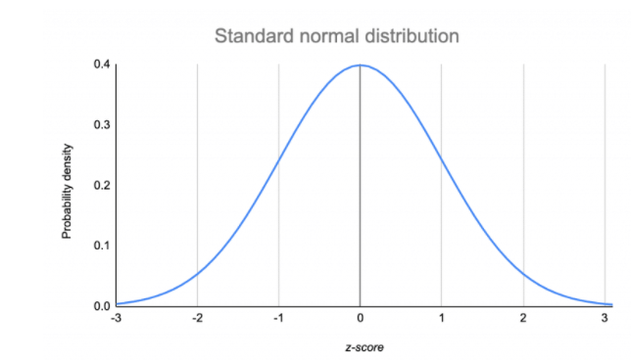
New Columns Functions:
rand(seed):
Generates a random column with independent and identically distributed (i.i.d.) samples from uniform distribution.
df.withColumn('random_col',rand(70)).show(truncate=False)
randn(seed):
Generates a column with independent and identically distributed (i.i.d.) samples from the standard normal distribution.
Uniform Distribution
Standard Distribution

Slide 316
DataFrame APIs : Column Encryption Functions

Slide 317
Column Encryption Functions
sha1(col):
Used for Encryption.
Returns the hex string result SHA-1 Family.
Only for string columns. Convert the int column to string.
df.select(df.age,sha1(df.age.cast('string'))).show(truncate=False)
sha2(col,numBits):
Used for Encryption.
Returns the hex string result of SHA-2 family.
numBits : 0, 224, 256, 384, 512
df.select(df.age,sha2(df.age.cast('string'))).show(truncate=False)
hash(*cols):
Any type of column or combination of columns.
Calculates the hash code of given columns and return result as int column.
May be used for Encryption.
df.select(df.age,hash(df.age)).show(truncate=False)
md5(cols):
Calculates the MD5 digest and returns the value as a 32 character hex string.
df.select(df.age,md5(df.age)).show(truncate=False)

Slide 318
DataFrame APIs : String Functions

Slide 319
String Manipulation Functions
split(str, pattern) : Splits str around pattern (pattern is a regular expression).
Ex-1
df = spark.createDataFrame((('ab12cd23fe27kl',)), ('s',))
df.select(split(df.s,'(0-9)+')).show(truncate=False)
Ex-2
ord.select(split(ord.order_date,'-')).show(truncate=False)
length(col): Computes the character length of string.
ordDF.select(length(ordDF.order_status)).distinct().show()
lower(col), upper(col), initcap(col):
ltrim(col),rtrim(col),trim(col):
lpad(col,len,pad), rpad(col,len,pad): Pad the string column to width `len` with `pad`.
reverse(col): Returns a reversed string.
repeat(col, n): Repeats a string column n times.
hex(col): Computes hex value of the given column.

Slide 320
String Manipulation Functions
concat(*cols): Concatenates multiple input columns together into a single column
ord.withColumn('IDStatus',concat(ord.order_id,ord.order_status)).show()
concat_ws(sep, *cols): Concatenates multiple input string columns together into a single string column, using the given separator.
ord.withColumn('IDStatus',concat_ws('-',ord.order_id,ord.order_status)).show()
substring(str, pos, len): Substring starts at `pos` and is of length `len` when str is String type.
ord.withColumn('orderYear',substring(ord.order_date,1,4)).show()
substring_index(str, delim, count):Returns the substring from string str before count occurrences of the delimiter delim. If count is positive, everything the left of the final delimiter (counting from left) is returned. If count is negative, every to the right of the final delimiter (counting from the right) is returned. substring_index performs a case-sensitive match when searching for delim.
ord.withColumn('sub',substring_index(ord.order_date,'-',1)).show()
instr(str, substr): Locate the position of the first occurrence of substr column in the given string.
Returns null if either of the arguments are null.
ord.withColumn('instr',instr(ord.order_status,'LO')).show()

Slide 321
String Manipulation Functions
locate(substr, str, pos=1): Locate the position of the first occurrence of substr in a string column, after position pos. The position is not zero based, but 1 based index. Returns 0 if substr could not be found in str.
ord.withColumn('instr',locate('00',ord.order_date,2)).show()
translate(srcCol, matching, replace): Translate any character in the `srcCol` by a character in `matching`.
df = spark.createDataFrame((('translate',)), ('col'))
df.select(translate(df.col, "rnlt", "123")).show()

Slide 322
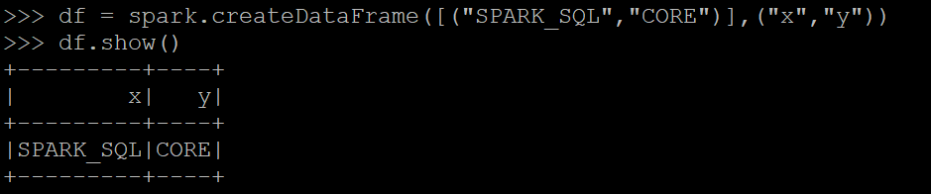
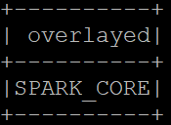
String Manipulation Functions
overlay(src,replace,pos,len): New in version 3.0. Overlay the specified portion of src with replace starting from the byte position pos of src and proceeding for len bytes.

Slide 323
DataFrame APIs : RegExp Functions

Slide 324
regexp_extract(str, pattern, idx):
We can extract a pattern.
str: string or column from which we want to extract data.
pattern: pattern-regex pattern.
idx: Group Number to extract
df=spark.createDataFrame(data=(('11ss1 ab',)),schema=('str'))
df.select(df.str,regexp_extract(df.str,'(\d+)(\w+)(\s)((a-z)+)',1).alias('op')).show()
regexp_replace(str, pattern, replacement):
We can replace a column value with a string for another string or substring.
Returns empty string if does not match.
df.select(regexp_replace(lit('11ss1 ab'),'(\d+)','xx').alias('op')).show()
Use when() for conditional replace.
addr = ((1,"2625 Indian School Rd","Phoenix"),
(2,"1234 Thomas St","Glendale"))
df =spark.createDataFrame(address,("id","addr","city"))
df.withColumn('new_addr',
when(df.addr.endswith('Rd'),regexp_replace(df.addr,'Rd','Road')) \
.when(df.addr.endswith('St'),regexp_replace(df.addr,'St','Street')) \
.otherwise(df.addr)) \
.show(truncate=False)
Quantifier | Meaning
\d | Matches digits 0-9.
\w | Matches alphabets and digits.
\s | Matches space.
. | Matches any character except newline.
? | 0 or more character.
+ | 1 or more character.
(a-zA-Z) | Anything in range a-z and A-Z.

Slide 325
rlike():
Not a dataframe function but a column function we can use to check if a pattern is found or not.
df.select(df.str.rlike('(\d+)')).show()

Slide 326
DataFrame APIs : Date Functions

Slide 327
### Prepare Data
ord = spark.read.load('retail_db/orders',sep=',',format='csv',schema=('order_id int,order_date timestamp, order_customer_id int,order_status string'))
ord_new = ord.withColumn('new_order_date',date_add(ord.order_date,50))

Slide 328
current_date():
Returns the current date.
df.select(current_date()).show()
current_timestamp():
next_day(date, dayOfWeek):
Returns the first date which is later than the value of the date column.
dayOfWeek - "Mon", "Tue", "Wed", "Thu", "Fri", "Sat", "Sun“.
ord.select(ord.order_date,next_day(ord.order_date,'Fri')).distinct().show()
last_day(date):
Returns the last day of the month which the given date belongs to.
ord.select(ord.order_date,last_day(ord.order_date)).distinct().show()
dayofweek(col):
dayofmonth(col):
dayofyear(col):
weekofyear(col):

Slide 329
second(col):
Extract the seconds of a given date as integer.
ord.select(current_timestamp(),second(current_timestamp())).distinct().show(truncate=False)
minute(col):
hour(col):
month(col):
quarter(col):
year(col):
months_between(date1, date2, roundOff=True)
The result is rounded off to 8 digits unless `roundOff` is set to `False`.
ord_new.select(ord_new.order_date,ord_new.new_order_date,months_between(ord_new.order_date,ord_new.new_order_date,roundOff=False)).show()
date_add(start, days) : Add Number Of Days.
ord.withColumn('new_order_date',date_add(ord.order_date,50)).show()
date_sub(start, days) : Subtract Number Of Days.
ord.withColumn('new_order_date',date_sub(ord.order_date,50)).show()
add_months(start, months): Add Number of months.
ord.withColumn('new_order_date',add_months(ord.order_date,3)).show()
datediff(end, start): Returns the number of days from `start` to `end`.
ord_new.select(datediff(ord_new.new_order_date,ord_new.order_date)).show()

Slide 330
date_trunc(format, timestamp)
Returns timestamp truncated to the unit specified by the format.
format: 'year', 'yyyy', 'yy', 'month', 'mon', 'mm', 'day', 'dd', 'hour', 'minute', 'second', 'week', 'quarter' .
ord.withColumn('new_order_date',date_trunc('yyyy',ord.order_date)).show()
date_format(date, format):
Converts a date/timestamp/string to a value of string in the format specified by the date.
ord.withColumn('new_order_date',date_format(ord.order_date,'yyyy/MM/dd')).show(5)
unix_timestamp(timestamp=None, format='yyyy-MM-dd HH:mm:ss'):
Convert time string with given pattern ('yyyy-MM-dd HH:mm:ss', by default) to Unix time stamp (in seconds), using the default timezone and the default locale, return null if fail.
ord.withColumn('new_order_date',unix_timestamp(ord.order_date)).show(5)
to_timestamp(col, format=None): Converts a Column into timestamp type.
df = spark.createDataFrame((('1997-02-28 10:30:00',)), ('t'))
df.select(to_timestamp(df.t).alias('dt')).show()

Slide 331
from_unixtime(timestamp, format='yyyy-MM-dd HH:mm:ss'):
Converts the number of seconds from unix epoch (1970-01-01 00:00:00 UTC) to a string representing the timestamp of that moment in the current system time zone in the given format.
time_df = spark.createDataFrame(((1428476400,)), ('unix_time'))
time_df.select(from_unixtime('unix_time').alias('ts')).collect()
from_utc_timestamp(timestamp, tz):
This is a common function for databases supporting TIMESTAMP WITHOUT TIMEZONE. This function takes a timestamp which is timezone-agnostic, and interprets it as a timestamp in UTC, and renders that timestamp as a timestamp in the given time zone.
df = spark.createDataFrame((('1997-02-28 10:30:00', 'JST')), ('ts', 'tz'))
df.select(from_utc_timestamp(df.ts, "PST").alias('local_time')).collect()
df.select(from_utc_timestamp(df.ts, df.tz).alias('local_time')).collect()

Slide 332
to_date(col, format=None):
Converts a string type or timestamp type into date type using the optionally specified format.
ord.select(ord.order_date,to_date(ord.order_date,'yyyy-mm-dd')).show()
to_timestamp(col, format=None):
df.select(df.t,to_timestamp(df.t).alias('dt')).show()

Slide 333
DataFrame APIs : Null Functions

Slide 334
###Prepare Data
df = spark.createDataFrame((('Robert',1, None,114.0), ('John',None, 2577,float('nan'))), ("name", "id","phone","stAdd"))
Isnull(col): Returns true if the column is null.
df.select(isnull(df.id)).show()
Isnan(col): Returns true if the column is NaN.
df.select(isnan(df.stAdd)).show()
nanvl(col1, col2): Returns col1 if it is not NaN, or col2 if col1 is NaN.
df.select(df.stAdd,df.phone,nanvl(df.stAdd,df.phone)).show()
coalesce(*cols): Returns the first column that is not null.
df.select(df.phone,df.stAdd,coalesce(df.phone,df.stAdd)).show()

Slide 335
DataFrame APIs : Collection Functions

Slide 336
### emp1 DataFrame
data =(('Alicia','Joseph',('Java','Scala','Spark'),{'hair':'black','eye':'brown'}), \
('Robert','Gee',('Spark','Java'),{'hair':'brown','eye':None}), \
('Mike','Bianca',('CSharp',''),{'hair':'red','eye':''}), \
('John','Kumar',None,None), \
('Jeff','L',('1','2'),{}))
schema = ('FirstName','LastName','Languages','properties')
emp1 = spark.createDataFrame(data=data,schema=schema)
### emp2 DataFrame
data=(('Robert',35,40,40),('Ram',31,33,29),('John',95,89,91))
schema = ('name','score1','score2','score3')
emp2= spark.createDataFrame(data=data, schema=schema)
### emp3 DataFrame
emp3 = spark.createDataFrame(data=(('John',(10,20,20),(25,11,10)),('Robert',(15,13,55),(5,None,29)),('James',(11,13,45),(5,89,79))),schema=('empName', 'score_arr1', 'score_arr2'))
### df DataFrame
df = spark.sql("SELECT array(struct(1, 'a'), struct(2, 'b')) as data")

Slide 337
size(col):
Returns the length of the array or map stored in the column.
Size is -1 for null elements.
emp1.select(size(emp1.Languages),size(emp1.properties)).show()
element_at(col,extraction):
Returns element of array at given index in extraction if col is array.
Returns value for the given key in extraction if col is map.
emp1.select(emp1.FirstName,element_at(emp1.Languages,2),element_at(emp1.properties,'eye')).show()
struct(*cols) :
Create a new struct column.
emp_new = emp1.select(struct((emp1.FirstName,emp1.LastName)))

Slide 338
array(*cols):
Creates a new array column.
emp_new = emp2.select(array(emp2.score1,emp2.score2,emp2.score3))
array_max(col), array_min(col):
Returns maximum or minimum values of an array column.
emp3.select(array_max("score_arr1")).show()
array_distinct(col):
Returns distinct values of an array column.
emp3.select(array_distinct("score_arr1")).show()
array_repeat(col,count):
Repeated count times.
emp3.select(array_repeat("score_arr1",3)).show(truncate=False)
--Flatten the array and chose the distinct values
emp3.select(array_distinct(flatten(array_repeat("score_arr1",3)))).show(truncate=False)
slice(col,start,length)
Returns an array containing all the elements in `col` from index `start` for length `length`.
col is Array Type.
emp1.select(emp1.Languages,slice(emp1.Languages,3,1)).show()

Slide 339
array_position(col,value):
Locates the position of the first occurrence of the given value in the given array.
Starts with Index 1.
emp3.select(emp3.score_arr1,array_position(emp3.score_arr1,27)).show()
array_remove(col,element):
Remove all elements that equal to element from the given array.
emp3.select(array_remove("score_arr1",20)).show()
array_sort(col):
Sorts the input array in ascending order.
The elements of the input array must be orderable.
Null elements will be placed at the end of the returned array.
emp3.select("score_arr1",array_sort("score_arr1")).show()
sort_array(col,asc=True):
Sorts the input array in ascending or descending order according to the natural ordering of the array elements.
Null elements will be placed at the beginning of the returned array in ascending order or at the end of the returned array in descending order.
emp3.select(emp3.score_arr1,sort_array(emp3.score_arr1,asc=False)).show()
array_contains(col, value):
Returns null if the array is null, true if the array contains the given value, and false otherwise.
emp3.select(array_contains(emp3.score_arr1,55)).show()

Slide 340
array_union(col1,col2):
Returns an array of the elements in the union of col1 and col2 without duplicates.
emp3.select(array_union(emp3.score_arr1,emp3.score_arr2)).show(truncate=False)
array_except(col1, col2):
Returns an array of the elements in col1 but not in col2 without duplicates.
emp3.select(array_except(emp3.score_arr1,emp3.score_arr2)).show(truncate=False)
array_intersect(col1, col2):
Returns an array of the elements in the intersection of col1 and col2 without duplicates.
emp3.select(array_intersect(emp3.score_arr1,emp3.score_arr2)).show(truncate=False)
array_join(col, delimiter, null_replacement=None):
Concatenates the elements of `column` using the `delimiter`.
Null values are replaced with `null_replacement` if set, otherwise they are ignored.
emp3.select(emp3.score_arr2,array_join(emp3.score_arr2,'#',null_replacement="1")).show()
arrays_zip(*cols):
Merge arrays. First element of array1 will be merged with first element of array 2 and so on.
emp3.select(arrays_zip(emp3.score_arr1,emp3.score_arr2)).show(truncate=False)

Slide 341
arrays_overlap(a1,a2):
Returns true if the arrays contain any common non-null element;
Returns null if both the arrays are non-empty and any of them contains a null element
Returns false otherwise.
emp3.select(arrays_overlap(emp3.score_arr1,emp3.score_arr2)).show(truncate=False)
shuffle(col):
Random shuffle an array.
emp3.select(emp3.score_arr1,shuffle(emp3.score_arr1)).show()

Slide 342
create_map(*cols):
Create a new map column.
emp1.select(create_map(emp1.FirstName,emp1.LastName)).printSchema()
map_from_entries(col):
col is array of paired structs.
Function returns a map created from the given array of entries.
df.select(map_from_entries("data").alias("map")).show()
map_from_arrays(col1,col2):
Creates a new map from two arrays.
emp3.select(map_from_arrays(emp3.score_arr1,emp3.score_arr2)).printSchema()
map_keys():
Returns an unordered array containing the keys of the map.
emp1.select(map_keys(emp1.properties)).show()
map_values():
Returns an unordered array containing the values of the map.
emp1.select(map_values(emp1.properties)).show()
map_concat(*cols):
Returns the union of all the given maps.
emp1.select(map_concat(emp1.properties,emp1.properties)).show(truncate=False)

Slide 343
sequence(start, stop, step =1):
Generate a sequence of integers from `start` to `stop`, incrementing by `step`.
If `step` is not set, incrementing by 1 if `start` is less than or equal to `stop`, otherwise -1.
emp2.select(emp2.score1, emp2.score2,sequence(emp2.score1,emp2.score2).alias('new_col')).show(truncate=False)

Slide 344
DataFrame APIs : na Functions

Slide 345
na Functions
Na Functions are used to work with missing data.
drop(how='any', thresh=None, subset=None):
Remove rows with NULL Values.
how: any or all.
If 'any', drop a row if it contains any nulls.
If 'all', drop a row only if all its values are null.
Thresh : If specified, drop rows that have less than `thresh` non-null values. This overwrites the `how` parameter.
Subset: optional list of column names to consider.
Ex- data=(('Alice',80,10),('Bob',None,5),('Tom',50,50),(None,None,None),('Robert',30,35))
schema='name string, age int, height int'
df = spark.createDataFrame(data,schema)
df.na.drop().show()

Slide 346
na Functions
fill(value, subset=None):
Replace null values.
value : Value to replace null values with.
subset: Optional list of column names to consider.
df.na.fill(50).show() #String Columns are ignored.
df.na.fill('Ram').show() #Non-String Columns are ignored.
df.na.fill({'age' : 50, 'name' : 'Ram' }).show()
df.na.fill(value=100,subset='height').show()
replace(to_replace, value=<no value>, subset=None)
df.na.replace(10,20).show()
df.na.replace({'Alice':'Alex','Bob': 'Cob'},subset='name').show()

Slide 347
DataFrame APIs : Mathematics and Statistics Functions

Slide 348
Mathematics Functions
abs(col):
Compute the absolute value.
df1.select(df1.col1,abs(df1.col1)).show()
exp(col):
Computes the exponential of the given value.
df1.select(df1.col1,exp(df1.col1)).show()
factorial(col):
Computes the factorial of the given value.
df1.select(df1.col1,factorial(df1.col1)).show()
sqrt(col):
cbrt(col) :
pow(col,n):
df.select(df.age,sqrt(df.age),cbrt(df.age),pow(df.age,2)).show()
floor():
ceil():
df2.select(df2.col1,floor(df2.col1),ceil(df2.col1)).show()

Slide 349
Mathematics Functions
round(col,scale=0):
df2.select(df2.col1,round(df2.col1,2)).show()
trunc(col,format):
Format : 'year', 'yyyy', 'yy' or 'month', 'mon', 'mm'
ord.select(ord.order_date,trunc(ord.order_date,'year')).show()
signum(): 1 if n > 0, 0 if n = 0, -1 if n < 0)
df2.select(df2.col1,signum(df2.col1)).show()
avg(col):
sum(col):
sumDistinct(col):
mean(col):
Count(col):
countDistinct(col):
min(col):
max(col):

Slide 350
Statistics Functions
corr(col1,col2):
Return Pearson Correlation Coefficient.
df.select(corr(df.salary,df.age)).show()
covar_pop(col1, col2):
Return population covariance.
df.select(covar_pop(df.salary,df.age)).show()
covar_samp(col1, col2):
Return sample covariance.
var_pop(col): Return population variance of the values in a group.
var_samp(col): Returns the unbiased variance of the values in a group.
variance(col): Returns the population variance of the values in a group.
stddev(col): Returns the unbiased sample standard deviation of the expression in a group.
stddev_pop(col): Returns population standard deviation of the expression in a group.
stddev_samp(col): Returns the unbiased sample standard deviation of the expression in a group.

Slide 351
DataFrame APIs : Explode and Flatten Functions

Slide 352
explode(col):
Can be used for array and map.
When an array is passed to this function, it creates a new column and each element of the array in a separate row.
When a map is passed to this function, it creates two new columns one for key and one for value.
This will ignore null elements.
data =(('Alicia',('Java','Scala'),{'hair':'black','eye':'brown'}),
('Robert',('Spark','Java',None),{'hair':'brown','eye':None}),
('Mike',('CSharp',''),{'hair':'red','eye':''}),
('John',None,None),
('Jeff',('1','2'),{}))
schema = ('empName','Languages','properties')
emp = spark.createDataFrame(data=data,schema=schema)
emp.select(emp.empName,explode(emp.Languages)).show()
emp.select(emp.empName,explode(emp.properties)).show()
explode_outer(col): In explode nulls are ignored, but in explode_outer nulls are reported.
emp.select(emp.empName,explode_outer(emp.Languages)).show()
posexplode(col): Explode with a separate position/index field. Ignores null values.
emp.select(emp.empName,posexplode(emp.Languages)).show()
emp.select(emp.empName,posexplode(emp.properties)).show()
posexplode_outer(col): Explode with a separate position/index field. Nulls are reported.
emp.select(emp.empName,posexplode_outer(emp.Languages)).show()
emp.select(emp.empName,posexplode_outer(emp.properties)).show()

Slide 353
flatten():
Convert an Array of Array Column to a single Array Column.
ArrayType(ArrayType(StringType)) → ArrayType(StringType)
If a structure of nested arrays is deeper than two levels, only one level of nesting is removed.
Ex-
data =(('Alicia',(('Java'),('Scala'),('Python'))),\
('Robert',((None),('Java'),('Hadoop')))
)
schema = ('empName','ArrayofArray')
emp = spark.createDataFrame(data=data,schema=schema)
emp.select(emp.empName,flatten(emp.ArrayofArray)).show()
Ex-
data =(('Alicia',((1),(2))),\
('Robert',(None,(1)))
)
schema = ('empName','ArrayofArray')
emp = spark.createDataFrame(data=data,schema=schema)
emp.select(emp.empName,flatten(emp.ArrayofArray)).show()

Slide 354
DataFrame APIs : Formatting Functions

Slide 355
### Prepare Data
ordItems=spark.read.load('retail_db/order_items',sep=',',format='csv',schema=('order_item_id int,order_item_order_id int,order_item_product_id int,quantity tinyint,subtotal float,price float'))
df = spark.createDataFrame(((5, "hello")), ('a', 'b'))
format_number(col,d): Formats the number X to a format to d decimal places with HALF_EVEN round mode, and returns the result as a string.
ordItems.select(ordItems.subtotal,format_number(ordItems.subtotal,4)).show()
format_string(format, *cols):
Formats the arguments in printf-style and returns the result as a string column.
df.select(format_string('%d %s', df.a, df.b).alias('v')).show()

Slide 356
DataFrame API: json Functions

Slide 357
### Prepare Data
data=((1,"""{"Zipcode":85016,"ZipCodeType":"STANDARD","City":"Phoenix","State":"AZ"}"""))
df_map=spark.createDataFrame(data,("id","value"))
data = ((1, '''(1, 2, 3)'''))
df_arr=spark.createDataFrame(data,("id","value"))
data=((1, """{"Zipcode":85016,"ZipCodeType":"STANDARD","City":"Phoenix","State":"AZ"}"""))
df_struct=spark.createDataFrame(data,("id","value"))

Slide 358
from_json(col, schema):
Convert a JSON string into a Map Type or StructType or ArrayType.
Returns `null`, in the case of an unparseable string.
--Map Type Ex
schema=MapType(StringType(),StringType())
df_map_new = df_map.withColumn('map_column',from_json(df_map.value,schema))
df_map_new.printSchema()
--Array Type Ex
schema=ArrayType(IntegerType())
df_arr_new = df_arr.withColumn('arr_column',from_json(df_arr.value,schema))
df_arr_new.printSchema()
--Struct Type Ex
schema=StructType((StructField("Zipcode",IntegerType()),StructField("ZipCodeType",StringType()),StructField("city",StringType()),StructField("state",StringType())))
df_struct_new = df_struct.withColumn('struct_column',from_json(df_struct.value,schema))
df_struct_new.printSchema()
Json String Column
Collection Type Column

Slide 359
to_json(col)
Converts a column with StructType or ArrayType or MapType into a JSON string.
Throws an exception, in the case of an unsupported type.
--Using Map Type
df_map_new.select(to_json(df_map_new.map_column)).printSchema()
--Using Array Type
df_arr_new.select(to_json(df_arr_new.arr_column)).printSchema()
--Using Struct Type
df_struct_new.select(to_json(df_struct_new.struct_column)).printSchema()
Collection Type Column
Json String Column

Slide 360
json_tuple(col, *fields):
Extract the elements from JSON string column and create the result as a new columns.
df_map.select(json_tuple(col("value"),"Zipcode","State")).toDF("Zip","State").show()
schema_of_json(json_string):
Use schema_of_json() to create schema string from JSON string column.
schemaOfStr=spark.range(1) \
.select(schema_of_json(lit("""{"id":101, "name":"Robert","City":"Phoenix","State":"AZ"}"""))) \
.collect()(0)(0)
get_json_object(col,path):
Used to extract the JSON string based on path from the JSON column.
df_map.select(col("id"),get_json_object(col("value"),"$.ZipCodeType").alias("ZipCodeType")) \
.show(truncate=False)
Json String Column
New Columns
Json String Column
Schema

Slide 361
DataFrame APIs : Other Aggregate Functions

Slide 362
### Prepare Data
data = (("James","Sales","NY",None,34),
("Alicia","Sales","NY",8600,56),
("Robert","Sales","CA",8100,30),
("John","Sales","AZ",8600,31),
("Ross","Sales","AZ",8100,33),
("Kathy","Sales","AZ",1000,39),
("Lisa","Finance","CA",9000,24),
("Deja","Finance","CA",9900,40),
("Sugie","Finance","NY",8300,36),
("Ram","Finance","NY",7900,53),
("Satya","Finance","AZ",8200,53),
("Kyle","Marketing","CA",8000,25),
("Reid","Marketing","NY",9100,50)
)
schema=("empname","dept","state","salary","age")
df = spark.createDataFrame(data=data,schema=schema)

Slide 363
first(col, ignorenulls=False) :
Returns the first value in a group.
Return the first non-null value it sees when ignoreNulls is set to true.
df.select(first(df.salary)).show()
last(col, ignorenulls=False):
greatest(*cols):
Returns the greatest value of the list of column names, skipping null values.
df.select(greatest(df.salary,df.age)).show()
least(*cols):
Returns the leastvalue of the list of column names, skipping null values.
skewness(col):
Returns the skewness of the values in a group.
df.select(skewness(df.salary)).show()
collect_list(col): Returns a list of objects with duplicates.
df.select(collect_list('age')).show(truncate=False)

Slide 364
DataFrame APIs : Other Misc Functions

Slide 365
###Prepare Data
df = spark.createDataFrame((('Robert',1, None,114.0), ('John',None, 2577,float('nan'))), ("name", "id","phone","stAdd"))
ascii(col):
Computes the numeric value of the first character of the string column.
df.select(ascii(lit('a'))).show()
bin(col):
Returns the string representation of the binary value of the given column.
df.select(df.phone,bin(df.phone)).show()
expr()

Slide 366
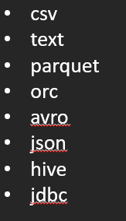
Part 3
DataFrame Extraction

Slide 367
Repartition & Coalesce

Slide 368
What is Partition ?
Datasets are huge is size and so they cannot fit into a single node and so they have to be partitioned across different nodes.
Partition in spark is basically an atomic chuck of data stored on a node in the cluster. They are the basic units of parallelism.
One partition can not span over multiple machines.
Spark automatically partitions RDDs/DataFrames and distributes the partitions across different nodes.
We can also configure the optimal number of partitions. Having too few or many partitions is not good.
How Spark does the default Partitioning of Data ?
Spark checks the HDFS Block size. The HDFS Block size for Hadoop 1.0 is 64mb and Hadoop 2.0/YARN is 128MB. It creates one partition for each block size.
Ex- We have a file of 500MB, so 4 partitions would be created.
At times programmers are required to change the number of partitions based on the requirements of the application job. The change can be to increase the number of partitions or decrease the number of partitions.
So we would either apply the repartition or coalesce.

Slide 369
File: test_data.csv
Size:2.6GB
Record Count :128m
HDFS
Size ~1MB
Record Count :64k
Apply a Filter T
Partitions: 21
Partitions: 21

Slide 370
### Create some Dump data for testing
df = spark.range(1000000)
df = df.select(df.id,df.id*2,df.id*3)
df = df.union(df)
df = df.union(df)
df = df.union(df)
df = df.union(df)
df = df.union(df)
df = df.union(df)
df = df.union(df)
### Save the file at a HDFS Path
df.write.save(‘/user/test/test_data.csv’,format=‘csv’)
### Testing
df_new = spark.read.load('/user/test/test_data.csv',format='csv',schema=('col1 int, col2 int, col3 int'))
df_new.rdd.getNumPartitions()
--- Apply Fillter
df_filter = df_new.where(df_new.col1 < 501)
df_filter.rdd.getNumPartitions()

Slide 371
Repartition
Repartition(numPartitions, *cols):
DataFrame is hash partitioned.
Create almost equal sized partitions.
Can increase or decrease the level of parallelism.
Internally, this uses a shuffle to redistribute data from all partitions leading to very expensive operation. So avoid if not required.
Spark performs better with equal sized partitions. If you need further processing of huge data, it is preferred to have a equal sized partitions and so we should consider using repartition.
If you are decreasing the number of partitions, consider using coalesce, where the movement of data across the partitions is lower.
Ex-df_new.rdd.glom().map(len).collect()
df_filter.rdd.glom().map(len).collect()
df_filter = df_filter.repartition(5)
df_filter.rdd.glom().map(len).collect()
Ex-
data=(('Ram',30),('Raj',25),('James',30),('Joann',25),('Kyle',25),('Robert',30),('Reid',35),('Sam',35))
df = spark.createDataFrame(data=data,schema=('name','age'))
df = df.repartition('age')
df.rdd.getNumPartitions()
spark.conf.get("spark.sql.shuffle.partitions")
df = df.repartition(4,'age')
df.rdd.getNumPartitions()

Slide 372
Repartition
repartition(2)
Shuffle in Repartition
P 1
P 6
P 2
P 3
P 7
P 4
P 5

Slide 373
coalesce
coalesce(numPartitions):
Return a new dataframe that is reduced into numPartitions partitions.
Optimized version of repartition().
No shuffling.
Results in a narrow dependency, e.g. if you go from 1000 partitions to 100 partitions, there will not be a shuffle, instead each of the 100 new partitions will claim 10 of the current partitions.
If a larger number of partitions is requested, it will stay at the current number of partitions.
df_filter.rdd.glom().map(len).collect()
df_filter = df.coalesce(5)
df_filter.rdd.glom().map(len).collect()

Slide 374
coalesce
coalesce(2)
No Shuffle in coalesce
P 1
P 1 (= P1 + P2)
P 2
P 3
P 3 (= P3 + P4)
P 4

Slide 375
Repartition vs Coalesce
Repartition
Repartitions does a full shuffle.
Preferable used to increase number of partitions.
Repartition creates new partitions and does a full shuffle.
Repartition results in roughly equal sized partitions.
Coalesce may run faster than repartition, but unequal sized partitions are generally slower to work with than equal sized partitions. You'll usually need to repartition datasets after filtering a large data set. I've found repartition to be faster overall because Spark is built to work with equal sized partitions.
It's critical to repartition after running filtering queries. The number of partitions does not change after filtering, so if you don't repartition, you'll have way too many memory partitions. The more the filter reduces the dataset size, the bigger the problem.
Coalesce
Coalesce avoids full shuffle.
Preferable used to decrease number of partitions.
Coalesce uses existing partitions to minimize the amount of data that's shuffled.
Coalesce results in partitions with different size of data.
Coalesce may run faster than repartition, but unequal sized partitions are generally slower to work with than equal sized partitions. You'll usually need to repartition datasets after filtering a large data set. I've found repartition to be faster overall because Spark is built to work with equal sized partitions.
It's critical to repartition after running filtering queries. The number of partitions does not change after filtering, so if you don't repartition, you'll have way too many memory partitions. The more the filter reduces the dataset size, the bigger the problem.

Slide 376
DataFrame Extraction

Slide 377
### Prepare Data
ord = spark.read.load('practice/retail_db/orders',sep=',',format='csv',schema=('order_id int,order_date timestamp, order_customer_id int,order_status string'))

Slide 378
Extraction : csv File
csv can take a lot of parameters. For complete list, use help command.
Below are few important parameters.
csv Params:
path
mode : default ‘error’ or ‘errorIfExists’ : Throw exception.
‘append’ :Append contents to existing data.
‘overwrite’ : Overwrite existing data.
‘ignore’ : Ignore the operation if data exists.
compression (none, bzip2, gzip, lz4,snappy and deflate)
sep (default ‘ , ’)
header (True or False. default – False)
dateFormat (default – ‘yyyy-MM-dd’)
timestampFormat (Default – ‘yyyy-MM-dd'T'HH:mm:ss.SSSXXX’)
ignoreLeadingWhiteSpace (Dafault – True)
ignoreTrailingWhiteSpace (Default – True )
And more …
PS - Calculate number of orders in each status and save into 2 files.
ordCountByStatus = ord.groupBy("order_status").count()
ordCountByStatus.coalesce(2).write.save('practice/dump/retail_db/ordCountByStatus',format='csv',sep='#',mode='overwrite',header=True, compression=‘gzip’)

Slide 379
Extraction : text file
To save into a text file, make sure to append all columns into a single column with String type.
Do not support a header.
To create a text file from dataframe, it should have only 1 column. So it is preferred to use a rdd for creating text file.
ordRDD = ordDF.rdd
ordRDD.saveAsTextFile('retail_db/orders')
Text Params:
path
compression
linesep (default – ‘\n’)
PS: Convert the Order csv file to text file with fixed length of tab and create 10 output files.
from pyspark.sql.functions import concat_ws
ordText = ord.select(concat_ws('\t',ord.order_id,ord.order_date,ord.order_customer_id,ord.order_status).alias('col1'))
ordText.repartition(10).write.save('practice/dump/retail_db/orderText',format='text')

Slide 380
Extraction : parquet File
parquet Params:
path
mode (Same as csv)
partitionBy (Apply partition as per the column. One file per each partition.)
Compression (Default Compression - spark.sql.parquet.compression.codec)
PS: Convert the Order csv file to parquet file. Create one file for each order status category.
ord.write.save('practice/dump/retail_db/orderParquet',format='parquet',mode='overwrite',partitionBy="order_status")

Slide 381
Extraction : orc File
orc Params:
path
mode (Same as csv)
partitionBy (Apply partition as per the column. One file per each partition.)
Compression (Default Compression - spark.sql.orc.compression.codec)
PS: Convert the Order csv file to orc file. Create one file for each order status category.
ord.write.save('practice/dump/retail_db/orderOrc',format='orc', partitionBy="order_status")

Slide 382
Extraction : json File
json Params:
path
mode
compression (none, bzip2, gzip, lz4,snappy and deflate)
dateFormat (default – yyyy-MM-dd)
timestampFormat (default - yyyy-MM-dd'T'HH:mm:ss.SSSXXX)
lineSep (default – ‘\n’)
PS: Convert the Order csv file to json file. File should be bzip2 compressed and total 1 output file.
ord.coalesce(1).write.save('practice/dump/retail_db/orderJson',format='json', compression='bzip2')

Slide 383
Extraction : avro File
Avro Is a third party file format. We need to import its package or jar file while launching pyspark or spark-submit. Spark by default does not support it.
pyspark2 --packages org.apache.spark:spark-avro_2.11:2.4.4
PS: Convert the Order csv file to avro file.
ord.write.save('practice/dump/retail_db/orderAvro',format='avro')

Slide 384
Extraction: hive Table
insertInto(tableName, overwrite=False):
Insert data to a Hive Table.
By default it will append the data. With overwrite=True, it will overwrite the existing data.
Table should be available, otherwise throws exception.
Ex-
ord.write.insertInto('db2.orders')

Slide 385
DataFrame: hive Table
saveAsTable(name, format=None, mode=None, partitionBy=None, **options)
format – File Format
If we do not pass any file format or compression, by default it is snappy compressed and parquet format.
mode - append, overwrite, error, ignore
Table should not exist if we do not pass a mode.
partitionBy - Create a partition on the partition column. Number of files created for the hive table is equal to the number of distinct values in that column.
compression: By default it is snappy compressed.
Pass compression=‘none’ to avoid compression.
Ex-
ord.write.saveAsTable(name='db2_orders.order_test', format='orc')
Ex-
ord.write.saveAsTable(name='db2_orders.order_test', format='orc', mode='overwrite')
Ex-
ord.write.saveAsTable('db2_orders.orders1',partitionBy='order_status',format='orc',mode='overwrite',compression='none')

Slide 386
Extraction : jdbc
Make sure JDBC jar file is registered using –packages or –jars while launching pyspark or spark-submit
Typical jdbc files are located at /usr/share/java folder. You may keep it there or copy it to your project lib folder.
pyspark2 --jars <jdbc driver jar file>
Complete list of properties:
https://spark.apache.org/docs/latest/sql-data-sources-jdbc.html
mode: append, overwrite,ignore, error or errorifexists (default case)
Ex-1 ( Write into a Table. Table should not exist.)
df.write.format("jdbc") \
.option("url", url) \
.option("driver", "oracle.jdbc.driver.OracleDriver") \
.option("dbtable","new_orders" ) \
.option("user", someUser) \
.option("password", somePassword) \
.save()
If Table exist, use mode.
df.write.format("jdbc") \
.option("url", url) \
.option("driver", "oracle.jdbc.driver.OracleDriver") \
.option("dbtable","new_orders" ) \
.option("user", someUser) \
.option("password", somePassword) \
.mode("overwrite") \
.save()

Slide 387
Extraction : jdbc
createTableColumnTypes : Apply column datatypes instead of defaults.
Ex -2 (Using createTableColumnTypes )
ord.select('order_id').write.format("jdbc") \
.option("url", url) \
.option("driver", "oracle.jdbc.driver.OracleDriver") \
.option("createTableColumnTypes","order_id char(10)" ) \
.option("dbtable","new_orders" ) \
.option("user", someUser) \
.option("password", somePassword) \
.mode("overwrite") \
.save()

Slide 388
Extraction : jdbc
batchsize: The JDBC batch size, which determines how many rows to insert per round trip. This can help performance on JDBC drivers. This option applies only to writing. It defaults to 1000.
fetchsize: reading.
ord.select('order_id').write.format("jdbc") \
.option("url", url) \
.option("driver", "oracle.jdbc.driver.OracleDriver") \
.option("createTableColumnTypes","order_id char(10)" ) \
.option("dbtable","new_orders" ) \
.option("user", someUser) \
.option("password", somePassword) \
.option("batchsize",5000) \
.mode("overwrite") \
.save()

Slide 389
Extraction : jdbc
queryTimeout: The number of seconds the driver will wait for a Statement object to execute to the given number of seconds. Zero is default and means there is no limit.
ord.select('order_id').write.format("jdbc") \
.option("url", url) \
.option("driver", "oracle.jdbc.driver.OracleDriver") \
.option("createTableColumnTypes","order_id char(10)" ) \
.option("dbtable","new_orders" ) \
.option("user", someUser) \
.option("password", somePassword) \
.option("queryTimeout",1) \
.mode("overwrite") \
.save()

Slide 390
Performance & Optimization

Slide 391
Caching Data in Memory
Configuration Options
Join Strategy Hints for SQL Queries
Coalesce Hint for SQL Queries
Adaptive Query Execution

Slide 392
Join Strategies

Slide 393
Join Strategies
Spark has below important join strategies.
Broadcast Join (Hint – BROADCAST)
Shuffle Hash Join (Hint - SHUFFLE_HASH)
Sort Merge Join (Hint - SORT MERGE)
Cartesian Product Join (Hint- BROADCAST)
Broadcast Nested Loop Join(Hint – SHUFFLE_REPLICATE_NL)

Slide 394
Broadcast Join

Slide 395
Divided into two Steps:
1. Broadcast the smallest dataset to all executors.
2. Perform a hash join

Slide 396
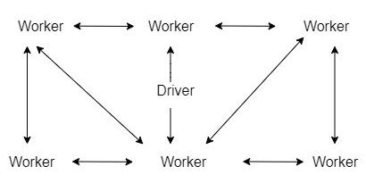
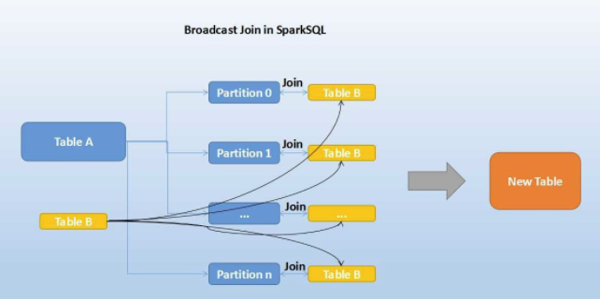
Broadcast Join in Spark
Hash join
1
Partition 1
Table B
BitTorrent Protocol/
peer to peer protocol.
Table A
Hash join
1
Partition 2
Table B
New Table
Hash join
1
Partition 2
Table B
Table B
…
Hash join
Partition n
1
Table B

Slide 397
Broadcast Join in Spark
2
Hash join
1
Partition 1
Table B
BitTorrent Protocol/
peer to peer protocol.
Table A
2
Hash join
1
Partition 2
Table B
New Table
2
Hash join
1
Partition 2
Table B
Table B
…
2
Hash join
Partition n
1
Table B

Slide 398
Hash Join: Only supported for “=“ join.
Create hash table based on the join key of smaller dataset.
Loop over large dataset and match the hashed join key with the hash table created above.

Slide 399
Broadcast Join:
One of the most impactful performance Impact optimization techniques we can use.
It performs a join on two datasets by first broadcasting the smaller one to all Spark executors using
BitTorrent peer to peer protocol.
In this way, each executor has all the information required to perform the join at its location, with out needing
redistributing data and shuffle.
Broadcast join can be very efficient for joins between a large table (fact) with relatively small tables (dimensions)
that could then be used to perform a star-schema join.
Size of the smaller table should be lesser than: spark.sql.autoBroadcastJoinThreshold. Configurable.
Default Size: 10MB
int(spark.conf.get("spark.sql.autoBroadcastJoinThreshold"))/1024/1024
Recently Spark has increased the maximum size for the broadcast table from 2GB to 8GB. Thus, it is not possible to
broadcast tables which are greater than 8GB.
Also called map-side join or replicated join.
Use Hint BROADCAST to force Spark Optimizer.

Slide 400
Auto Detection:
In many cases, Spark can automatically detect whether to use a broadcast join or not, depending on the size of the data. If Spark can detect that one of the joined DataFrames is small (10 MB by default), Spark will automatically broadcast it for us.
Spark will perform auto-detection when
Constructs a DataFrame from scratch, e.g. spark.range.
It reads from files with schema and/or size information, e.g. Parquet, Avro
Ex – Lets join orders and orderItems files.
ordDF = spark.read.load('practice/retail_db/orders',sep=',',format='csv',schema=('order_id int,order_date timestamp, \
order_customer_id int,order_status string'))
ordItemsDF=spark.read.load('practice/retail_db/order_items',sep=',',format='csv',schema=('order_item_id int,\
order_item_order_id int,order_item_product_id int,quantity tinyint,subtotal float,price float'))
joined= ordDF.join(ordItemsDF,ordDF.order_id == ordItemsDF.order_item_order_id)
Joined.explain()

Slide 401
Sometimes Not:
But not always, Spark can do auto detection. For Ex- Local Collection.
The reason is that Spark will not determine the size of a local collection because it might be big.
In this case, we can force optimizer to use BROADCAST Hint.
Ex –
largeDF = spark.range(1,1000000000)
data = [(1, 'a'),(2, 'b'),(3, 'c')]
schema= ['id', 'col2']
smallDF=spark.createDataFrame(data,schema)
joined = largeDF.join(smallDF, "id")
joined.explain()
Ex- Use hint.
from pyspark.sql.functions import broadcast
joined = smallDF.hint('broadcast').join(broadcast(largeDF), "id")
joined.explain()

Slide 402
Testing:
If you want to test the joins with out presence of automatic optimization, set spark.sql.autoBroadcastJoinThreshold to -1.
This will disable the automatic broadcast join detection.
spark.conf.set("spark.sql.autoBroadcastJoinThreshold", -1)

Slide 403
Notes:
Table needs to be broadcast less than spark.sql.autoBroadcastJoinThreshold the configured value, default 10M (or add a broadcast join the hint).
Only supported for ‘=’ join.
Supported for all join types (inner, left, right) except full outer join.
Faster than any other join strategies.

Slide 404
Shuffle Hash Join

Slide 405
Shuffle Hash Join is divided into two steps:
Step#1 : (Shuffle Phase):
Both datasets are read and shuffled.
So the same keys from both sides end up in the same partition or task.
P 1
P 1
10
10
30
30
10
20
30
40
Shuffle
P 1
P 1
10
Shuffle
10
15
4
;00000
DataFrame B
DataFrame A
P 2
P 2
P 2
P 2
30
40
10
20
20
20
40
40
15
35
40
40
35
Shuffle
Shuffle

Slide 406


Step#2 : (Hash Join Phase):
After Shuffle phase, spark picks one side based on statistics(generally the smaller dataset) and it
will be hashed into buckets.
Then hash join is performed.
Hash Join
P 1
P 1
10
10
30
30
P 1
10
20
30
40
10 Bucket 1
10 10
30
30
Shuffle
P 1
P 1
10
Shuffle
10
15
4
;00000
DataFrame B
DataFrame A
P 2
P 2
P 2
P 2
P 2
30
40
10
20
20
20
40
40
Bucket 1
20 15
20 35
40 Bucket 2
40 40
15
35
40
40
35
Shuffle
Shuffle

Slide 407
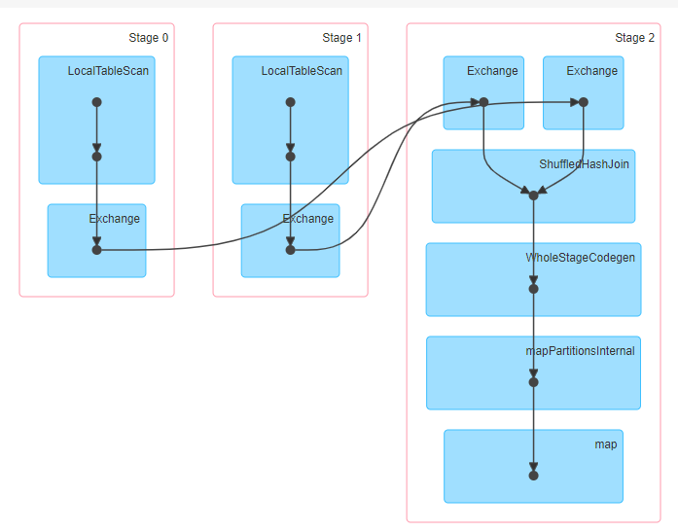
DAG Visualization:

Slide 408
When does shuffle hash join work:
Only for equi joins (‘=‘).
Works well when a dataset can not be broadcasted but one side of the partitioned data after shuffling will be small
enough for hash join.
When does shuffle hash join not work:
Non-equi Joins (<,>,<=,>= etc)
Does not work with data which are heavily skewed.

Slide 409
Note:
The join keys don’t need to be sortable.
Supported for all join types except full outer joins.
Expensive join as both shuffle and hashing are involved. Spark prefers Sort merge join than Shuffle Hash Join.
By default spark.sql.join.preferSortMergeJoin is True, but configurable.
Hint: SHUFFLE_HASH

Slide 410
spark.conf.set("spark.sql.join.preferSortMergeJoin", "false")
spark.conf.set("spark.sql.autoBroadcastJoinThreshold", 2)
Ex –
df1 = spark.range(1,10000000000)
df2 = spark.range(1,10000000)
spark.conf.set("spark.sql.join.preferSortMergeJoin", False)
joined = df1.join(df2,"id")
joined.explain()
joined = df1.hint('shuffle_hash').join(df2,”id”)

Slide 411
Shuffle Sort Merge Join

Slide 412
Shuffle Sort Merge Join:
From spark 2.3 Merge-Sort join is the default join algorithm in spark. However, this can be turned down by using
the internal parameter ‘spark.sql.join.preferSortMergeJoin’ which by default is true.
Divided into two steps:
The first step is to shuffle and sort the join keys of both the datasets.
Apply the merge algorithm.
Hint: merge

Slide 413
Merge
Partition 1
P 1
P 1
P 1
P 1
Partition 1
Merge
Partition 2
P 2
P 2
P 2
P 2
Shuffle
Partition 2
Shuffle
Sort
Sort
Table A
Merge
Table B
Partition 3
P 3
P 3
P 3
P 3
Partition 3
Merge
Partition 4
P 4
P 4
P 4
P 4
Partition 4
New Table

Slide 414
User Table
Product Table
Id | Name
2 | Json
1 | Kyle
4 | Reid
3 | Robert
Product Id | User Id
101 | 2
102 | 4
103 | 4
104 | 1
Sorting on Joining Key
Id | Name
1 | Kyle
2 | Json
3 | Robert
4 | Reid
Product Id | User Id
104 | 1
101 | 2
102 | 4
103 | 4
Merge

Slide 415
Notes:
Only supported for ‘=‘ join.
The join keys need to be sortable.
Supported for all join types (inner, left, right etc).

Slide 416
Ex –
df1 = spark.range(1,10000000000)
df2 = spark.range(1,10000000)
joined = df1.join(df2,"id")
joined.explain()
joined = df1.hint(‘merge').join(df2,”id”)

Slide 417
Cartesian Product Join

Slide 418
Cartesian Product Join:
Steps:
Both datasets are read.
All partitions from one of the dataset are sent to all partitions in the other dataset. So shuffle.
Once partitions from both dataset are available on one side, a nested loop join is performed.
If there are M records in first dataset and N records in the second dataset, nested loop is performed on M *N records.
Very expensive and high possibility of OOM errors. Lots of shuffle.
Supports both “=“ and non-equi joins (<=, <, >=,>)
Supports all join types.
Hint : shuffle_replicate_nl
P1
P1
for rec in table1:
for rec in table2:
on table1.join_key = table2.join_key
P2
P2
Dataset 1
Dataset 2

Slide 419
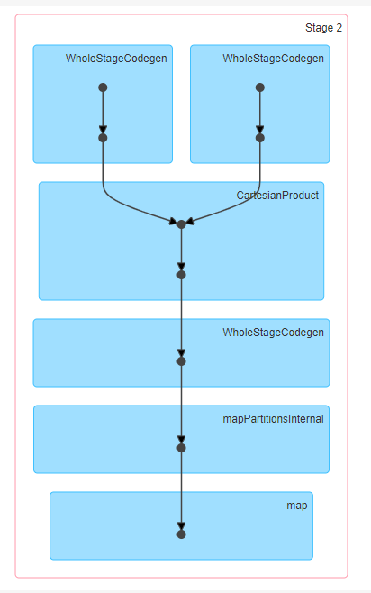
DAG Visualization: The join is executed all in 1 stage.

Slide 420
Broadcast Nested Loop Join

Slide 421
Broadcast Nested Loop Join:
2 Steps:
Broadcast: Smallest dataset is broadcasted to all executors processing the bigger dataset.
Nested Loop Join Phase: Every Record from one dataset is attempted to join with every record from another dataset in a nested loop.
Since this join is used for non-equi conditions, the iteration can not stop as soon as a match is encountered like in Sort Merge Join. The iteration will go through the entire dataset.
No sort in this join.
Very slow, but no Shuffle. Preferred than Cartesian Product Join.
This join will not work when either sides are big enough for broadcasting and you could see Out Of Memory exceptions.
Supports both “=“ and non-equi joins (<=, <, >=,>)
Supports all join types.
for rec in table1:
for rec in table2:
on table1.join_key = table2.join_key

Slide 422
spark.conf.set("spark.sql.crossJoin.enabled",True)
df1 = spark.range(1,1000)
df2 = spark.range(1,100)
joined = df1.join(df2)
joined.explain()

Slide 423
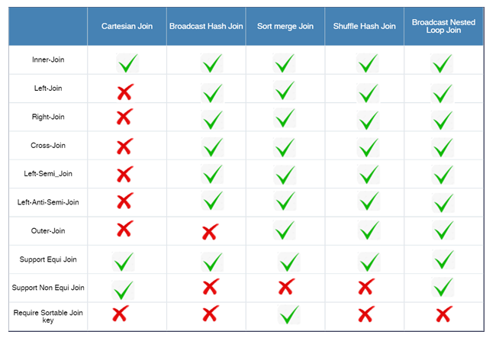

Slide 424
How Spark Prioritize Join Strategies:
When More than one hint is specified and hints are applicable:
If its an ‘=‘ join:
Broadcast hint : Pick broadcast hash join
Merge hint : Pick sort-merge join
Shuffle_Hash hint : Pick shuffle hash join
Shuffle_replicate_nl hint : Pick Cartesian Product join.
If its not ‘=‘ join:
Broadcast hint: Pick broadcast nested loop join.
Shuffle_replicate_nl : Pick Cartesian product if join type is inner like.
When no hints are specified or hints are not applicable
If its an ‘=‘ join:
Pick broadcast hash join if one side is small enough to broadcast, and the join type is supported.
Pick shuffle hash join if one side is small enough to build the local hash map, and is much smaller than the other side, and spark.sql.join.preferSortMergeJoin is false.
Pick sort-merge join if join keys are sortable.
Pick Cartesian product if join type is inner .
Pick broadcast nested loop join as the final solution. It may OOM but there is no other choice.
If its not ‘=‘ join:
Pick broadcast nested loop join if one side is small enough to broadcast.
Pick cartesian product if join type is inner like.
Pick broadcast nested loop join as the final solution. It may OOM but we don’t have any other choice.

Slide 425
>>> spark.conf.set("spark.sql.crossJoin.enabled",True)
>>> df1 = spark.range(1,1000)
>>> df2 = spark.range(1,100)
>>> joined = df1.join(df2)
>>> joined.explain()
== Physical Plan ==
BroadcastNestedLoopJoin BuildRight, Inner
:- *(1) Range (1, 1000, step=1, splits=2)
+- BroadcastExchange IdentityBroadcastMode
+- *(2) Range (1, 100, step=1, splits=2)

Slide 426
Driver Configurations

Slide 427
Driver Options:
When we apply collect(), take() operations on datasets, it requires the data to be moved to Driver. If we do so on huge dataset, it can crash the driver process with Out Of Memory errors(OOM).
If you observe, we perform most of the computational work of a Spark Job in the Executors and so we rarely required to do any performance tuning for the driver.
However sometimes, the job may fail if they collect too much data to the driver.
Setting a proper limit can protect the driver from out of memory errors.
Spark-submit Options:
--driver-memory : Memory for driver (e.g. 1000M, 2G) (Default: 1024M)
Driver Memory is the amount of memory to use for driver process, i.e. the process running the main() function of the application
and where SparkContext is instantiated.
--driver-cores :
Number of cores used by the driver, only in cluster mode (Default: 1).
Generally not required unless you want to perform some local computations in parallel.

Slide 428
Configuration Properties:
spark.driver.memory : Default 1024
spark.driver.cores : Default 1
spark.driver.maxResultSize:
Limit of each Spark action (e.g. collect) in bytes.
Should be at least 1M, or 0 for unlimited. Jobs will be aborted if the total size is above this limit.
Having a high limit may cause out-of-memory errors in driver (depends on spark.driver.memory and memory overhead of objects in JVM).
Setting a proper limit can protect the driver from out-of-memory errors.
spark.driver.memoryOverhead: Default driverMemory * 0.10, with minimum of 384
Amount of overhead (non-heap) memory to be allocated per driver process in cluster mode, in MiB unless otherwise specified.
This is memory that accounts for things like VM overheads, interned strings, other native overheads, etc.
This tends to grow with the container size (typically 6-10%).
All Properties:
https://spark.apache.org/docs/latest/configuration.html

Slide 429
Driver in Cluster deploy mode:
Driver in Client deploy mode:
Driver JVM
Client JVM
JVM Heap
JVM Heap
Client JVM
Overhead
Overhead
Off- Heap
Off- Heap
Spark Context
Driver
Spark Application
Spark Context
Spark Application

Slide 430
Executors Configurations

Slide 431
Data Node
Executor 1
Cache
Executor 2
Cache
JVM Heap
JVM Heap
Task
Task
Core 2
Core 1
Task
Task
Core 6
Core 5
Task
Core 3
Core 4
Task
Task
Core 7
Core 8
Task
Executors and Cores:
Executors are created in worker/data nodes and they are in charge of running tasks in a given spark job.
Each executor comprises a JVM. They are launched at the beginning of a spark application and run the entire lifetime of the spark job.
After they run the assigned task, they send the results to the driver.
They also provide in-memory storage for RDDs that are cached by user programs.
Each worker node can have one or multiple cores.
To run the tasks in parallel, we can launch executors with multiple cores.

Slide 432
Below three options play a very important role in spark performance as they control the amount of CPU & memory of our spark application.
Lets understand how to configure them.
--executor-memory: Memory per executor (e.g. 1000M, 2G) (Default: 1G).
--num-executors: Number of executors to launch (Default: 2).
--executor-cores: Number of cores per executor. (Default: 1 in YARN mode).
Below conf application properties are related to Executors.
spark.executor.memory : Default (1G)
spark.executor.cores: Default 2.
Spark.executor.memoryOverhead : 10% or 384MB (Whichever is higher)
The amount of off-heap memory to be allocated per executor, in MiB unless otherwise specified.
This is memory that accounts for things like VM overheads, interned strings, other native overheads, etc.
This tends to grow with the executor size (typically 6-10%).
When we plan the performance tuning we need to consider this as well.
spark.executor.heartbeatInterval: Default 10s
Interval between each executor's heartbeats to the driver. Heartbeats let the driver know that the executor is still alive.
List of all Configuration properties:
https://spark.apache.org/docs/2.4.0/configuration.html

Slide 433
Spark Runtime Components in Cluster deploy mode:
Cluster
Executor JVM
Driver JVM
JVM Heap
Task Slots
T
T
T
T
T
JVM Heap
Unoccupied Task Slots
T
Client JVM
T
Spark Context
Spark Application
Executor JVM
JVM Heap
T
T
T
T

Slide 434
Spark Runtime Components in Client deploy mode:
Executor JVM
Executor JVM
JVM Heap
Client JVM
JVM Heap
JVM Heap
T
T
T
T
T
T
T
T
T
T
T
Driver
Executor JVM
Spark Context
Executor JVM
Spark Application
JVM Heap
JVM Heap
T
T
T
T
T
T
T
T

Slide 435
Node Manager
YARN Container
Executor JVM
JVM Heap
Daemon Processes
Others (Non-spark)
T
T
T
T
Overhead (10% or 384 MB)
Off-Heap (Disabled by Default)

Slide 436
Lets Assume :-
Cluster Configuration:
10 Nodes
16 cores per each Node.
64GB RAM per Node

Slide 437
Cluster Configuration:
10 Nodes
16 cores per each Node.
64GB RAM per Node
Spark Job was run with one core per executor.
Total number of cores in cluster = 16 * 10 = 160
So number of executors = 160
Number of executors per Node = 160/10 = 16
Memory per Executor = 64/16 = 4GB
Problems:
With only one executor per core, we will not be able to take advantage of running multiple tasks in the same JVM.
There is ~10% overhead for each JVM. Due to 160 executors 160 JVM processes would be created and so lot of unnecessary overheads.
Shared variables (Broadcast, Accumulator) will be copied 160 times.
Not leaving enough memory for YARN Daemon processes and Application Manager.
Not enough memory for executors.
NOT GOOD
Executor 1
Memory: 4GB
Cache
Executor 2
Memory: 4GB
Cache
Task
Task
Core 1
Core 1
……………………..
……………………..
……………………...
Executor 159
Memory: 4GB
Cache
Executor 160
Memory: 4GB
Cache
Task
Core 1
Task
Core 1

Slide 438
Cluster Configuration:
10 Nodes
16 cores per each Node.
64GB RAM per Node
Spark Job was run with 5core per executor.(--executors-cores = 5)
Let’s Leave 1 core for YARN Daemons.
So total available cores per node for processing job = 16-1=15
So total number of cores in cluster = 15 * 10 = 150
So Number of available Executors = 150/5 = 30
Let’s leave 1 executor for Yarn Application Master.
So total number of available executors = 30 -1 = 29
Number of Executors per each Node = 30/10 =3
Memory per Executor: 64 GB/3 = 21.3 GB
Heap overhead around 10% (2.13GB)
So actual Memory per executor = 19.7GB
With this approach, we have achieved the parallelism and best throughputs.
GOOD
BALANCED
RECOMMENDED
Approach …
Executor 1
Memory: 32GB
Executor 2
Memory: 32GB
Cache
Cache
Task
Task
Core 1
Task
Task
Core 1
Task
Task
Core 2
Core 3
Core 2
Core 3
Task
Task
Task
Task
Core 4
Core 5
Core 4
Core 5
……………………..
……………………..
……………………...
Executor 29
Memory: 32GB
Cache
Executor 30
Memory: 32GB
Cache
Task
Core 1
Task
Task
Task
Core 2
Core 3
Core 1
Task
Task
Core 2
Core 3
Task
Task
Task
Task
Core 4
Core 5
Core 4
Core 5

Slide 439
Let’s see how we can pass these options in spark-submit:
spark2-submit \
--master <master-url> \
--deploy-mode <deploy-mode> \
--conf <key<=<value> \
--driver-memory 2G\
--executor-memory 64G \
--executor-cores 5 \
--num-executors 10\
--jars <comma separated dependencies> \
--packages <package name> \
--py-files \
<application> <application args>

Slide 440
Parallelism Configurations

Slide 441
As the shuffle operations re-partitions the data, we can use below two configurations to control the number of partitions shuffle creates.
spark.default.parallelism
spark.sql.shuffle.partitions
spark.default.parallelism :
Only applicable to RDD.
Default value set to the number of all cores on all nodes in a cluster.
RDD wider transformations like reduceByKey(), groupByKey(), join() triggers the data shuffling. Prior to using these operations, use the below code to set the desired partitions for shuffle operations. Change the value accordingly.
spark.conf.set("spark.default.parallelism",150)
spark.conf.get("spark.default.parallelism")
Ex –
pyspark2 --master yarn --conf spark.default.parallelism=150
rdd = sc.parallelize(range(1000))
rdd.getNumPartitions()
150

Slide 442
spark.sql.shuffle.partitions:
Only applicable to DataFrames.
Default to 200.
For DataFrame, wider transformations like groupBy(), join() triggers the data shuffling hence the result of these transformations results in partition size same as the value set in spark.sql.shuffle.partitions.
spark.conf.get("spark.sql.shuffle.partitions")
Ex –
data=(('Ram',1),('Raj',2),('Ram',1),('Joann',4),('Raj',2),('Robert',5),('Reid',6),('Sam',7))
df = spark.createDataFrame(data=data,schema=('name','id'))
df.rdd.getNumPartitions()
2
df1 = df.groupBy("name").count()
df1.rdd.getNumPartitions()
200

Slide 443
Memory Management

Slide 444
YARN Cluster Manager
Node Manager
Container
Driver
Resource
Manager
Application
Master
Node Manager
Node Manager
Container
Container
Executor
Executor
Task
Task
Task
Task

Slide 445
YARN as Spark Cluster Manager:
Yet Another Resource Negotiator for Hadoop 2.x.
Cluster Management – Used for resource allocation and Scheduling.
It has 3 major components –
Resource Manager
Node Manager
Application Master
Flow:
Client submit the Spark application. Driver instantiates SparkContext.
Driver talks to the cluster manager(YARN) and negotiates resources.
The YARN resource manager search for a Node Manger which will, in turn, launch an ApplicationMaster for the specific job in a container.
The ApplicationMaster registers itself with the resource Manager.
The ApplicationMaster negotiates containers for executors from the ResourceManager. Can request for more resources from RM.
The ApplicationMaster notifies the Node Managers to launch the containers and executors. Executor then executes the tasks.
Driver communicates with executors to coordinate the processing of tasks of an application.
Once the tasks are complete, ApplicationMaster un-registers with the Resource Manager.

Slide 446
Node Manager
YARN Container
Heap
YARN Container
Spark Memory = 70 %
Heap (Executor)
Daemon Processes
Overhead
User Memory = 23 %
Others (Non-spark)
Off-heap
Reserved Memory = 7 %
70%,23% and 7% are when we allocate 4GB to Executor(Heap) and use the default Options.

Slide 447
yarn-site.xml
Spark 1.6
Node Manager(YARN)
Executor Container(YARN)
Heap
Spark.executor.memory
No Hard Boundary
Execution Memory
Usable Memory *
spark.memory.fraction *
(1 – spark.memory.storageFraction)
Storage Memory
Usable Memory *
spark.memory.fraction *
spark.memory.storageFraction
Usable Memory
Executor Memory
Daemon Processes
User Memory (Usable Memory * (1 - spark.memory.fraction))
Reserved Memory (reserved_system_memory_bytes = 300MB)
Others (Non-spark)
Overhead
spark.executor.memoryOverhead
10% or a minimum 384MB
Off-Heap
spark.memory.offHeap.size
It is disabled by default.

Slide 448
Off-heap Memory:
We had covered this in the RDD Persistence.
Off-Heap Memory is a segment of memory lies outside the JVM, but is used by JVM for certain use-cases. Off-Heap memory can be used by Spark explicitly as well to store serialized data-frames and RDDs.
Spark may use off-heap memory for data-intensive applications.
User can also persist data at Off-heap memory using persist method.
Off-heap storage is not managed by JVM’s GC mechanism and so must be explicitly handled by the application.
It is disabled by default.
spark.memory.offHeap.enabled (Default False)
spark.memory.offHeap.size → Can be set after enabling it.
Overhead Memory:
Default - 10% of executor memory with a minimum of 384MB.
Can be set by property:
spark.executor.memoryOverhead
It basically covers expenses like VM overheads, interned strings, other native overheads, etc.

Slide 449
Executor Container is a JVM process. It allocates memory to 3 sections – Heap Memory, Off-Heap Memory and Overhead memory.
Heap Memory:
All objects in heap memory are bound by GC.
3 Regions – Reserved Memory, User Memory and Spark Memory(Unified Execution/Storage Memory).
Reserved Memory: Reserved to store internal objects. Hardcoded to 300MB.
User Memory:
Stores all the user defined data structures, any UDFs created by the user etc.
Not managed by spark.
Formula - Usable Memory * (1 - spark.memory.fraction)
Ex – 3796 * (1 – 0.75) = 950 MB
Spark Memory: Managed By Spark.
Storage Memory:
Used for storing all the cached data, shared variables.
Any persist() operation with Memory storage level.
Spark deletes old data and insert new data using LRU mechanism.
Data might store in disk once removed from cache or recomputed if MEMORY_ONLY is set..
Formula - Usable Memory *spark.memory.fraction * spark.memory.storageFraction
Ex – 3796 * 0.75 * 0.50 = 1423 MB
Execution Memory:
Used by Spark for objects created during execution of a task.
When you perform an T and A, all the intermediate results are stored here.
Ex – it is used to store hash table for hash aggregation step.
Supports spilling on disk if not enough memory is available.
Formula - Usable Memory * spark.memory.fraction * (1 – spark.memory.storageFraction)
Ex – 3796 * 0.75 * (1-0.5) = 1423MB

Slide 450
Dynamic Occupancy Mechanism :
Execution Memory
Storage Memory
Disc
Important Notes for Execution Memory:
Execution can not be break.
Execution memory can borrow space from Storage memory if blocks are not used in Storage memory.
If blocks from Execution memory is used by Storage memory and Execution needs more memory, it can forcefully evict the excess blocks occupied by Storage Memory. Blocks from storage memory will be written to disk or recomputed (of persistence level is MEMOEY_ONLY).
Write into disk if still more memory is required.

Slide 451
Dynamic Occupancy Mechanism :
Execution Memory
Storage Memory
Disc

Slide 452
Dynamic Occupancy Mechanism :
Execution Memory
Storage Memory
Disc

Slide 453
Dynamic Occupancy Mechanism :
Storage Memory
Execution Memory
Disc
X
X
X
X
Important Notes for Storage Memory:
Storage memory can borrow space from execution memory only if blocks are not used in Execution memory.
Storage memory can not forcefully evict the excess blocks occupied by Execution Memory. It will wait till spark releases the excess blocks stored by Execution memory and then occupies them.

Slide 454
Dynamic Occupancy Mechanism :
Storage Memory
Execution Memory
Disc
X
X
X
X

Slide 455
Dynamic Occupancy Mechanism :
Storage Memory
Execution Memory
Disc
X
X
X
X

Slide 456
Ex - For understanding purpose.
Take 4GB Memory Allocation for executor and leave the default configurations.
Executor Memory(EM) = 4GB
Reserved Memory(RM) =300MB
Usable Memory = EM-RM= 4GB – 300 MB = 4096MB – 300MB = 3796 MB
spark.memory.fraction (Fraction of heap space used for execution and storage) = 0.75
Spark.memory.storageFraction(Amount of storage memory immune to eviction) = 0.50

Slide 457
Heap
Spark.executor.memory = 4GB = 4096 MB
Spark Memory
Execution Memory
Usable Memory *
spark.memory.fraction *
(1 – spark.memory.storageFraction)
=3796 * 0.75 * 0.5
= 1423.5 MB
Storage Memory
Usable Memory *
spark.memory.fraction *
spark.memory.storageFraction
=3796 * 0.75 * 0.5
= 1423.5 MB
Usable Memory
Executor Memory
User Memory
(Usable Memory * (1 - spark.memory.fraction)) = 3796 * (1-0.75)
=3796 * 0.25 = 949 MB
Reserved Memory
(reserved_system_memory_bytes = 300MB)
Overhead
spark.executor.memoryOverhead
10% or a minimum 384MB = 409.6 MB
Off-Heap
spark.memory.offHeap.size
It is disabled by default.

Slide 458
Executor
Heap
Spark Memory = 70 %
User Memory = 23 %
Reserved Memory = 7 %

